Slide 1
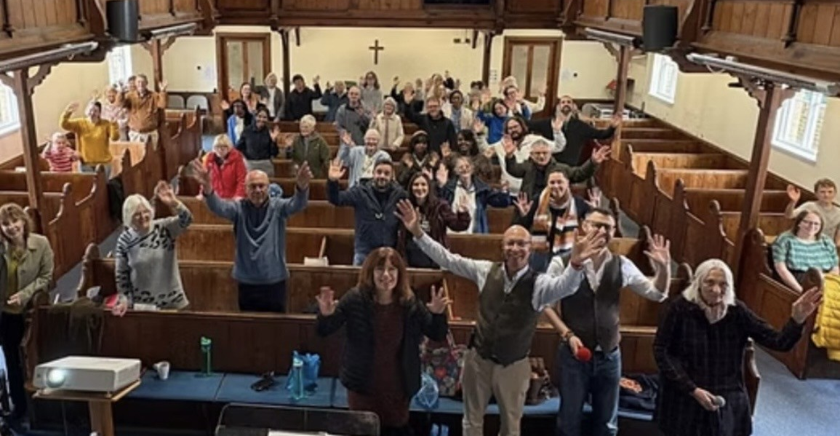
Harlow Baptist Church is a friendly, welcoming church, founded in 1662 , which is very active in its local community. The position of their historic Church building , with a modern church hall, is in the centre of old Harlow, making it ideally positioned to be the community’s local church.
On a Sunday, the main service is run as a team ministry with Rev Paul Walker, their minister since December, his wife and others preaching and leading worship. Additionally, the building is in constant use, not just on a Sunday with HBC’s own service, but in the evening with a growing Romanian church. Throughout the week there are many community events held within the building.
Harlow Baptist Church are grateful for this exciting phase of church life, with 5 baptisms at Pentecost and 4 more planned. They celebrate the crossover as people who attend community events at the church see advertising for and attend church events. They are currently looking forward to the revival of a well-attended remembrance service in early December, for those who have been bereaved; and beyond that to Advent and Christmas events, praying that they are as successful as the 100 kids-strong summer event hosted by HBC in conjunction with the other town churches.
Prayer Focus:
Harlow Baptist Church, Essex

Slide 2
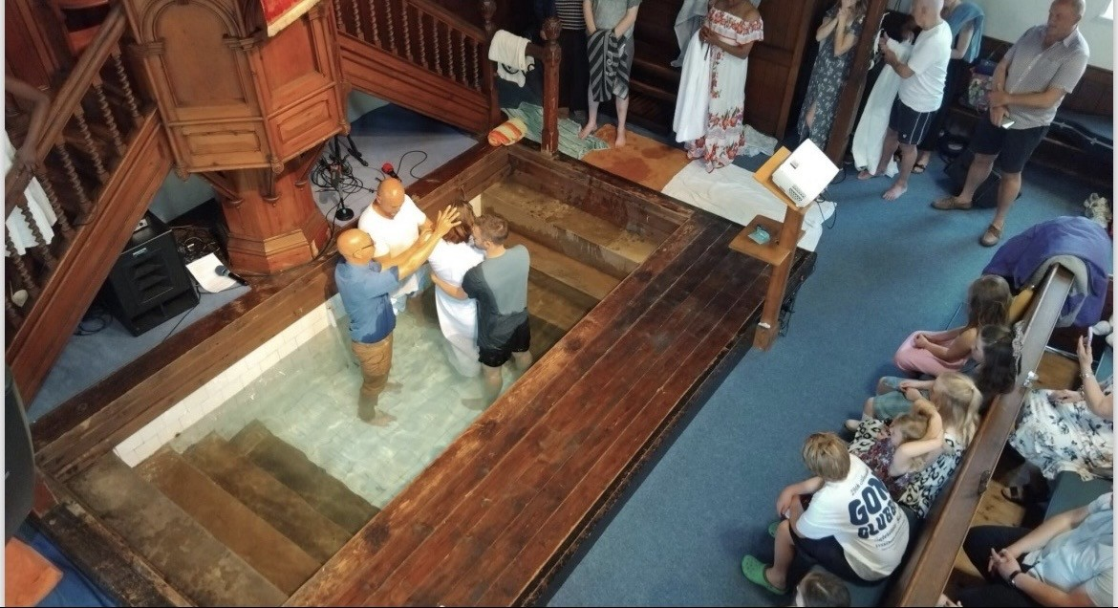
Prayer Focus:
Harlow Baptist Church
Please pray with them:
For the energy of the folks running these many activities
For wisdom and guidance in maintaining and developing the current youth and children’s works.
That the new people entering the church are fully integrated into church life.
For all those who have been, and are considering baptism.
For the upcoming remembrance service
For the planned future building works and ongoing maintenance of a historic building.
https://www.harlowbaptist.org

