Slide 1
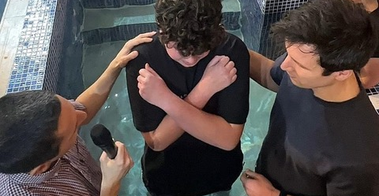
Belle Vue Baptist Church is one of the larger and older Baptist Churches in the City of Southend, Essex. Originally built in the village of Southchurch, it has remained a constant presence for nearly 125 years as all around it has changed. Today, surrounded by schools, the poorest estate in Southend is close by, while not very far away is the ‘well-to-do’ area of Thorpe Bay. This mixed demography is reflected in its 80 strong congregation, of different ages, that gather together as ‘a community of God’ on a Sunday morning. During the week, its Centre Café with Play Space on a Tuesday morning offers excellent cake and tea/coffee in a space for people of all ages to come and chat. The church hosts Renew Wellbeing on a Thursday afternoon and has a vibrant Boys Brigade that meets on Tuesday and Friday evenings. The church has celebrated seeing some of the teenagers from Boys Brigade join the congregation
Prayer Focus:
Belle Vue Baptist Church, Essex

Slide 2
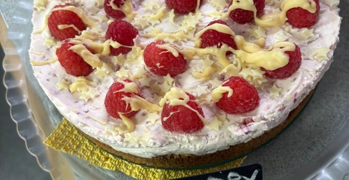
Prayer Focus:
Belle Vue Baptist Church
It has also experienced the joy of 7 baptisms, including some young people, in the last 14 months with more baptism classes planned for 2027. The church is a distribution centre and host for the central warehouse for Southend Foodbank. Andy Goodliff, has been the minister for 16 years. In recent times he has gone part-time (to lecture at Regent’s Park College, Oxford) enabling the church to take the positive step of appointing Jeanette Pool as its Family & Community Worker.
Please pray for:
Andy, Jeanette and the Deacons
The special events planned for next year to honour and celebrate the church’s 125th anniversary
The building projects planned as part of the church’s looking to the future
The baptisms, planned and hoped-for in the coming months

