Slide 1
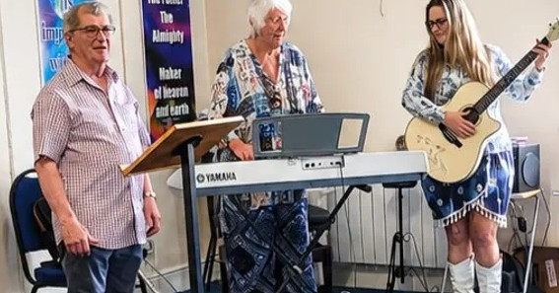
Maylands Baptist Church is a very small fellowship, meeting in St Barnabas Family Centre. A Bible-centred church, they focus on praise, pastoral care and prayer support. Worship is led by a range of visiting preachers and worship leaders from Christian charities and churches.
Originally a small waterfront village, Mayland is located on the Dengie peninsula in Essex. Once quite isolated, there’s been lots of new houses built and more are planned. The village is fairly affluent and the northern part, known as Maylandsea, has a small marina, two sailing clubs and views over the estuary.
Maylands Baptist Church was planted from Burnham Baptists about 40 years ago. The current congregation is elderly, with all the limitations that entails. Still recovering from a painful split a few years ago, they are concerned about their future and are praying for wisdom as to how they can continue to be a beacon of light in Mayland.
Prayer Focus:
Maylands Baptist Church, Essex

Slide 2
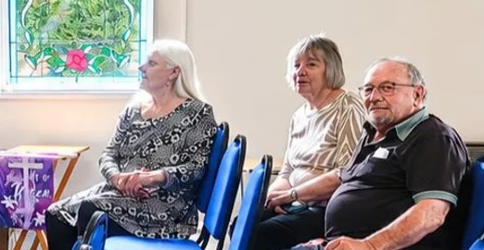
Prayer Focus:
Maylands Baptist Church
Prayer points
Please thank God
for being a constant inspiration, guide and hope to those at Maylands
for his faithfulness in providing speakers and preachers for services and the finances to pay expenses and rent the family centre
Please pray
for healing, renewing and strengthening, from hurts and for the future
that the Lord shows the church how they can best bless and serve the village of Mayland and glorify him

