Slide 1
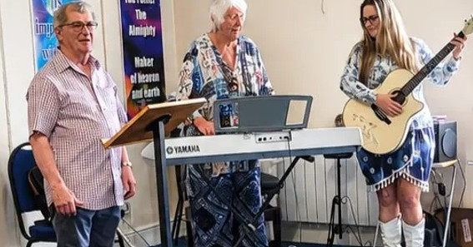
Text
Prayer Focus:
XXXX Baptist Church

Slide 2
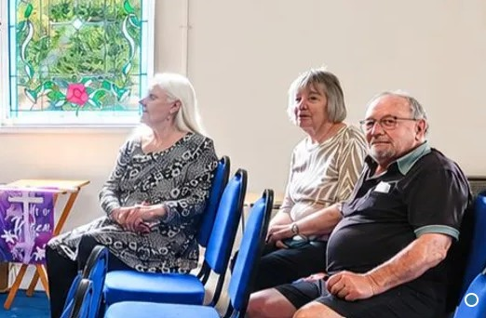
Prayer Points
Prayer Focus:
XXXX Baptist Church

