Slide 1


BMS World Mission partners with Baptist churches around the world, helping them strengthen and grow their mission so that more people can encounter the good news of Jesus. One example is our partnership with the Asia Pacific Baptist Federation (APBF), whose inspiring vision is to see every nation and people group across Asia and the Pacific reached with the gospel. Together, BMS and APBF equip Baptist churches and leaders, strengthen regional collaboration and support mission among communities where there is little or no Christian witness.
Prayer Focus:
BMS World Mission

Slide 2
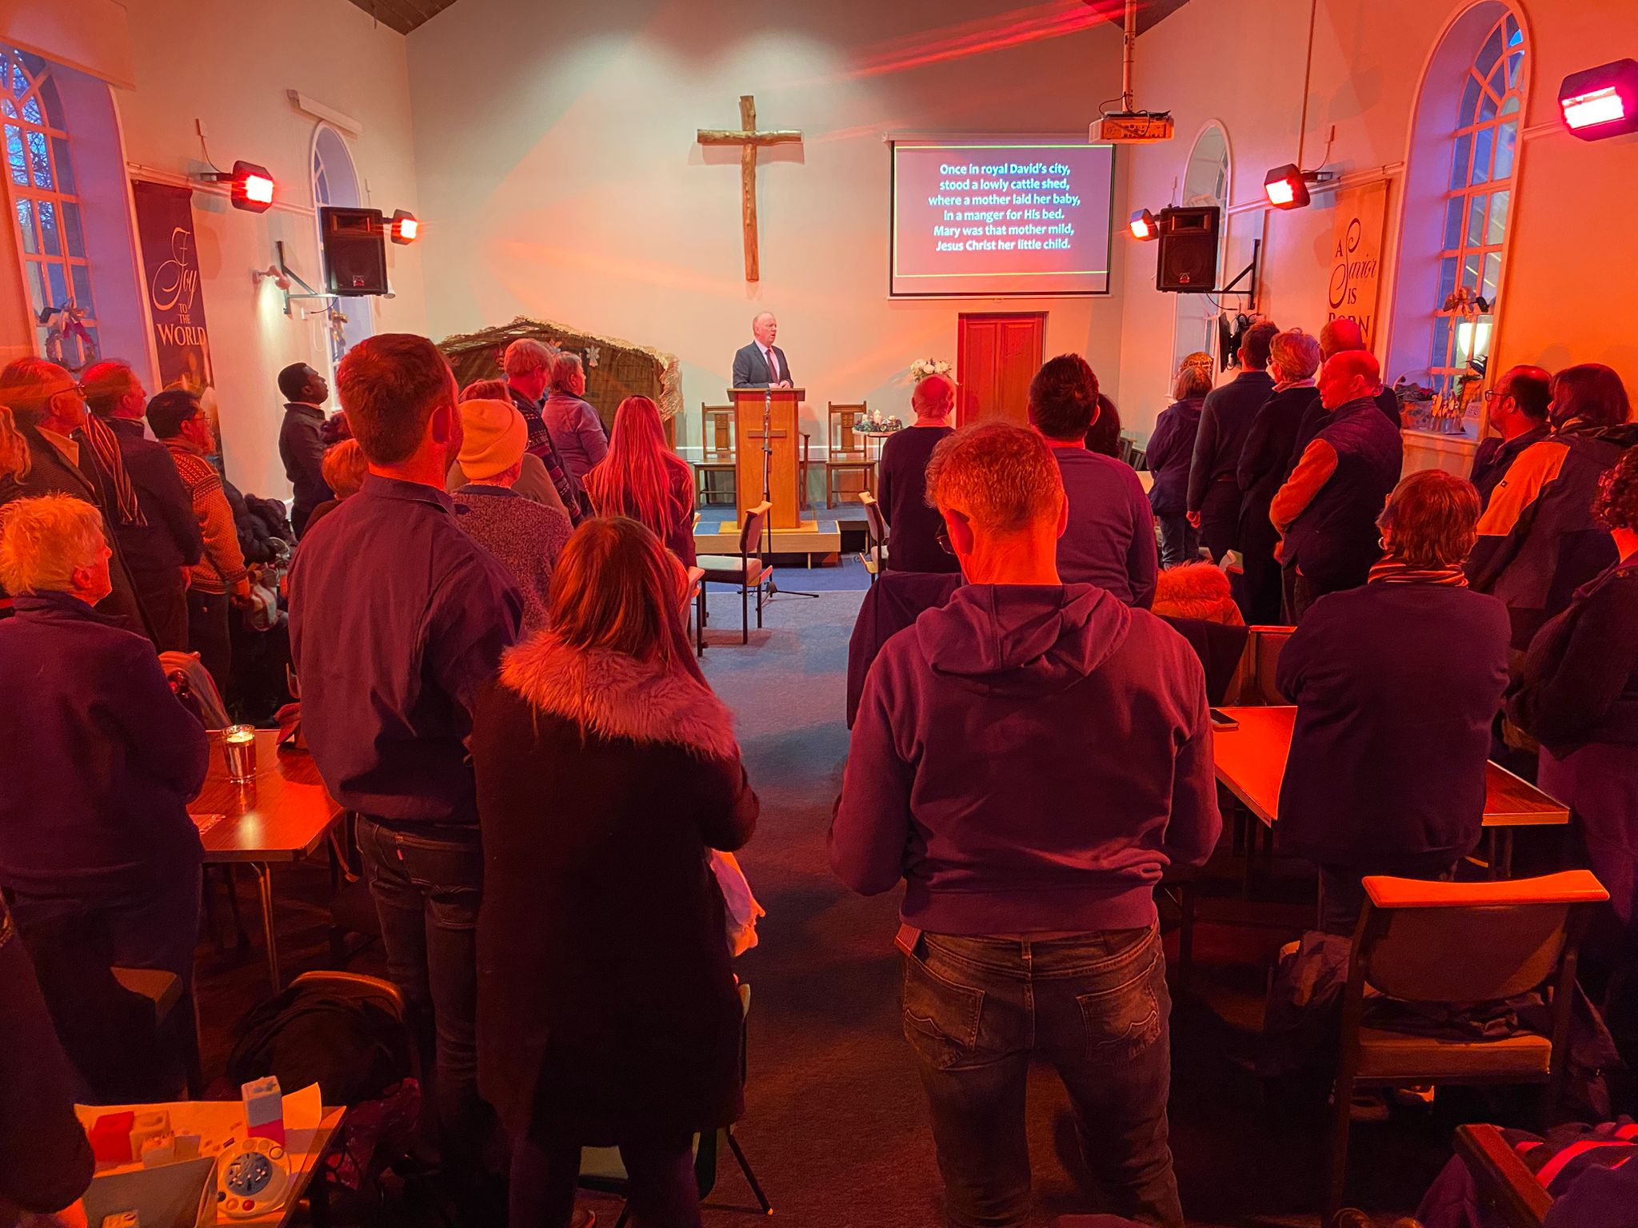
Prayer Points
Prayer Points
Please pray for this vibrant and growing movement. Ask God to give wisdom, courage and fresh opportunities to APBF staff and member conventions.
Pray that churches will be equipped to send and receive mission workers, that strong partnerships will develop across the region, and that unreached and unengaged people groups will encounter the hope of the gospel.
You can discover more at the APBF Prayer and Share event on 12 November at 12.30 pm. There will be time to hear their stories, ask questions and pray together. You can also explore how a Church Partner relationship could connect your congregation directly with God’s work across the region through prayer letters, videos and regular updates.
Prayer Focus:
BMS World Mission

