Slide 1
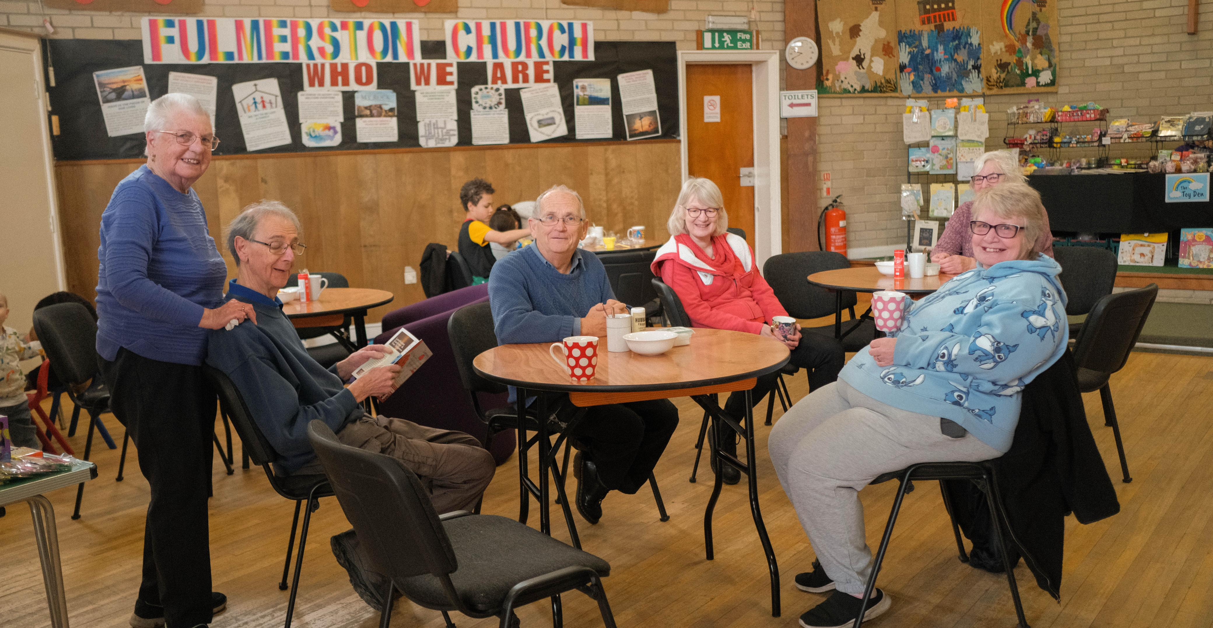
Gorleston Baptist Church is a down-to-earth, authentic, prayerful Baptist Church that celebrates whole-life discipleship, encourages faith journeys and getting to know Jesus better. They are a growing church family located on the Norfolk coast, south of Great Yarmouth; a seaside town with considerable needs.
Mike Flynn, their minister for 6 years, speaks of three areas of church life. Firstly, their important, worship-filled Sunday services with an amazing worship band. Secondly, fellowship with one another, encouraged by Life Groups and supported by well-attended monthly prayer meetings. Thirdly, The Well, their drop-in centre, which is a significant part of their community outreach. Here, you will find breakfasts and the food pantry for people in need, alongside a laundry and showers, which are well used by the local homeless community. Mike believes that all the volunteers are blessed by their service in this place.
Prayer Focus:
Gorleston Baptist Church, Norfolk

Slide 2
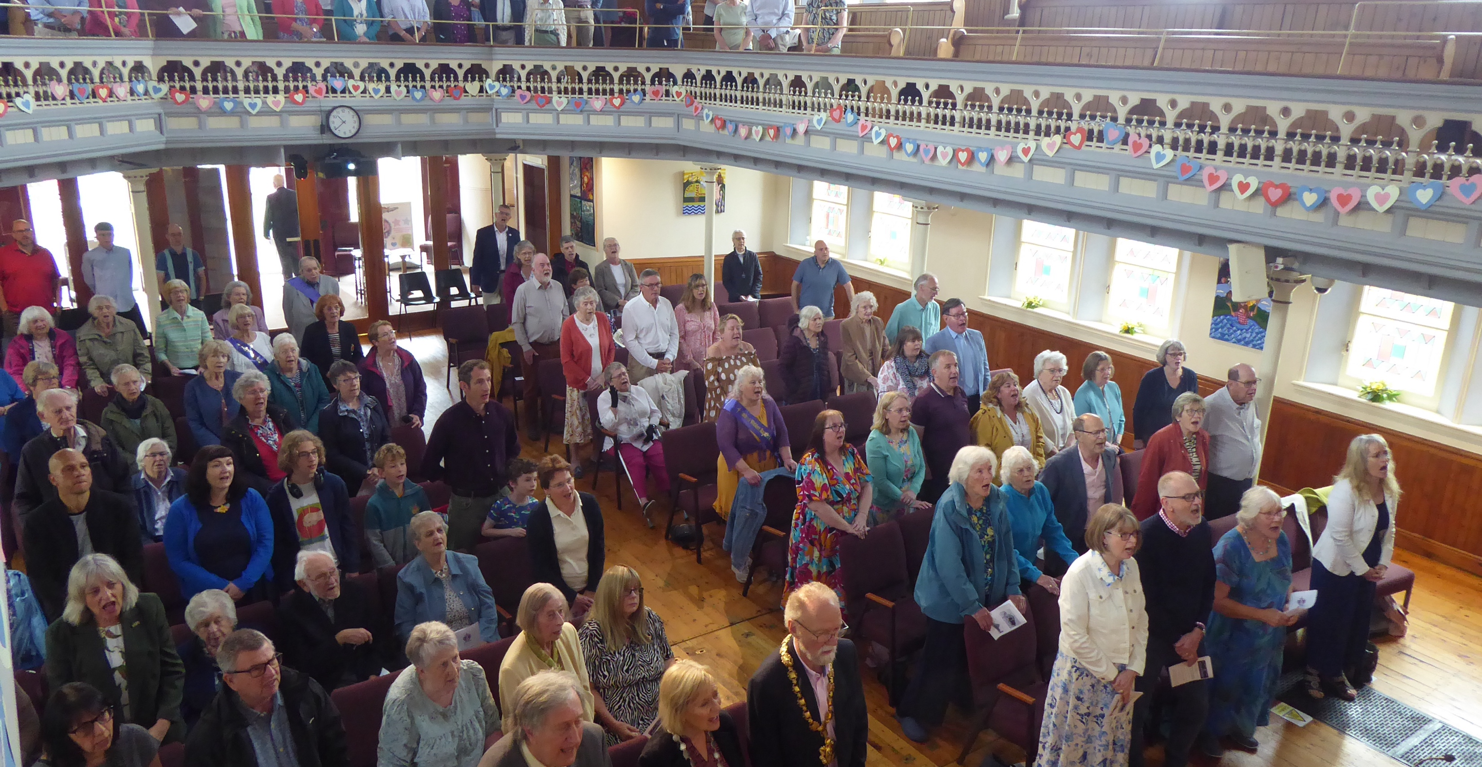
Prayer Focus:
Gorleston Baptist Church
Looking to the future, they are planning a day of prayer in early November to listen and discern God’s plans for them and their community as they seek to be faithful in their calling in the next phase of their life together.
Please pray with them:
That they may hear God’s voice clearly as they look to the future.
To continue to maintain the good relations they enjoy with other local churches.
That their awareness of the needs of the community is focused on what GBC needs to do, so they serve well.
For God’s love in Jesus to be made known in Gorleston and beyond.

