Slide 1
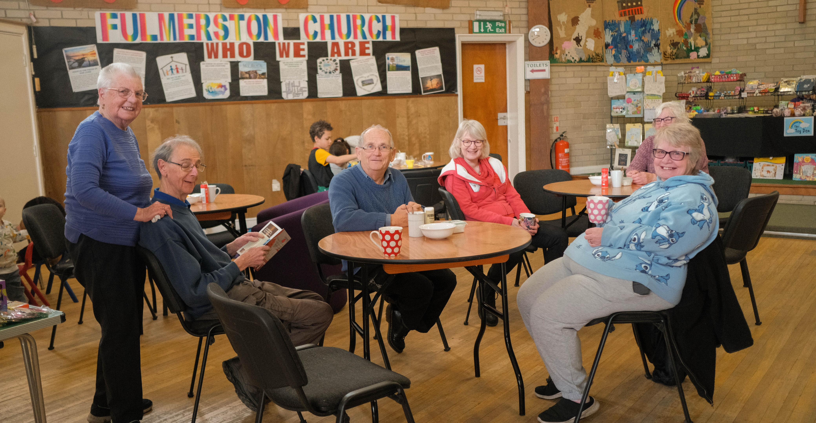
Fulmerston is a small church located on a London overspill housing estate in Thetford, Norfolk. It has built strong links to the community over many years and seeks to be a warm, welcoming and real presence.
The Church is active and busy. As well as Sunday morning services and children’s group, it has a variety of weekly and fortnightly activities, including a “craft buddies” group, “chat & chill” coffee morning, a “meeting place” social group for older people. They host an exercise class run by a local charity and other community groups make use of their building, including as a polling station. A “house group” meets fortnightly for fellowship, to learn from the Bible and pray together.
The Church is in good spirits. In the last 3-4 years, after a long period of no numerical growth, they have been greatly encouraged by a significant number of new people and by 3 baptisms. They give thanks for the Lord’s faithfulness and pray that the Lord will continue to bless them.
Prayer Focus:
Fulmerston Community Church, Thetford

Slide 2
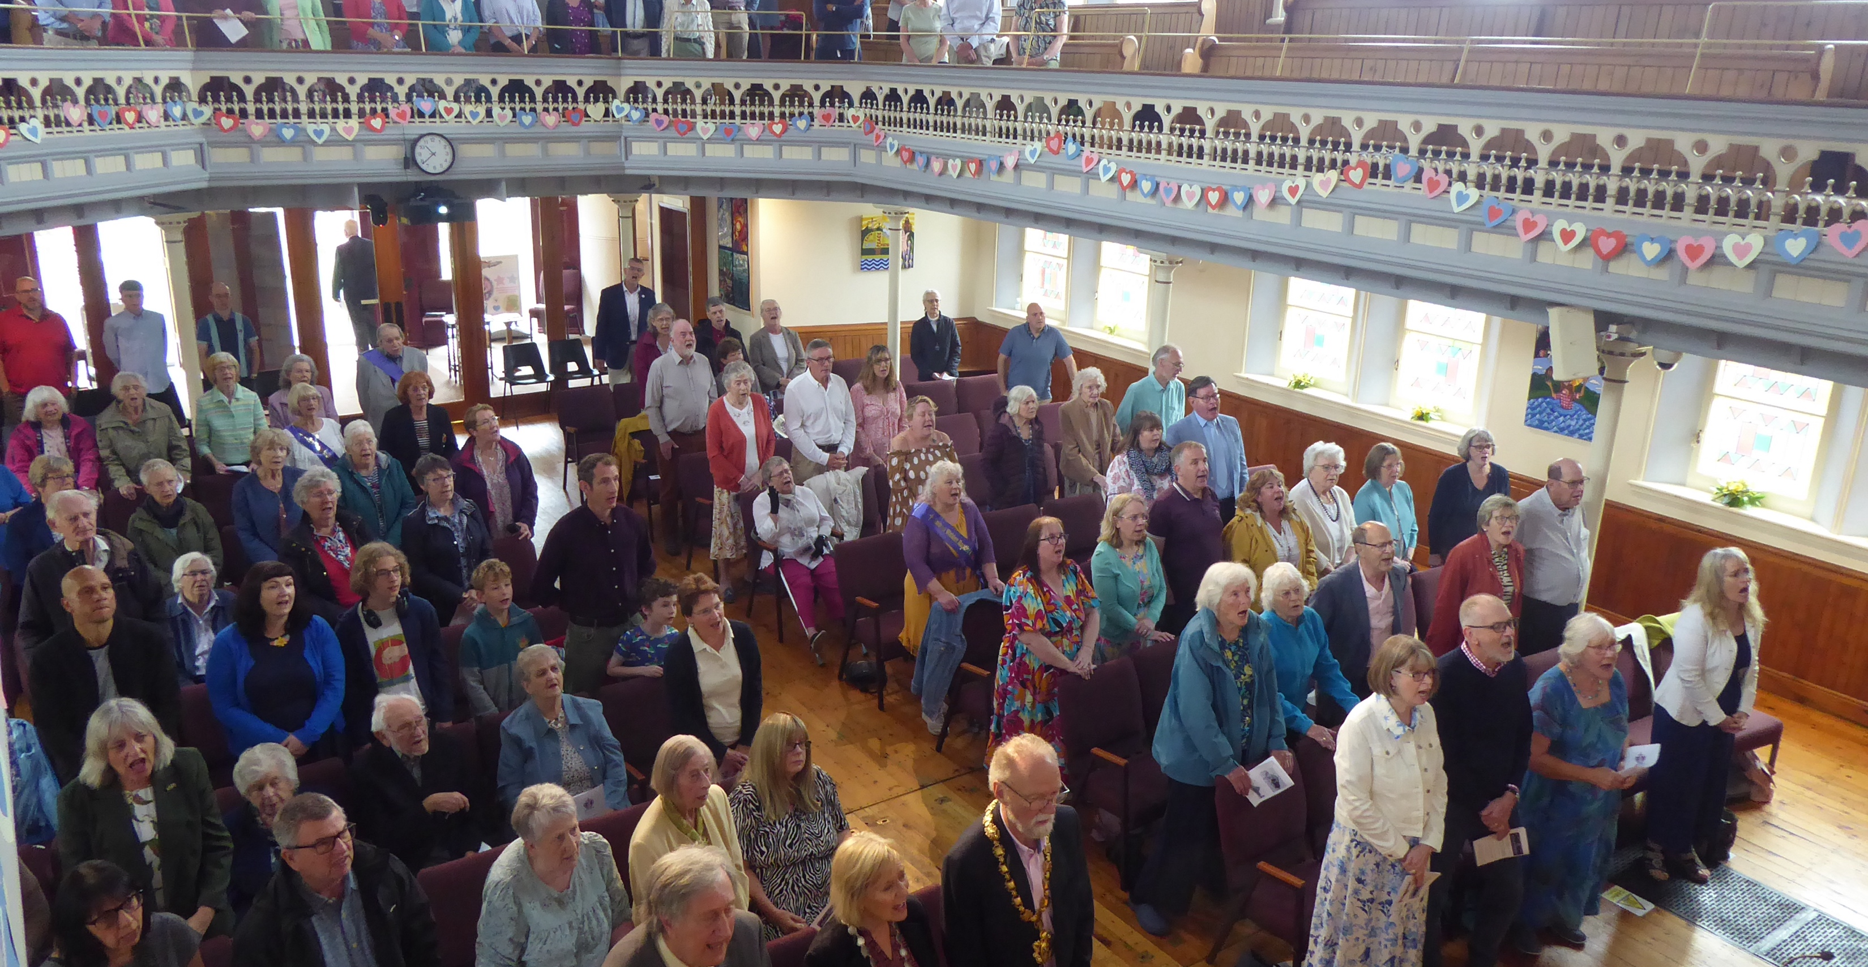
Prayer Focus:
Fulmerston Community Church
Prayer points
Pray for discernment for those new to the Church and the recently baptised. May they discover their gifts and want to use them in building God’s Kingdom.
For people attending the various activities to come to know Jesus personally and grow into His faithful followers.
Ask God to bless and refresh those who have faithfully led activities for many years; to give them energy, compassion and wisdom to build positive relationships with local people.
Pray for all those in Thetford who are concerned about the proposal to house a significant number of migrants nearby. Ask God to guide all those in national and local government who are considering and deciding upon this issue; may they take time to listen to voices from local communities. And for Tim Lovejoy (Fulmerston’s Church & Community Worker) and other local church leaders, seeking to be a positive and unifying influence in the town. May God’s protection and peace be over them all.

