Slide 1
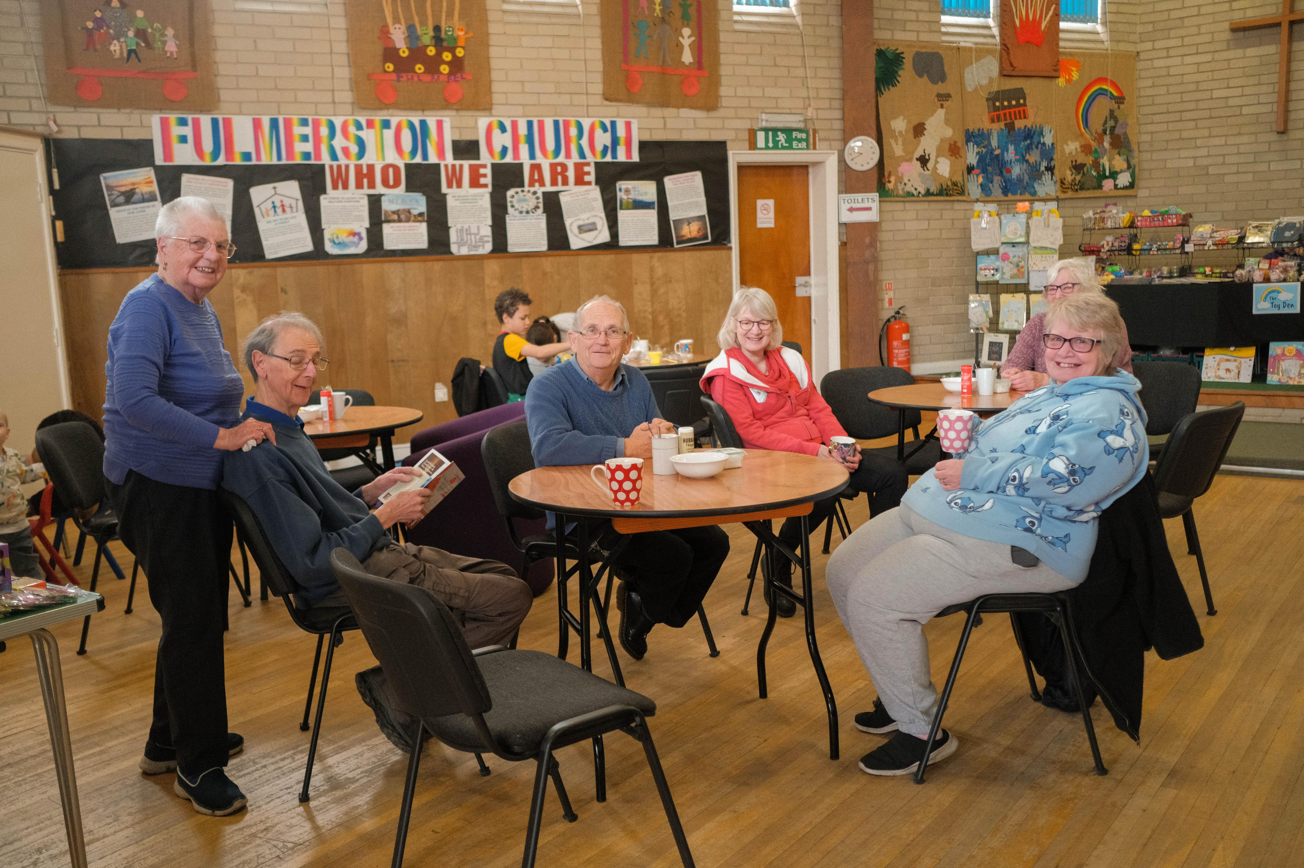
Fulmerston is a small church located on a London overspill housing estate in Thetford, Norfolk. It has built strong links to the community over many years and seeks to be a warm, welcoming and real presence.
The Church is active and busy. As well as Sunday morning services and children’s group, it has a variety of weekly and fortnightly activities, including a “craft buddies” group, “chat & chill” coffee morning, a “meeting place” social group for older people. They host an exercise class run by a local charity and other community groups make use of their building, including as a polling station. A “house group” meets fortnightly for fellowship, to learn from the Bible and pray together.
The Church is in good spirits. In the last 3-4 years, after a long period of no numerical growth, they have been greatly encouraged by a significant number of new people and by 3 baptisms. They give thanks for the Lord’s faithfulness and pray that the Lord will continue to bless them.
Prayer Focus:
Fulmerston Community Church

Slide 2
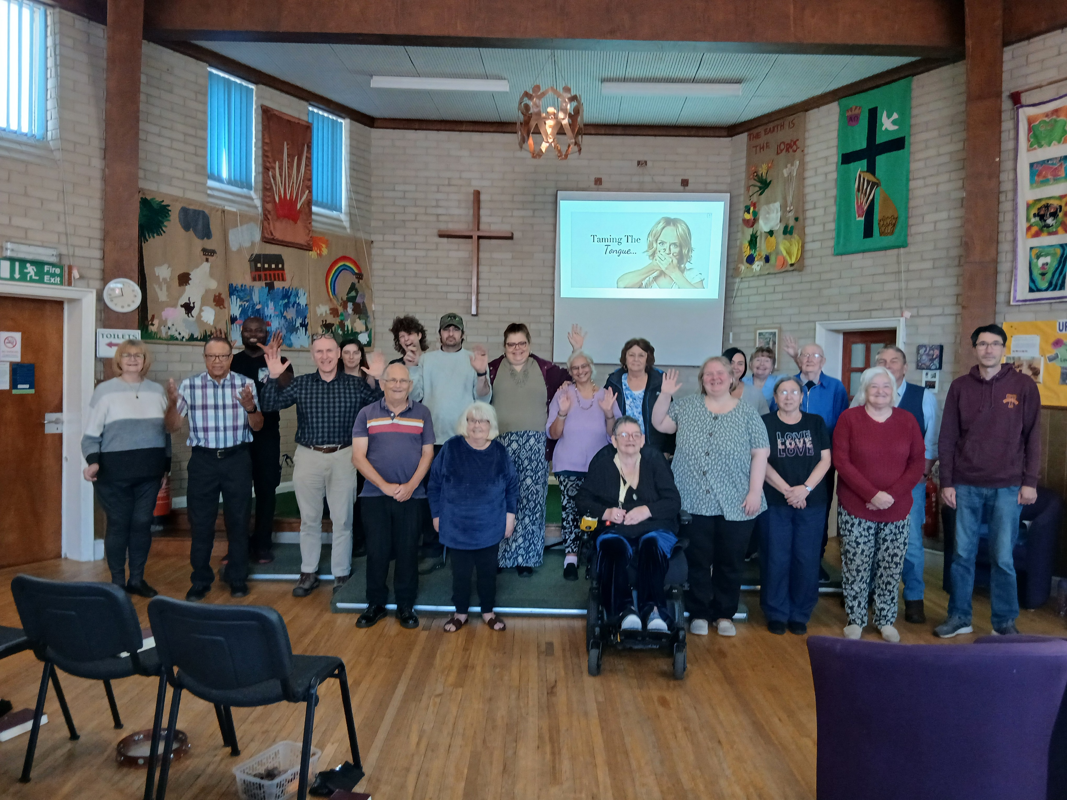
Prayer points
*Pray for discernment for those new to the Church and the recently baptised. May they discover their gifts and want to use them in building God’s Kingdom.
*For people attending the various activities to come to know Jesus personally and grow into His faithful followers.
*Ask God to bless and refresh those who have faithfully led activities for many years; to give them energy, compassion and wisdom to build positive relationships with local people.
*Pray for all those in Thetford who are concerned about the proposal to house a significant number of migrants nearby. Ask God to guide all those in national and local government who are considering and deciding upon this issue; may they take time to listen to voices from local communities. And for Tim Lovejoy (Fulmerston’s Church & Community Worker) and other local church leaders, seeking to be a positive and unifying influence in the town. May God’s protection and peace be over them all.
Prayer Focus:
Fulmerston Community Church

