Slide 1
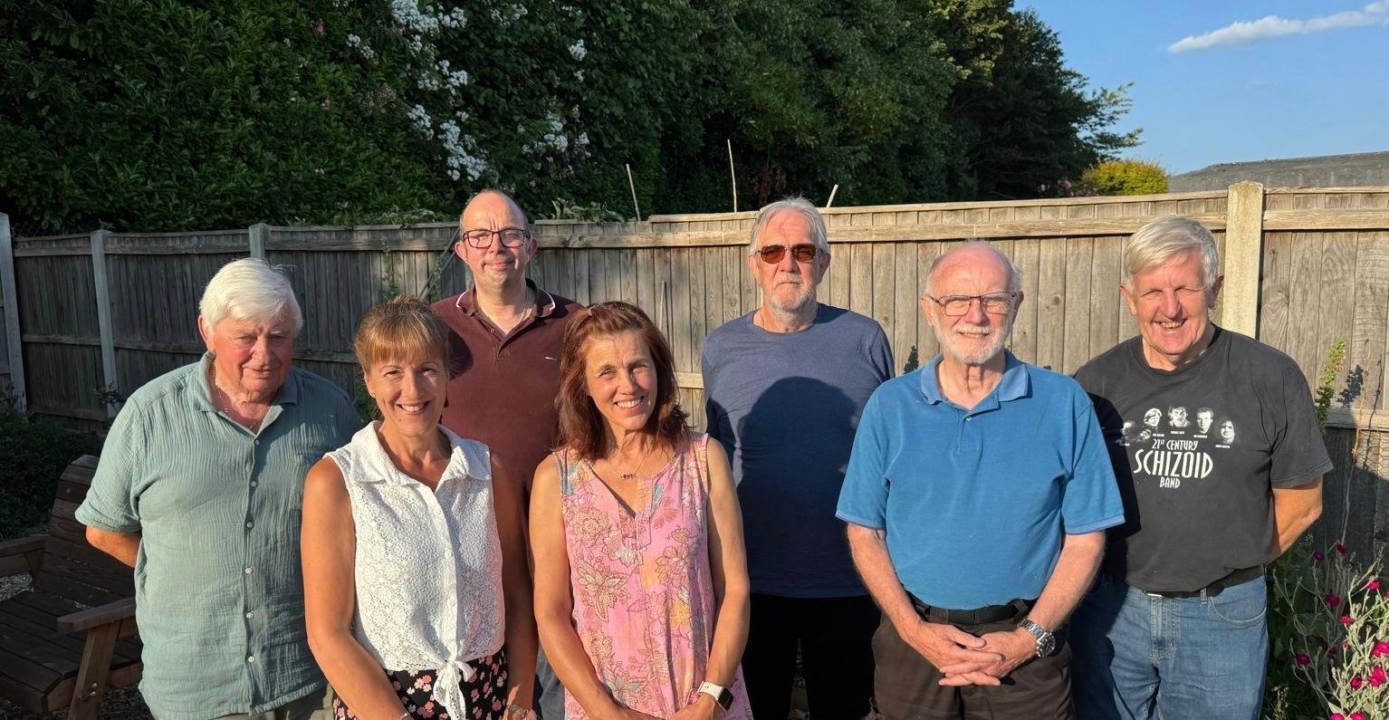
Prayer Focus: Fakenham Community Baptist Church
FCBC is living testimony that a church is not a building, nor activities, but people together on a mission to know Jesus and make Him known. Their, mostly older, members currently meet in Fakenham Community Centre. They hold Little Fishes there, Lifegroup and coffee meetings. On market day, they run a stall where they enjoy good relationships and where people come for prayer & at Weatherspoons, they host ‘drop-in sessions. They also hold fast days and prayer meetings.
In recent years, their faithfulness and resilience have been tested by the setbacks besetting the sale of their building and new church near a planned housing estate.

Slide 2
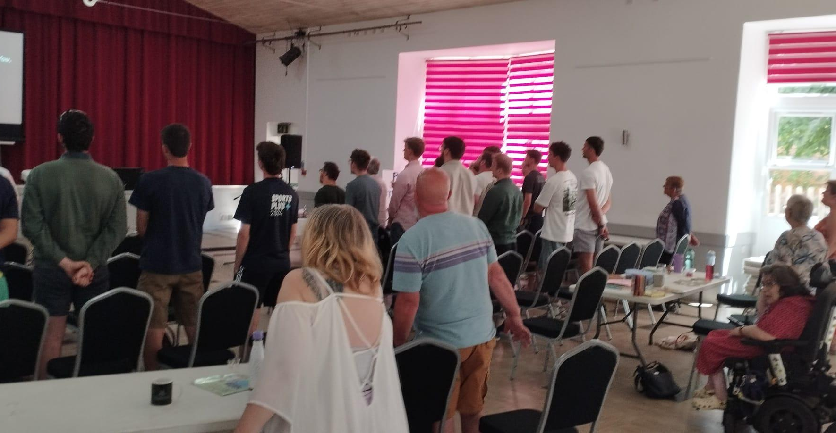
Prayer Focus: Fakenham Community Baptist Church, Norfolk
Thankfully, the sale of the land is nearing a conclusion, which will give the church the opportunity for a fresh start. Prayer points
* For the sale to be completed and for the church to find a new building in town.
* For the church to go deeper in knowing God and enable others to know him too.
* To meet new people who share their love of God and for them to find their home in the church.
* To thank God for the ministry and support of their Moderator, Jonathan Squirrell and from guest speakers.

