Slide 1
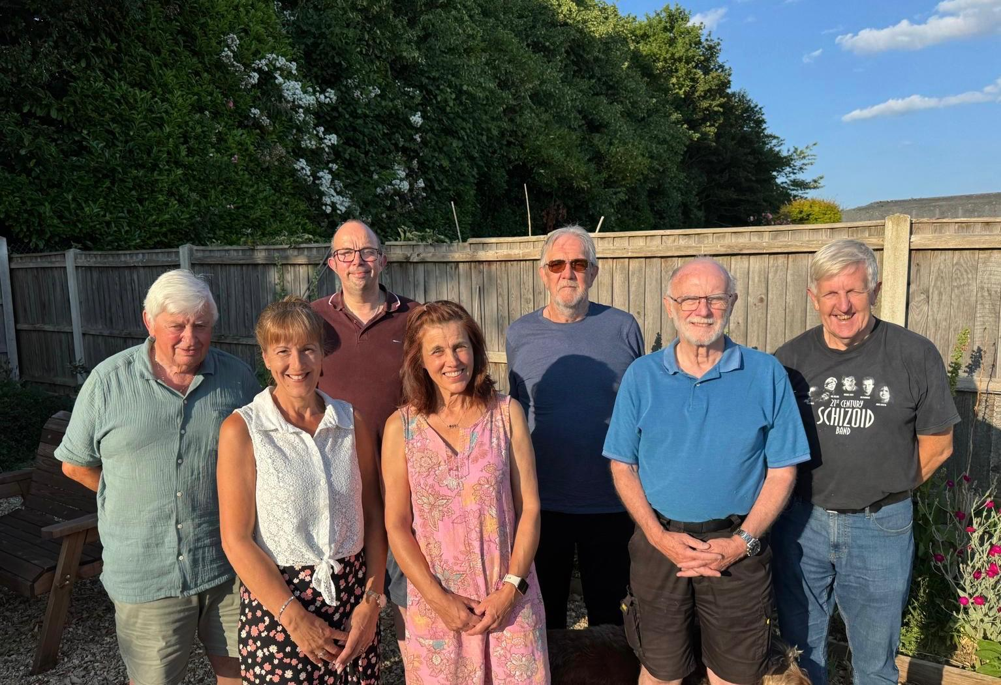
FCBC, in Norfolk, is living testimony that a church is not a building, or even its activities, but people together on a mission to know Jesus and make Him known. Their 30 or so mainly older members, with a few younger people, currently meet in Fakenham Community Centre. They hold Little Fishes there, a Lifegroup and coffee meetings. At the town’s Thursday Market, they run a market stall where they enjoy good relationships with the other stall holders and where people also come for prayer; while at their local Weatherspoons, they host ‘sit and chat’ drop-in sessions. They hold fast days, prayer meetings and are part of Fakenham Churches Together.
In recent years, their faithfulness and resilience have been tested by the setbacks besetting the sale of the original church building and the purchase of land for a new church near a planned new housing estate.
Prayer Focus: Fakenham Community Baptist Church

Slide 2
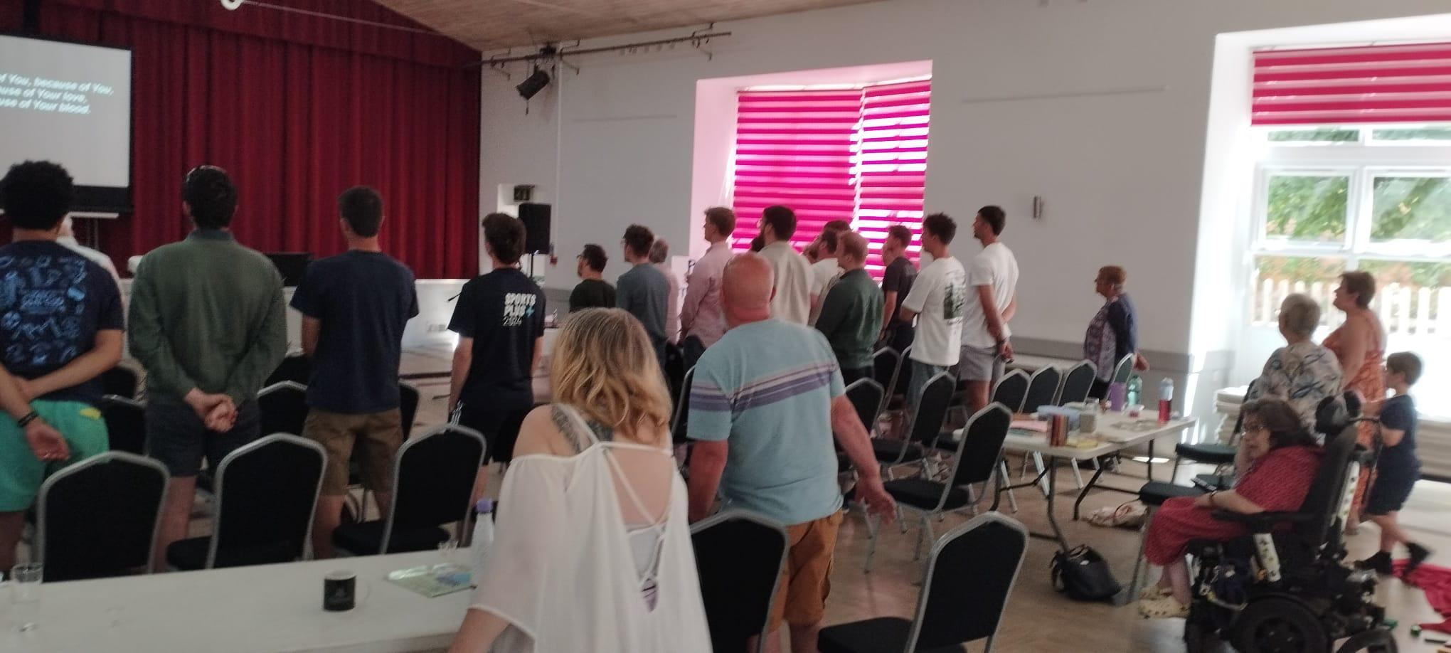
Thankfully, the sale of the land is nearing a conclusion, which will give the church the opportunity for a fresh start. Prayer points
* For the sale of Clipbush to be completed and for the church to find a new church building in Fakenham town.
* For the church to go deeper in knowing God and to have success in enabling others to know him too.
* To meet new people who share their love of God and for them to find their home in the church.
* To thank God for the ministry and support of their Moderator, Jonathan Squirrell and from guest speakers.
Prayer Focus: Fakenham Community Baptist Church

