Slide 1
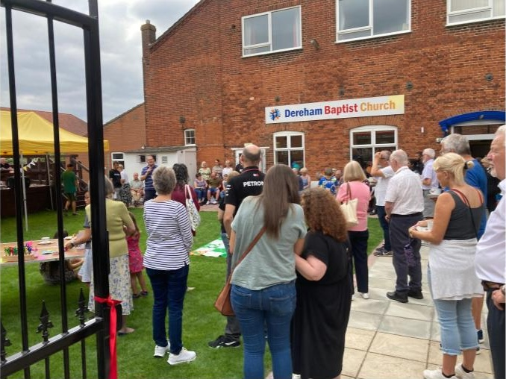
DBC is well placed in the centre of the small town of Dereham, Norfolk. Nigel Bayley, their pastor of 9 years adds, “The Church has a heart to impact the town for Jesus, seeking to move out of our walls and help people to experience and know Jesus.”
Dereham Baptist has 3 congregations, an English speaking one, a Portuguese speaking one and a gathering for families that grew out of one of their two toddler groups. They also have small groups, including one for young adults and another for teenagers, which was launched after a group of youngsters returned from “Newday” wanting to study the Bible together.
The Church partners with 2 other Christian charities in "The Green Pastures Community Hub" which is a shop space in the town offering food, welcome and support and a Christian bookshop.
Prayer Focus: Dereham Baptist Church

Slide 2
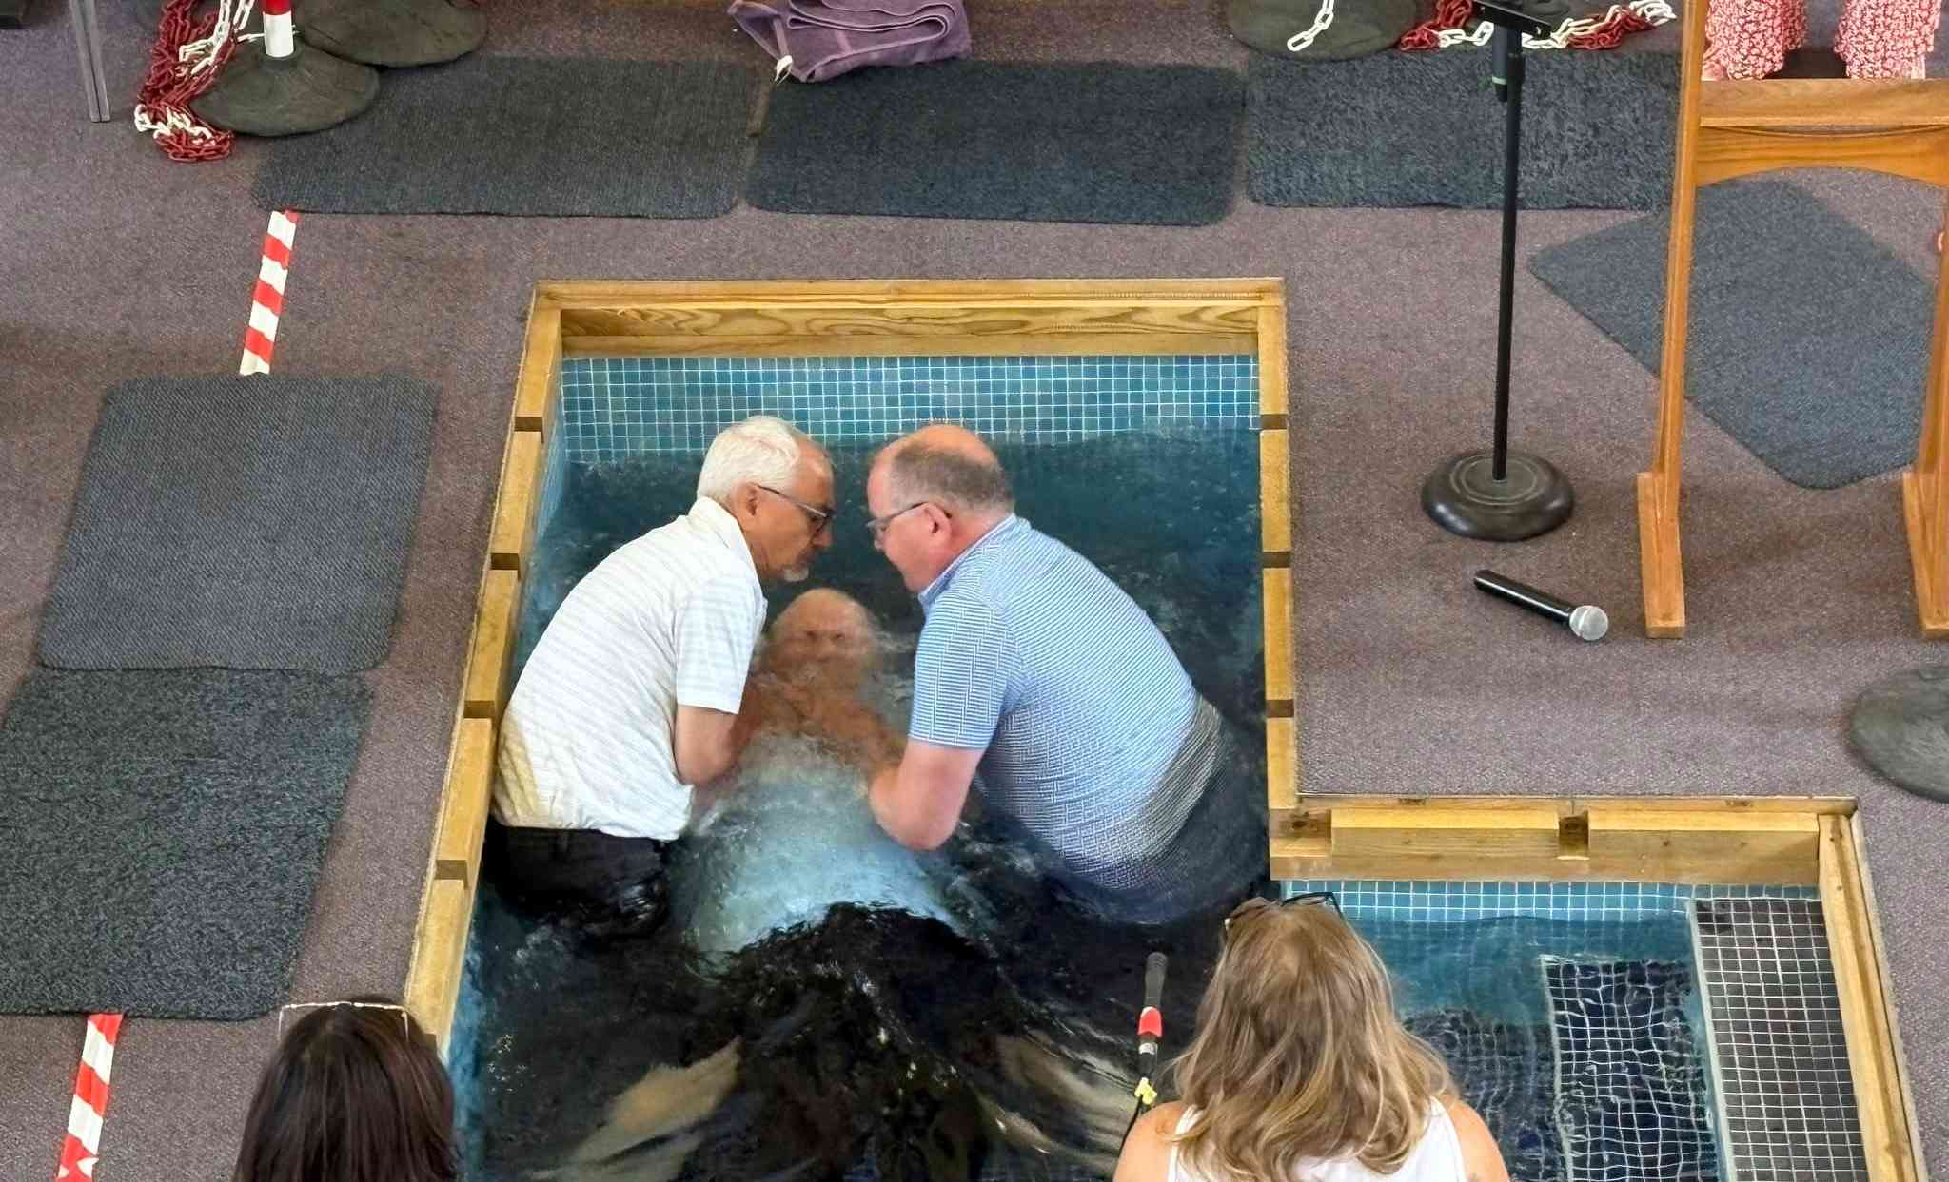
The Church has a strong sense that God is moving in their town, bringing people into the Hub and the Church. They recently had 8 baptisms with others journeying towards baptism. Prayer points:
* Give thanks that God is on the move. Ask for open hearts and minds to follow God’s lead.
* Pray for young people and others studying the Bible together. May they grow as disciples and be encouraged to invite their friends. May God’s protection and guidance be over those baptised.
* Through God’s provision, the Church has refurbished its back entrance; may God show them how this space can be used in fresh ways.
*Pray for wisdom and resources in taking their youth work forward and for God to provide the right person to replace their office administrator, who is retiring.
Prayer Focus: Dereham Baptist Church

