Slide 1
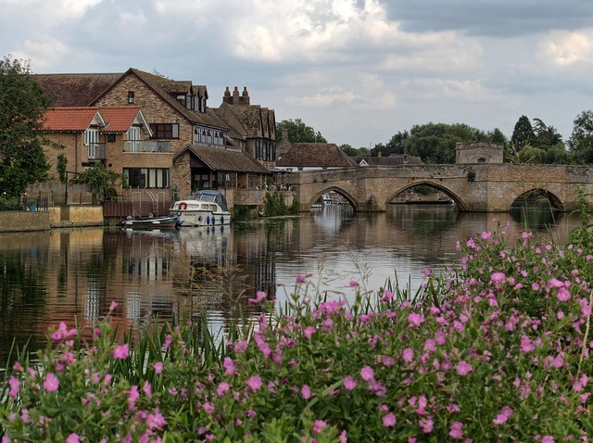
This week the EBA marks Cambridgeshire Week, a week-long opportunity to pray for and celebrate our churches and ministers across the county.
We have 37 Cambridgeshire churches in the EBA, an encouraging number of chaplains working in multiple healthcare settings, and pioneers seeking to engage with new people and in new places. The 37 churches are varied in so many ways, and we’re grateful for the gifts that each of them brings to Association life.
Cambridgeshire is home to a good number of retired ministers, many of whom make a significant contribution to the life of their own churches, to other churches through preaching and moderating, and in serving various charities and other church bodies.
Ecumenism is a strong feature of church life across Cambridgeshire. We are glad to be part of a number of LEPs across the county, and to have good ecumenical relationships with other denominational leaders. We’re pleased to have one our ministers, Rev Mark Burleigh, serving as the part-time County Ecumenical Officer.
Prayer Focus: Cambridgeshire Week

Slide 2
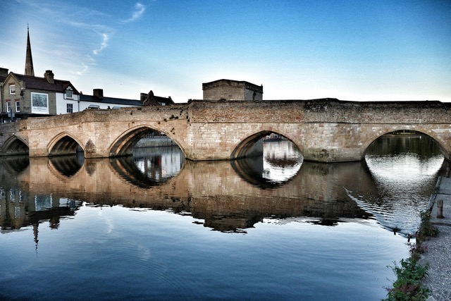
During the week, our EBA team will be out and about visiting and meeting people across the county, and on Sunday they will be preaching at services at St Andrew’s Street Baptist Church in Cambridge, Melbourn Baptist Church, and Centenary Baptist Church in March.
Prayer requests:
* That each of our Cambridgeshire churches might be encouraged in their mission and ministry.
* For all our chaplains serving in hospitals and hospices across the county.
* For the churches in Cambridgeshire that are currently seeking a minister in the Settlement system.
* For our ecumenical partners also serving the county, and the work of Churches Together in Cambridgeshire.
Prayer Focus: Cambridgeshire Week

