Slide 1
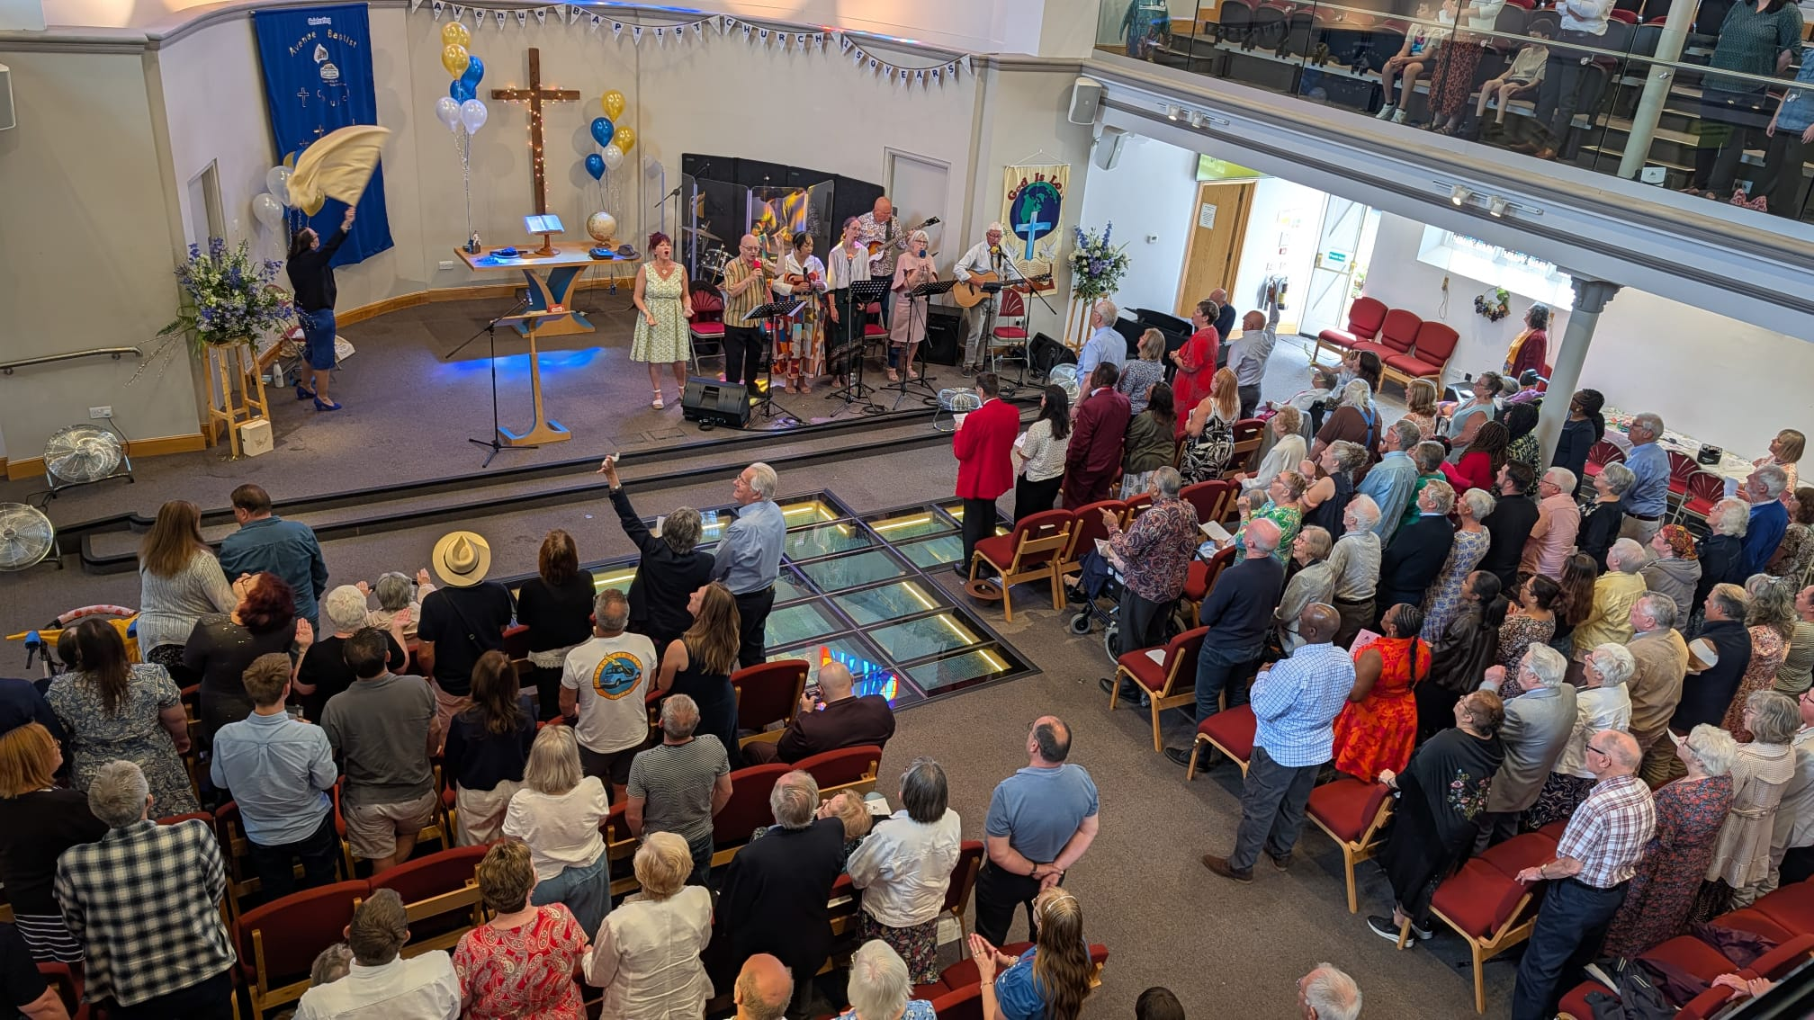
Prayer Focus: Avenue Baptist Church, Southend-on-Sea
ABC is an active and thriving City Church, with all the needs, challenges, and joys of suburban life. This year, they joyfully celebrated their 150th anniversary of service to their God. Their minister Jane Guest sensed the underlying theme of ‘Celebrating God’s Faithfulness.’ On the anniversary, Jonathan Edwards, former General Secretary of BUGB, spoke on encouraging others. They welcomed Claire Blatchford, local Councillors, MP’s and the former Mayor. The church held a month-long celebration including birthday party and varied music events. Event tickets were sold for charity. The church is praising their Wonderful Lord after celebrating and pulling together.

Slide 2
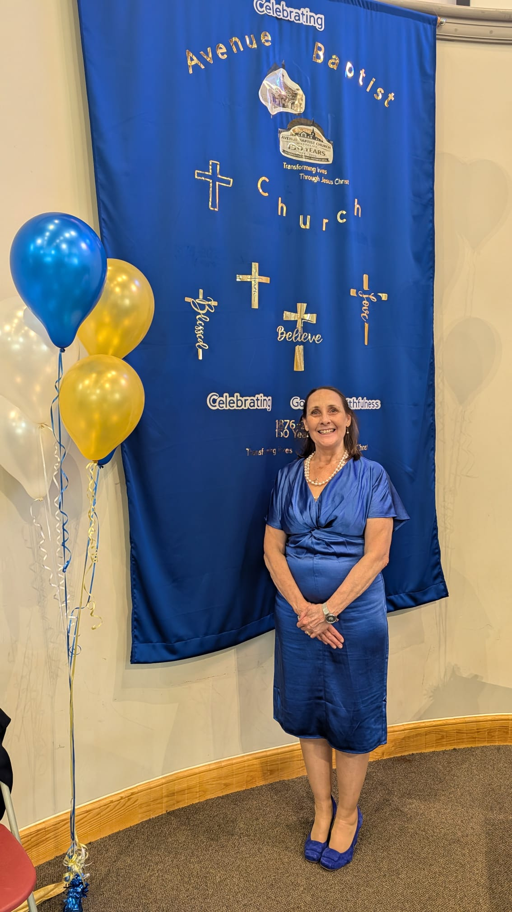
Prayer Focus: Avenue Baptist Church
The busyness of church life continues, with a wedding and community funeral, four people coming into membership too since. Prayers will be appreciated:
* For a new venture in summer 2027 where the church seeks to partner with TLG (Transforming Lives for Good) to cook and serve meals once a week in the school holidays for young families. Needed are volunteers and a cook.
* For the ability to balance the many blessings and richness of church life alongside the hardships of the times and the needs in the community.
* That they continue to be good stewards in the mission of Christ, reflecting His goodness and faithfulness as they seek to be people who ‘put courage into people.’

