Slide 1
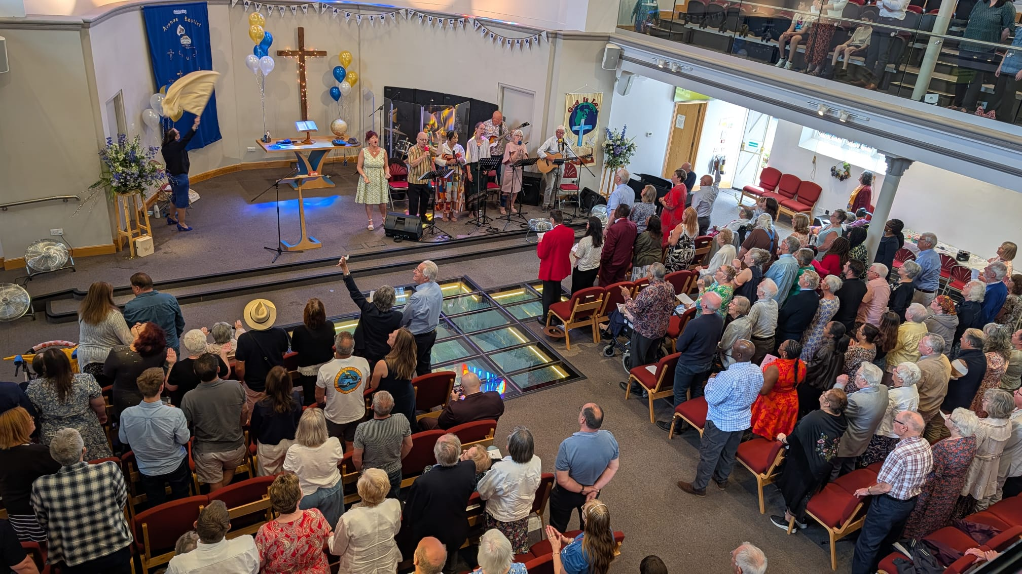
Avenue Baptist Church is an active and thriving City Church in the centre of Southend-on-Sea, with all the needs, challenges, and joys of suburban life. This year, they joyfully celebrated their 150th anniversary of service to their God. Their minister Jane Guest sensed the underlying theme of ‘Celebrating God’s Faithfulness’ On the anniversary, Jonathan Edwards, former General Secretary of BUGB, spoke inspiringly on the importance of encouraging others. They also welcomed Claire Blatchford, Regional Minister, local Councillors, MP’s and the former Mayor.
The church held a month-long celebration: Birthday Party for seventy children, IDMC gospel choir, and AV4C contemporary gospel group, a Jonathan Veira concert- a Christian opera singer; and barn dance. Duggie Dug came to lead an All-age Service. Event tickets were sold for charity, and the money raised went to the Foodbank, homeless ministry, Compassion UK and Avenue Contact Centre. The church is on cloud nine praising their Wonderful Lord after celebrating and pulling together.
Prayer Focus: Avenue Baptist Church

Slide 2
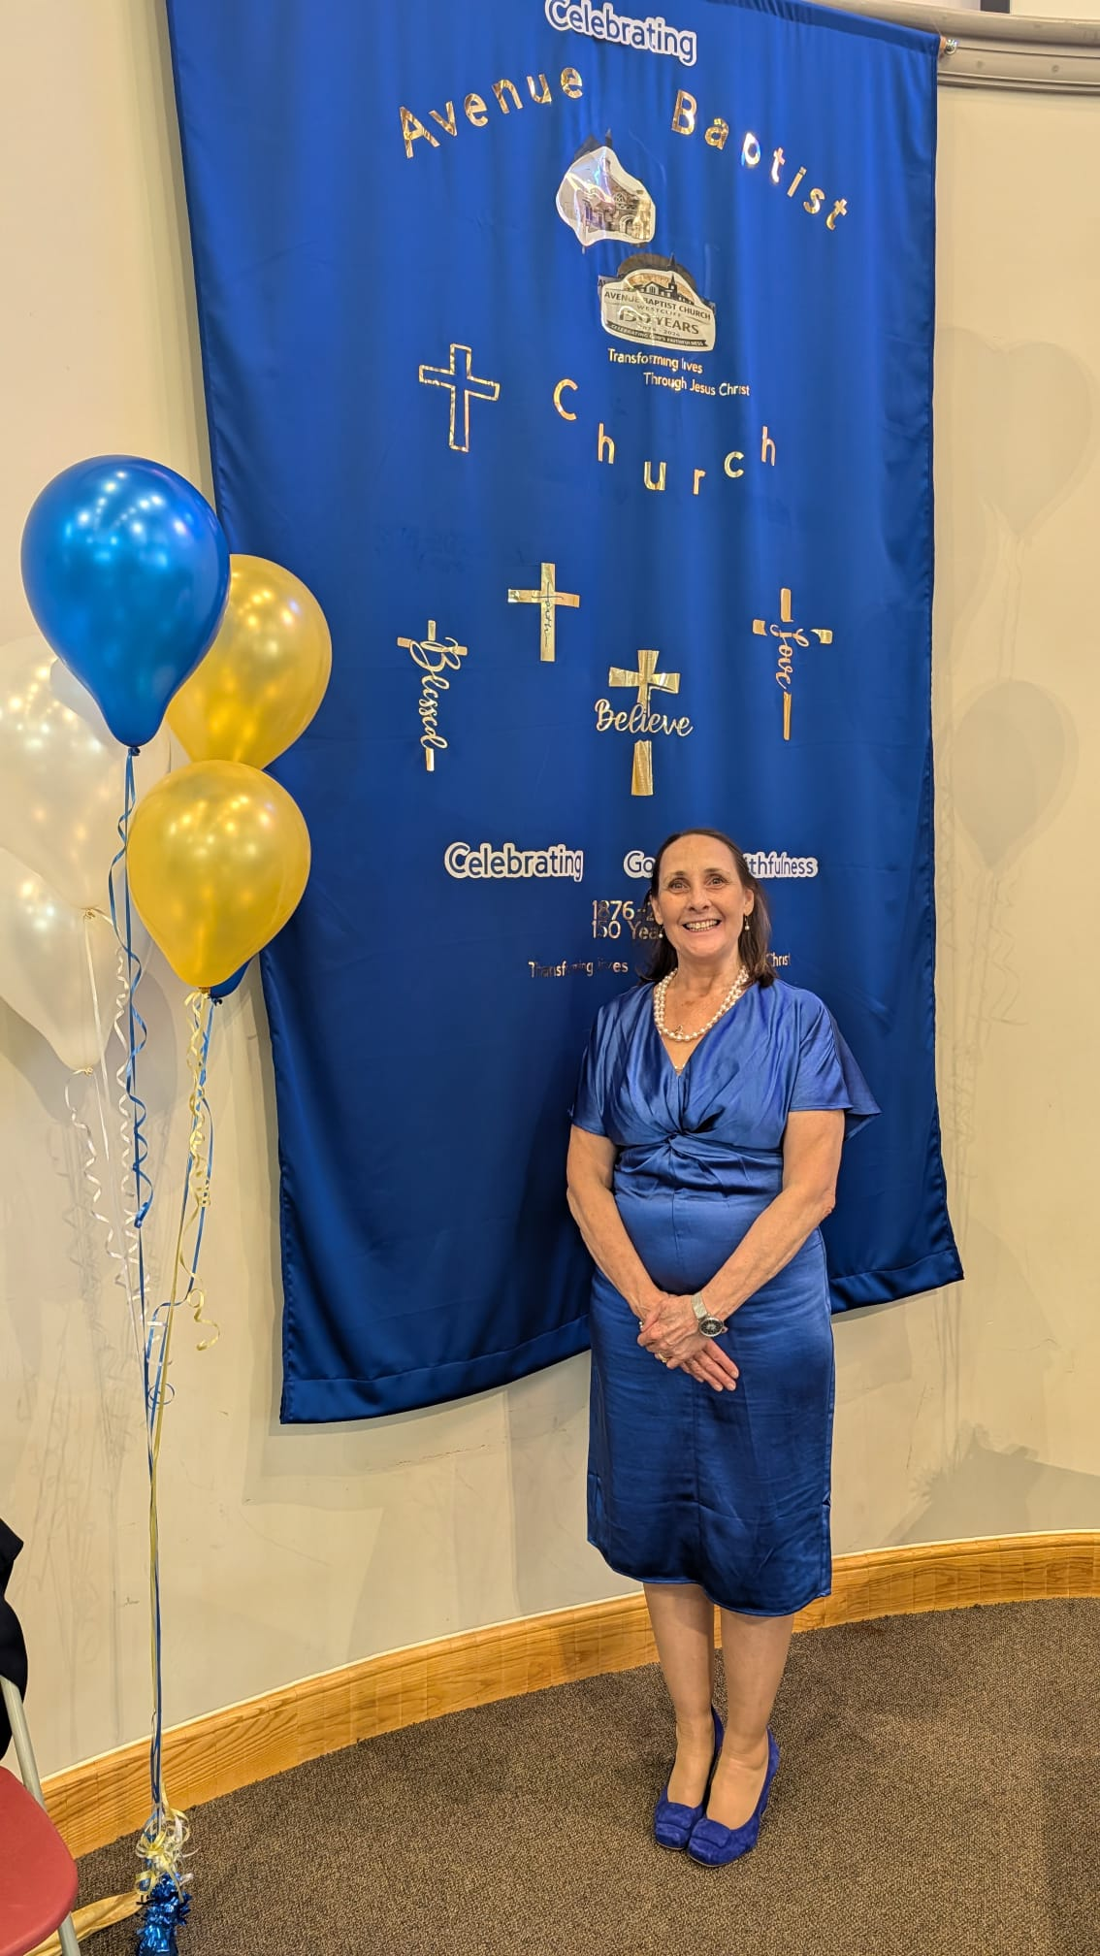
The busyness of church life continues, with a wedding and community funeral, four people coming into membership too since.
Prayers will be appreciated:
* For a new venture in summer 2027 where the church seeks to partner with TLG (Transforming Lives for Good) to cook and serve meals once a week in the school holidays for young families. Needed are volunteers and a cook.
* For the ability to balance the many blessings and richness of church life alongside the hardships of the times and the needs in the community.
* That they continue to be good stewards in the mission of Christ, reflecting His goodness and faithfulness as they seek to be people who ‘put courage into people.’
Prayer Focus: Avenue Baptist Church

