Slide 1
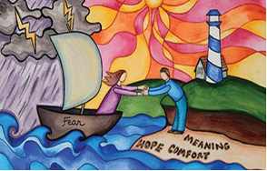
Prayer Focus: Healthcare Chaplaincy
People experience life-changing events every day within the NHS. Across the EBA, Baptist chaplains serve in hospitals, providing pastoral, spiritual and religious care to patients, visitors and staff of all faiths and none. They offer compassionate, person-centred support; listen to people’s stories, respect their beliefs and help them find meaning. They conduct rituals and acts of remembrance or celebration.
Chaplains play a vital role supporting people through traumatic experiences such as pregnancy loss, sudden death, mental health crises, life-limiting diagnoses and end-of-life care. They also support NHS staff, students and volunteers.

Slide 2
Prayer Focus: Healthcare Chaplaincy
Chaplaincy work within multidisciplinary teams, ethics and leadership groups, and build links with local faith communities to help hospitals understand and meet local needs. There is no such thing as a standard week in chaplaincy. Prayer points:
* Thank God for the patients that chaplains encounter, may they be treated as individuals – made in the image of God
* Pray for the NHS staff, having to make difficult, life-changing decisions. May those decisions be wise.
* Pray for chaplaincies, for joy & laughter, fulfilment & meaning, protection & burnout

