Slide 1
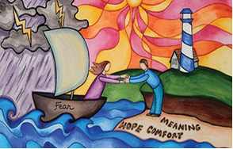
People experience life-changing events every day within the NHS. Across the EBA, Baptist chaplains serve in a number of hospitals, providing pastoral, spiritual and religious care to patients, visitors and staff of all faiths and none.
While chaplaincy is not a statutory NHS requirement, most hospitals provide chaplaincy services. Chaplains offer compassionate, person-centred support, listening to people’s stories, respecting their beliefs and helping them find meaning during difficult times. They may also conduct or facilitate religious rituals and acts of remembrance or celebration.
Chaplains play a vital role in responding to crises and supporting people through traumatic experiences such as pregnancy loss, sudden death, mental health crises, life-limiting diagnoses and end-of-life care. They also support NHS staff, students and volunteers, contributing to wellbeing and resilience.
Prayer Focus: Healthcare Chaplaincy

Slide 2
In addition, chaplains work within multidisciplinary teams, ethics and leadership groups, deliver training, provide supervision, support emergency planning, and build links with local faith and belief communities to help hospitals better understand and meet local needs.
There is no such thing as a standard week in chaplaincy.
Prayer points
* Thank God for the patients that chaplains encounter, may they be treated as individuals – made in the image of God
* Pray for the NHS staff, having to make difficult, life-changing decisions. May those decisions be wise.
* Pray for chaplaincy departments. Pray for joy and laughter, pray for fulfilment and meaning. Pray for protection and burnout.
Prayer Focus: Healthcare Chaplaincy

