Slide 1
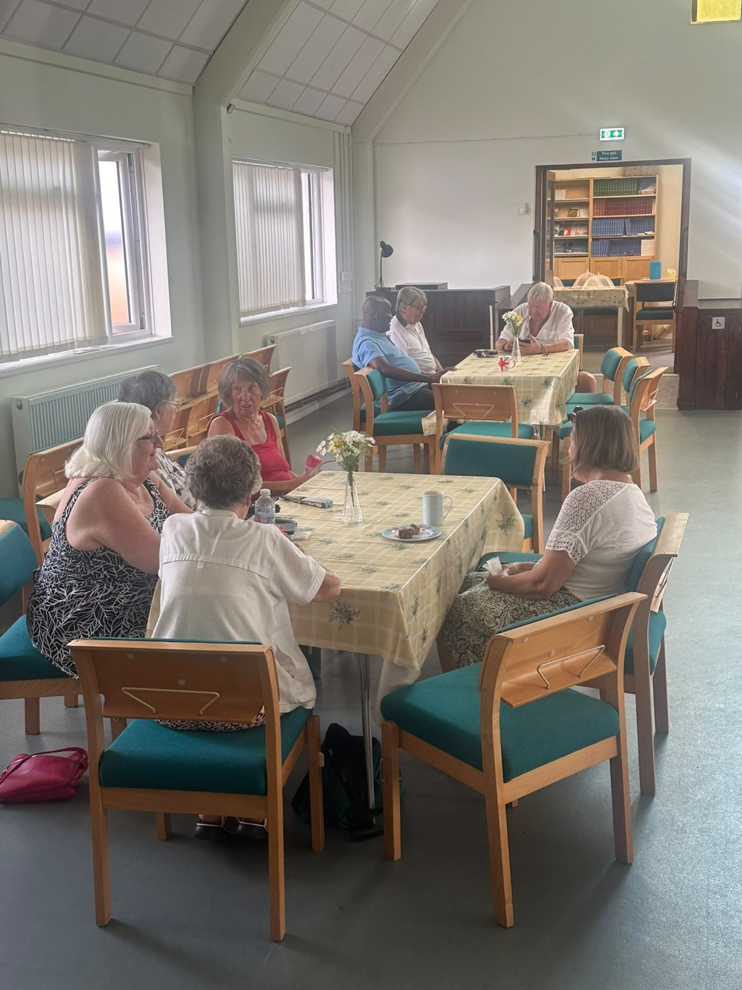
Elm Park Baptist Church, Essex, will celebrate its 90th anniversary next year. The fellowship today comprises people of all ages and backgrounds, very different from the original, predominantly middle-class church established in the garden suburb of Elm Park Garden City. Between 35 and 40 people worship on a Sunday morning. Though they lack musicians, they join in sung worship using online music videos and feel blessed by the ministry of two local preachers and one of its deacons.
The church finds itself in a place of ‘taking stock’ following a period of mourning and transition. Its once strong uniform organisations never reopened after the COVID pandemic. They are also without a minister following the departure, 4 years ago, of its full-time Minister and, more recently, their unpaid Associate Pastor. Yet they also feel a sense of peace and are waiting on God for a new direction and a fresh work.
Prayer Focus: Elm Park Baptist Church

Slide 2
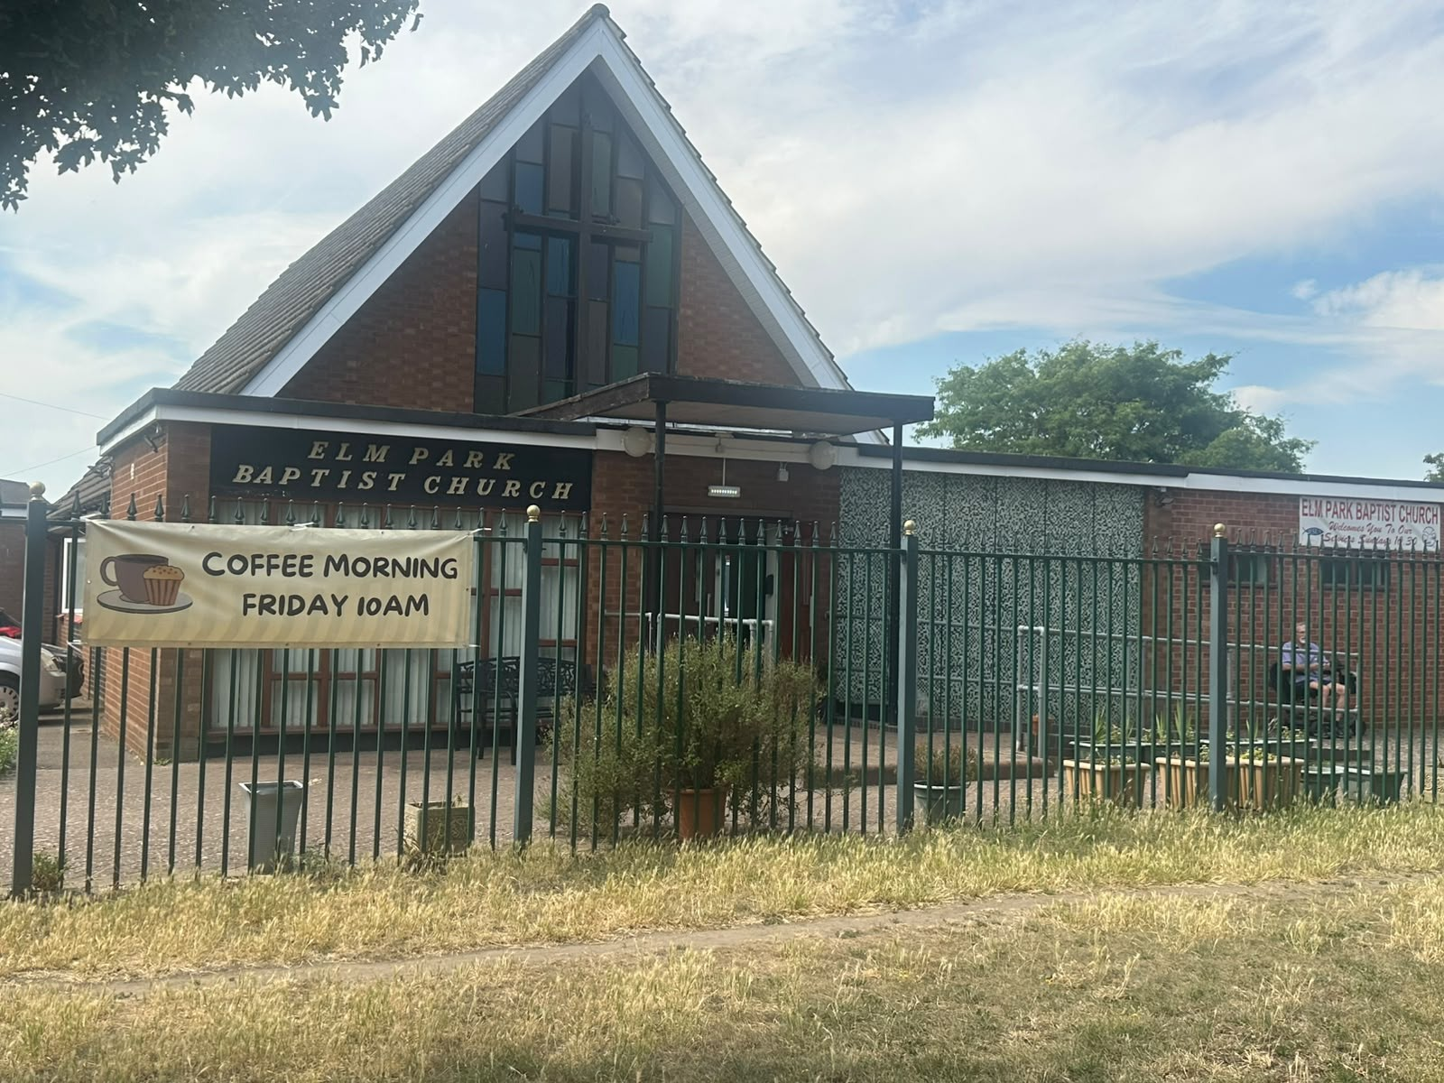
The church holds a weekly prayer meeting and Bible study, at which they often share testimonies, and a weekly prayer walk to pray for the houses and streets in the community. The church hosts an OFSTED registered preschool that meets daily, a weekly Zumba group and a group for people with Parkinson’s, and every other Friday, a homemade cakes and coffee morning. Very gradually, they have seen one or two people from these activities move towards the fringes of the church. Please pray for:
* The Leadership of 4 Deacons
* The church in the community – that the community knows why the church is there and what it stands for
* God’s direction in setting out a vision for the future
* Growth and for young Christian families to join their fellowship
* Readiness for the work God wants them to do.
Prayer Focus: Elm Park Baptist Church

