Slide 1
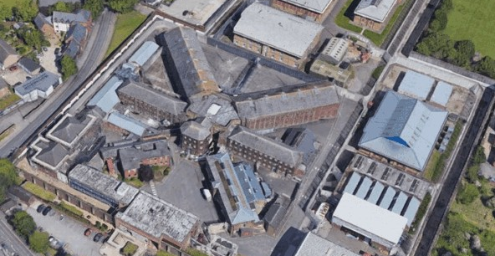
Prayer Focus: Prison Chaplaincy
From the beginning of the prison service the church, has been at the centre of prison care. Each prison within the EBA is required by law to run a Chaplaincy supporting prisoners of all faiths and none, with daily duties, 365 days a year:
• on arrival, often a time of shock, uncertainty, and fear, with no idea what to expect.
• on the segregation wing, where the most vulnerable and troubled prisoners may be held in segregated accommodation for their own safety or the safety of others.
• in healthcare, where there is a wide range of physical and mental health needs.
• before they leave custody.

Slide 2
Prayer Focus: Prison Chaplaincy
Chaplains also provide opportunities for worship and study as well as pastoral care for prisoners and staff of any faith or none. They journey with prisoners wondering about faith. They share amazing testimonies, celebrate baptisms and witness surprising spiritual encounters. They see prisoners discovering hope, some for the first time. They see the Holy Spirit bringing transformation to broken and troubled lives. They see John 1:5, ‘The light shines in the darkness and the darkness will not overcome it’. You can be part of this, as we enable ex-prisoners to become part of a faith community on the outside through The Welcome Directory.

