Slide 1
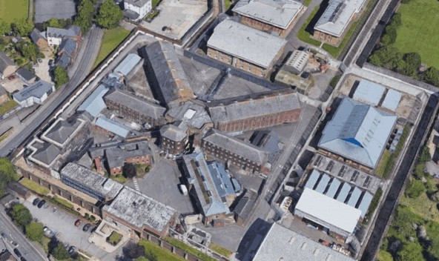
From the beginning of the prison service the church, and now multi- faith provision, has been at the centre of care provided to people detained by the courts. Within the EBA there are a number of prisons; each one is required by law to run a Chaplaincy supporting prisoners of all faiths and none, with daily duties, 365 days a year.
Every day a member of the chaplaincy team meets face to face with every prisoner:
• on arrival. Chaplains meet prisoners at a time of shock, uncertainty, and fear, often not expecting to find themselves in jail and with no idea what to expect next.
• on the segregation wing. Often, the most vulnerable and troubled prisoners may be held in segregated accommodation for their own safety or the safety of others.
• in healthcare, where there is a wide range of physical and mental health needs.
• before they leave custody.
Chaplains also provide support in attending a funeral of a close family member.
Prayer Focus: Prison Chaplaincy

Slide 2
On top of this, chaplains provide opportunities for worship and study as well as pastoral care for prisoners and staff of any faith or none. Chaplains journey with prisoners, wondering about faith for the first time as they have more time to think about the important things in life or are rekindling a neglected faith. They share remarkable testimonies, celebrate baptisms and witness spiritual encounters that take us all by surprise. They see prisoners discovering hope, some for the first time in their lives. They see the Holy Spirit bringing transformation to broken and troubled lives. They often think of the truth of John 1:5, ‘The light shines in the darkness and the darkness will not overcome it’.
You can be part of this too, as we seek to enable ex-prisoners to become part of a faith community on the outside through The Welcome Directory.
Prayer Focus: Prison Chaplaincy

