Slide 1
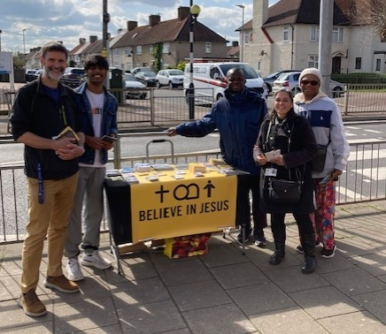
OLBC is in a changing, multi-ethnic community, which the church reflects. Neil Kinghorn is their minister. Outreach is at the heart of the church’s mindset. Weekly, a book table is placed outside local shops where people can learn about the church, and conversations are enabled. Blessings and fruit have resulted from this.
Bi-monthly a Christian/Muslim discussion takes place. Both faiths express their own perspectives on a topic, and learn about each other’s faith through open discussion. This is building bridges into the community in a loving and friendly way.
The church has some young people and a discipleship programme where they discuss the love of God to equip and encourage them to build on His foundation.
OLBC are ‘re-freshing’ their social media to be more visible to people seeking a church family with Christ Jesus and the great commission at the centre of all it does.
Prayer Focus: Oxlow Lane Baptist Church, Dagenham

Slide 2
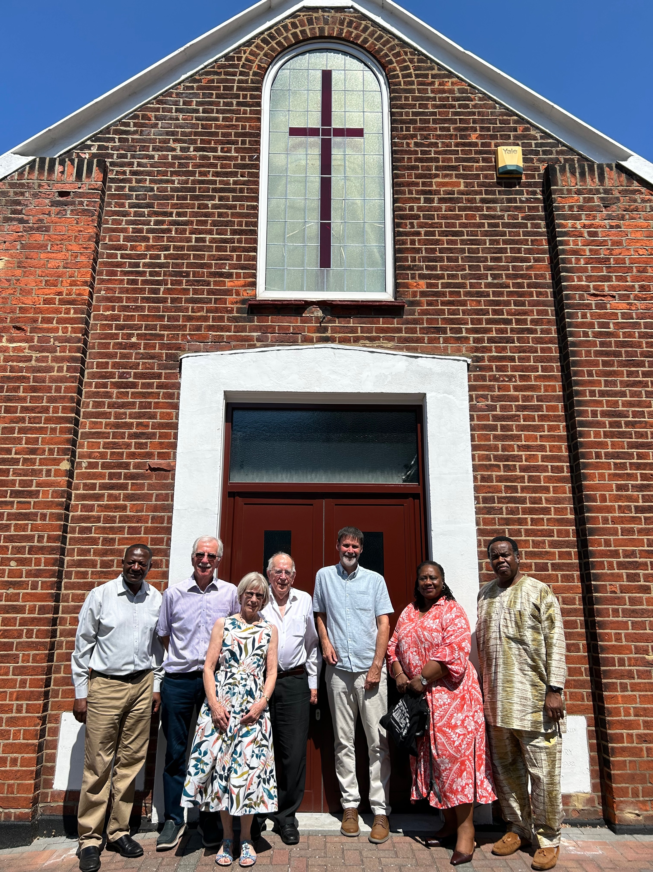
Gratitude to God is given as the Lord has added to their number since the pandemic and the church has rejoiced in seeing baptisms from across the age ranges.
Please pray with the church:
• That these ongoing and outward-reaching ministries keep growing, and this is an opportunity for the church to grow in the knowledge and love of God for His world.
• For Neil and his ongoing interaction with a Jehovah’s Witness who comes to study the Bible and chat with him about the Christian Gospel. This came about through the book table ministry, where this person passed, engaged and stopped to talk.
• For God to receive all the glory as they seek to reach the changing community of East London in their locality.
Prayer Focus: Oxlow Lane Baptist Church

