Slide 1
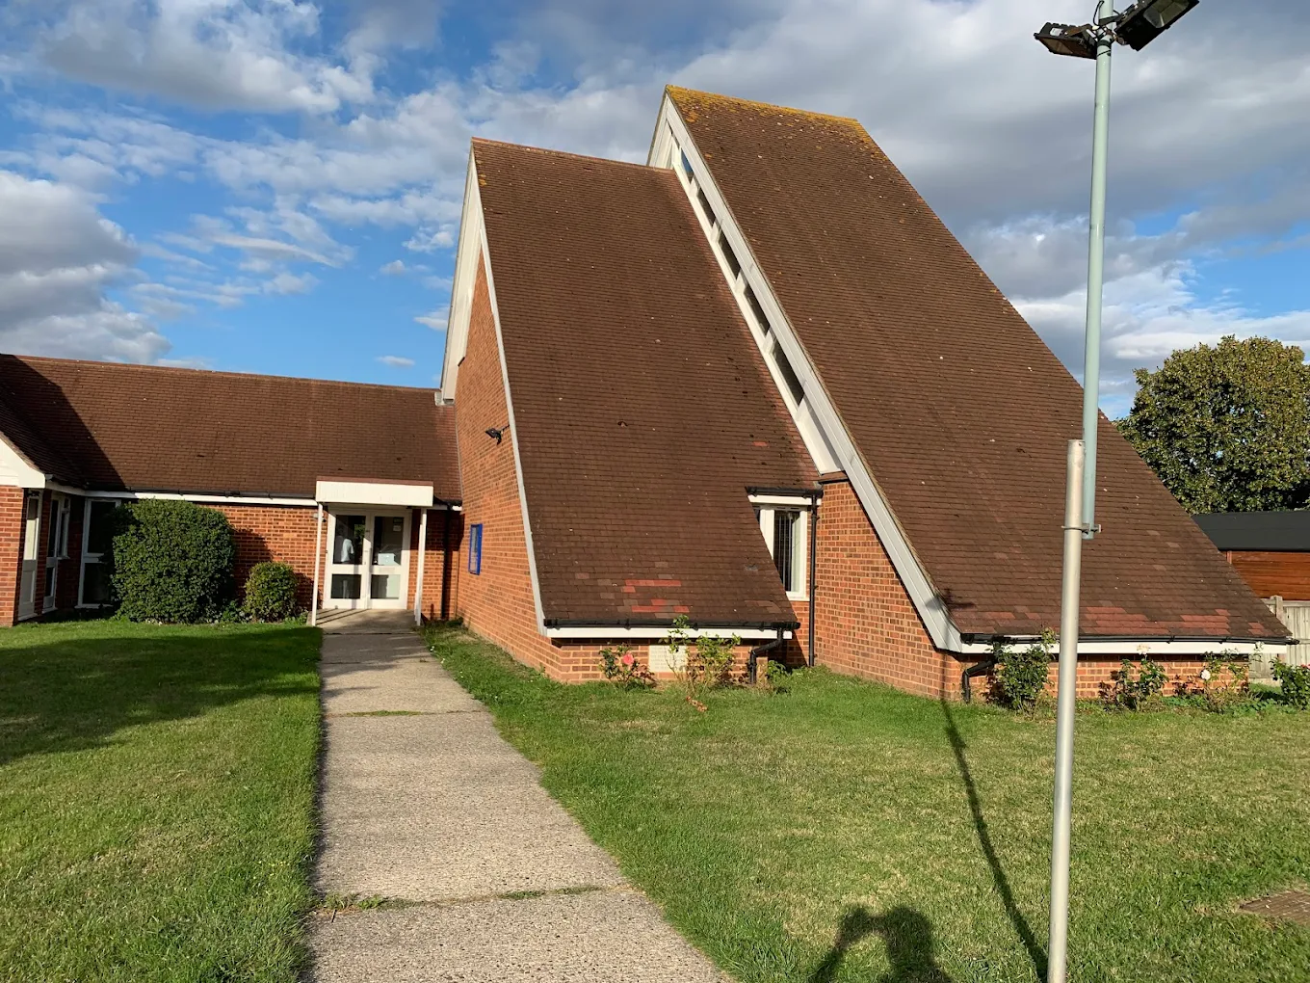
NSBC recently celebrated their fiftieth anniversary last November. The church lies in the centre of a big housing estate. Recently God answered prayer and they are welcoming new families, alongside being blessed to see a new multi-ethnic influx as part of the life of the church.
Regular activities throughout the week are: Happy Faces for 0-4’s; Coffee Morning; Kraft Club; Drop in at Church; a youth group; regular bible study, a praise and worship service, and prayer walks alongside weeks of prayer. The coffee morning is new but successful. Attendance has led to questions and requests for bible study. Encouragingly the youth group has two youngsters seeking baptism and some have become door greeters on a Sunday, with another wanting to join the flower rota.
Prayer Focus: North Springfield Baptist Church, Essex

Slide 2
The church has a deep desire to continue developing their outreach and senses that people are seeking but without knowing what they are seeking for. They find that people are receptive and long to reach into this. The church is without a minister, but exploration with a visiting preacher is occurring. There are high hopes for a new minister to be part of their outreach and for all ages to come to know the Lord Jesus. Prayer would be valued:
• For the discussions and further steps with a possible new minister; that this will combine with the church developing their outreach to the community around.
• That the church may continue in its service among the different groups but also build on going out into the community where the people are.
• Where a smaller number do a great amount, hopes are that this small church with a big heart will grow and develop to shine into their community for the Lord’s sake.
Prayer Focus: North Springfield Baptist Church

