Slide 1
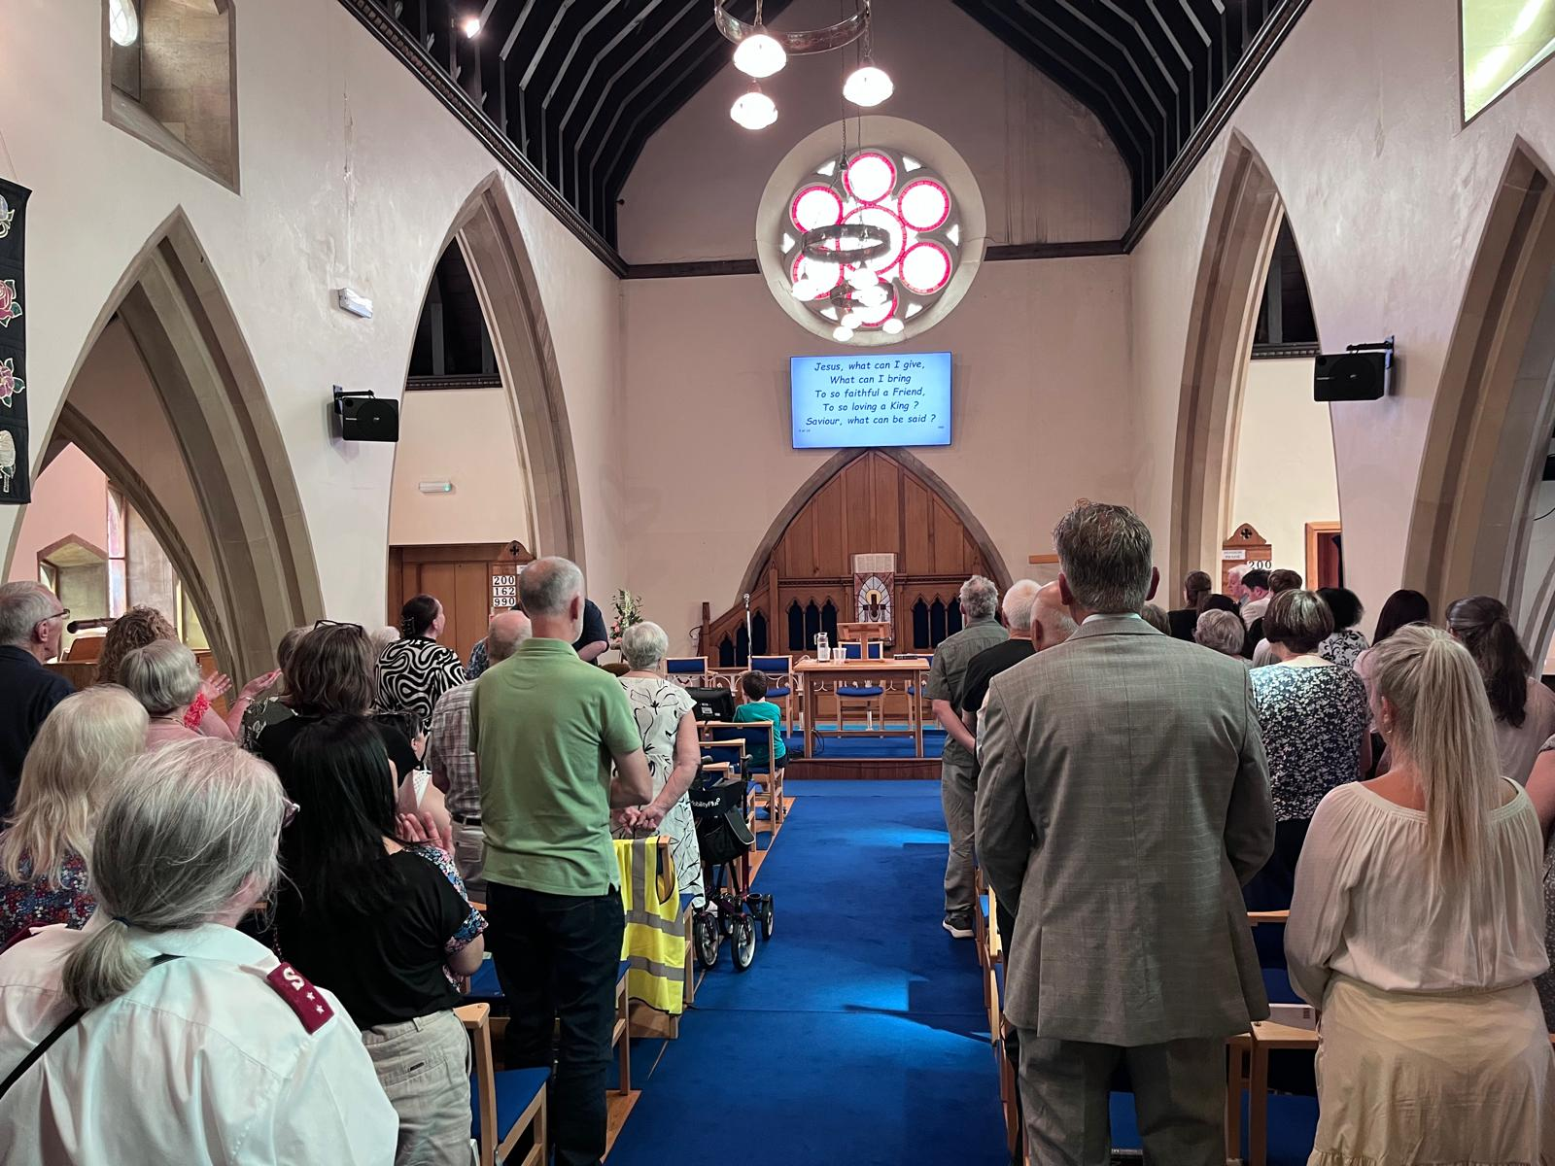
Wisbech Baptist Church is situated in the north-western corner of our region, in Cambridgeshire. Leadership of the church has recently been taken on by Amy and Dave Barker, who have moved from Coventry. Amy is also employed by the EBA as its Director of Vocations, while Dave is working for the Methodist Church, starting an outdoor garden church
A move from Coventry to the Fens is a big change for Dave and Amy and their three children, and they are enjoying getting to know the members of their fellowship. On a Sunday morning, around 40 people attend weekly worship at the church, which is situated on Wisbech High Street. The fellowship is becoming more diverse, with international members and some children. Dave and Amy are exploring ways of welcoming local children into the church over the summer holidays.
Prayer Focus: Wisbech Baptist Church

Slide 2
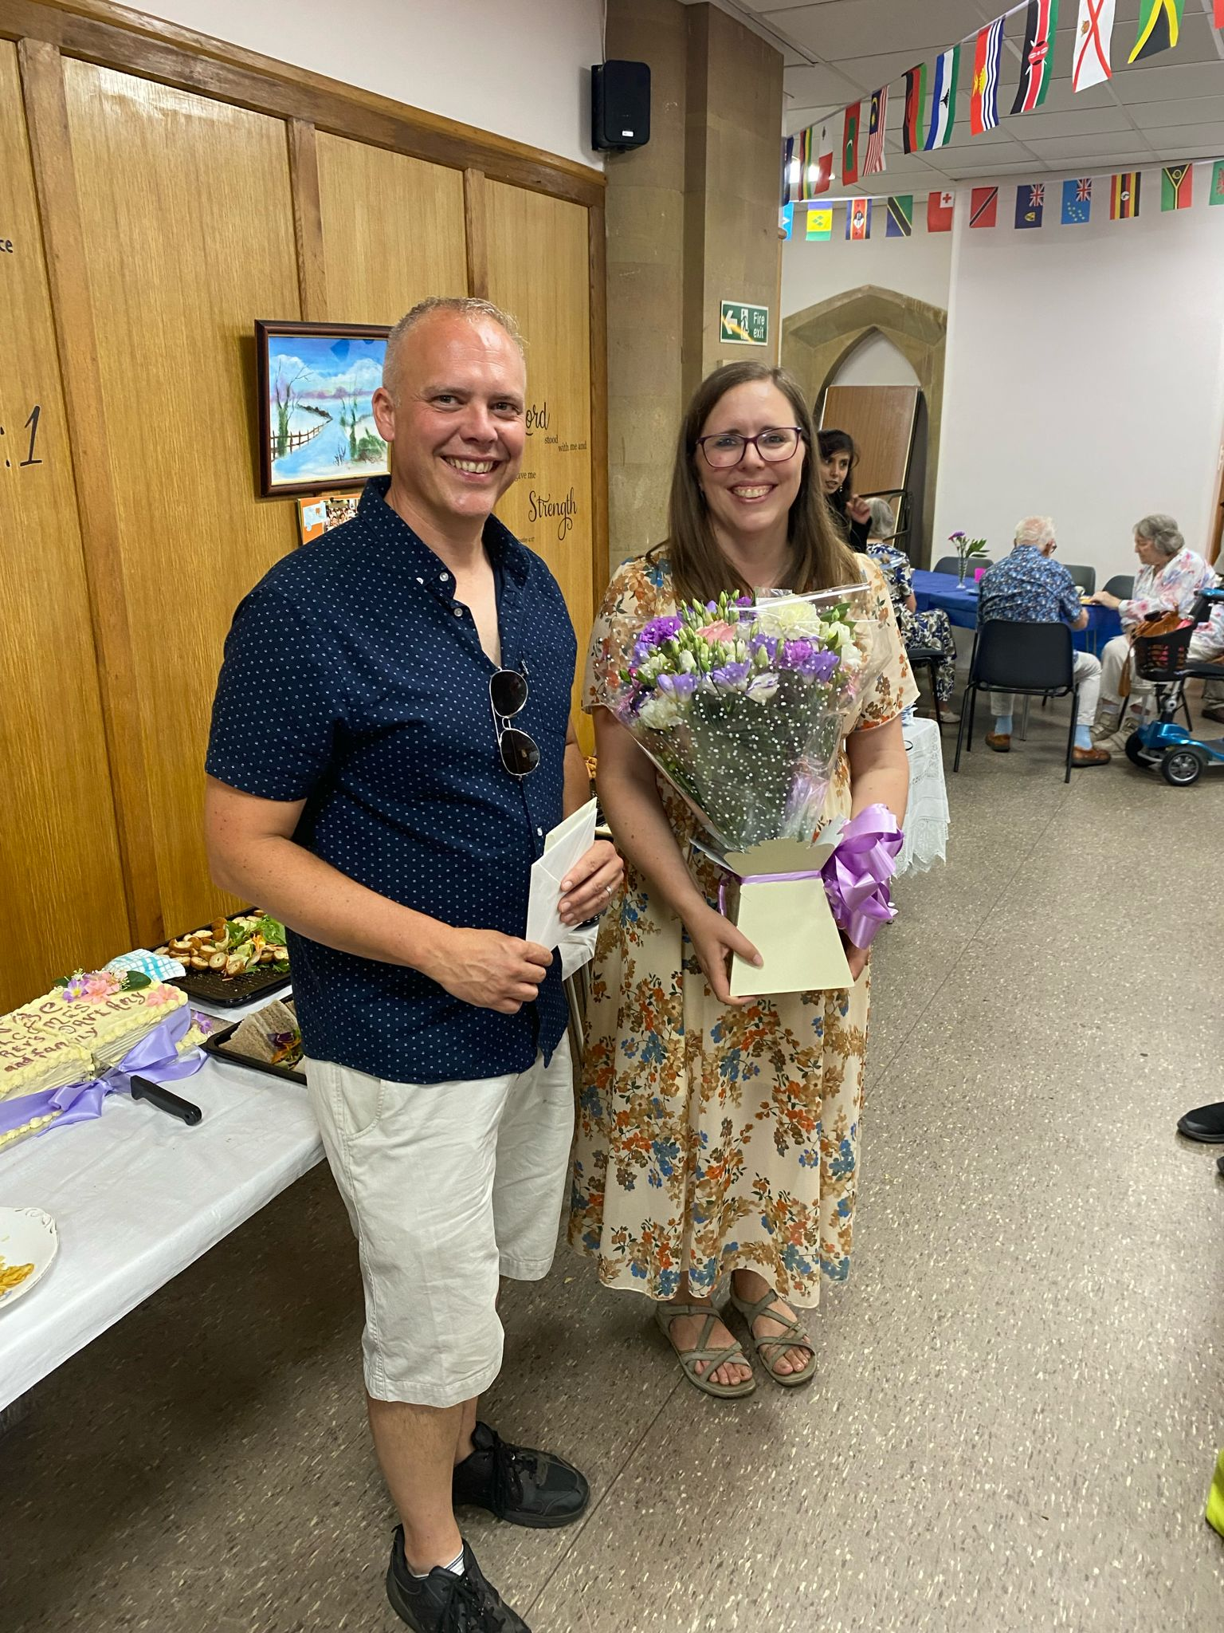
On Monday mornings, the church is open for those who are dropping in for coffee, and the local food bank uses the premises on three days of the week. On Sunday afternoons, “Lite Bites” provides an opportunity for the community to share food together and study the Bible.
Please pray for the church as it celebrates Dave and Amy's induction service and for the local community they were able to invite.
Please also pray for Dave and Amy, and the rest of the leadership team, as they seek God's vision for the future of Wisbech Baptist Church.
Prayer Focus: Wisbech Baptist Church

