Slide 1
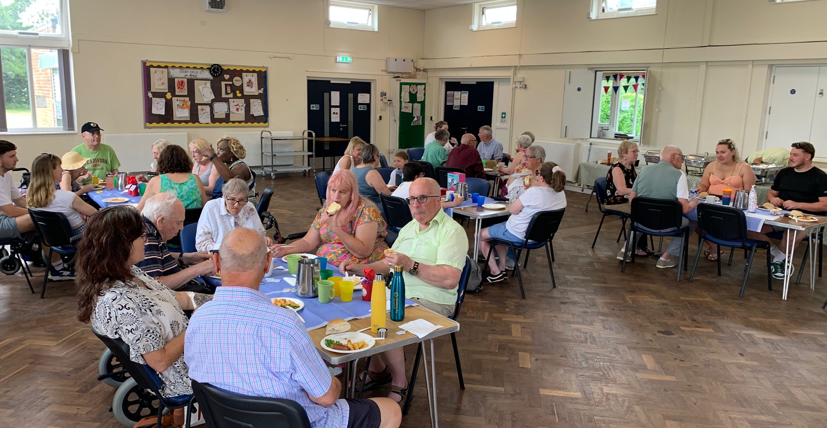
Prayer Focus: Pilgrims Hatch Baptist Church, Brentwood
PHBC worships in a Community Centre at the heart their residential suburb. The church is very community focused, with close links to a charity for community meals, and a PHBC baby bank charity for baby equipment and clothes. There are two house groups, a prayer meeting, and a service in the local care home.
Their current attendance comprises mainly of middle aged to elderly, although encouragingly a younger family has joined. Manpower can be an issue, but they have been encouraged throughout their ministerial vacancy as they have pulled together. They see this as a God-given strength due to their closeness as a church family.

Slide 2
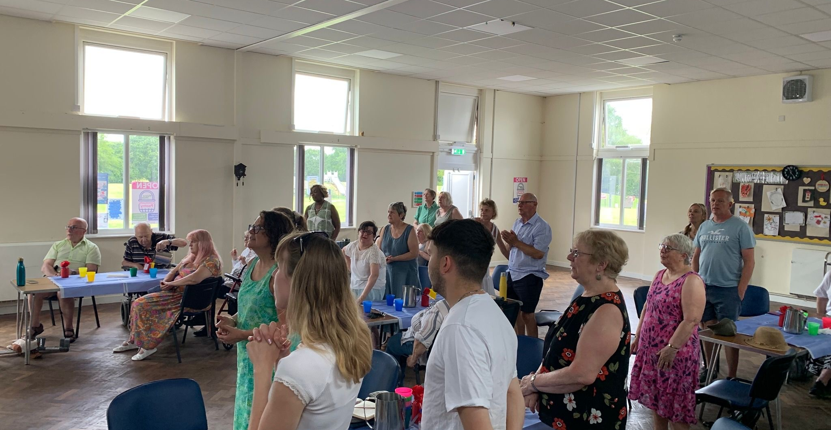
Prayer Focus: Pilgrims Hatch Baptist Church
Exciting times lie ahead as they have called a new minister who starts in August and who shares their vision as a community focused church. This will really help to remotivate and envision them further into the future. Prayer is valued for:
• Their new minister, her husband and three sons as they relocate and settle in.
• The planning of and arrangements for the coming induction on 19th September.
• That new families will be led by God into the church.
• That God will bless them as a church and lead them forward under their new leadership, so the community around will see the light of Christ radiating from them.

