Slide 1
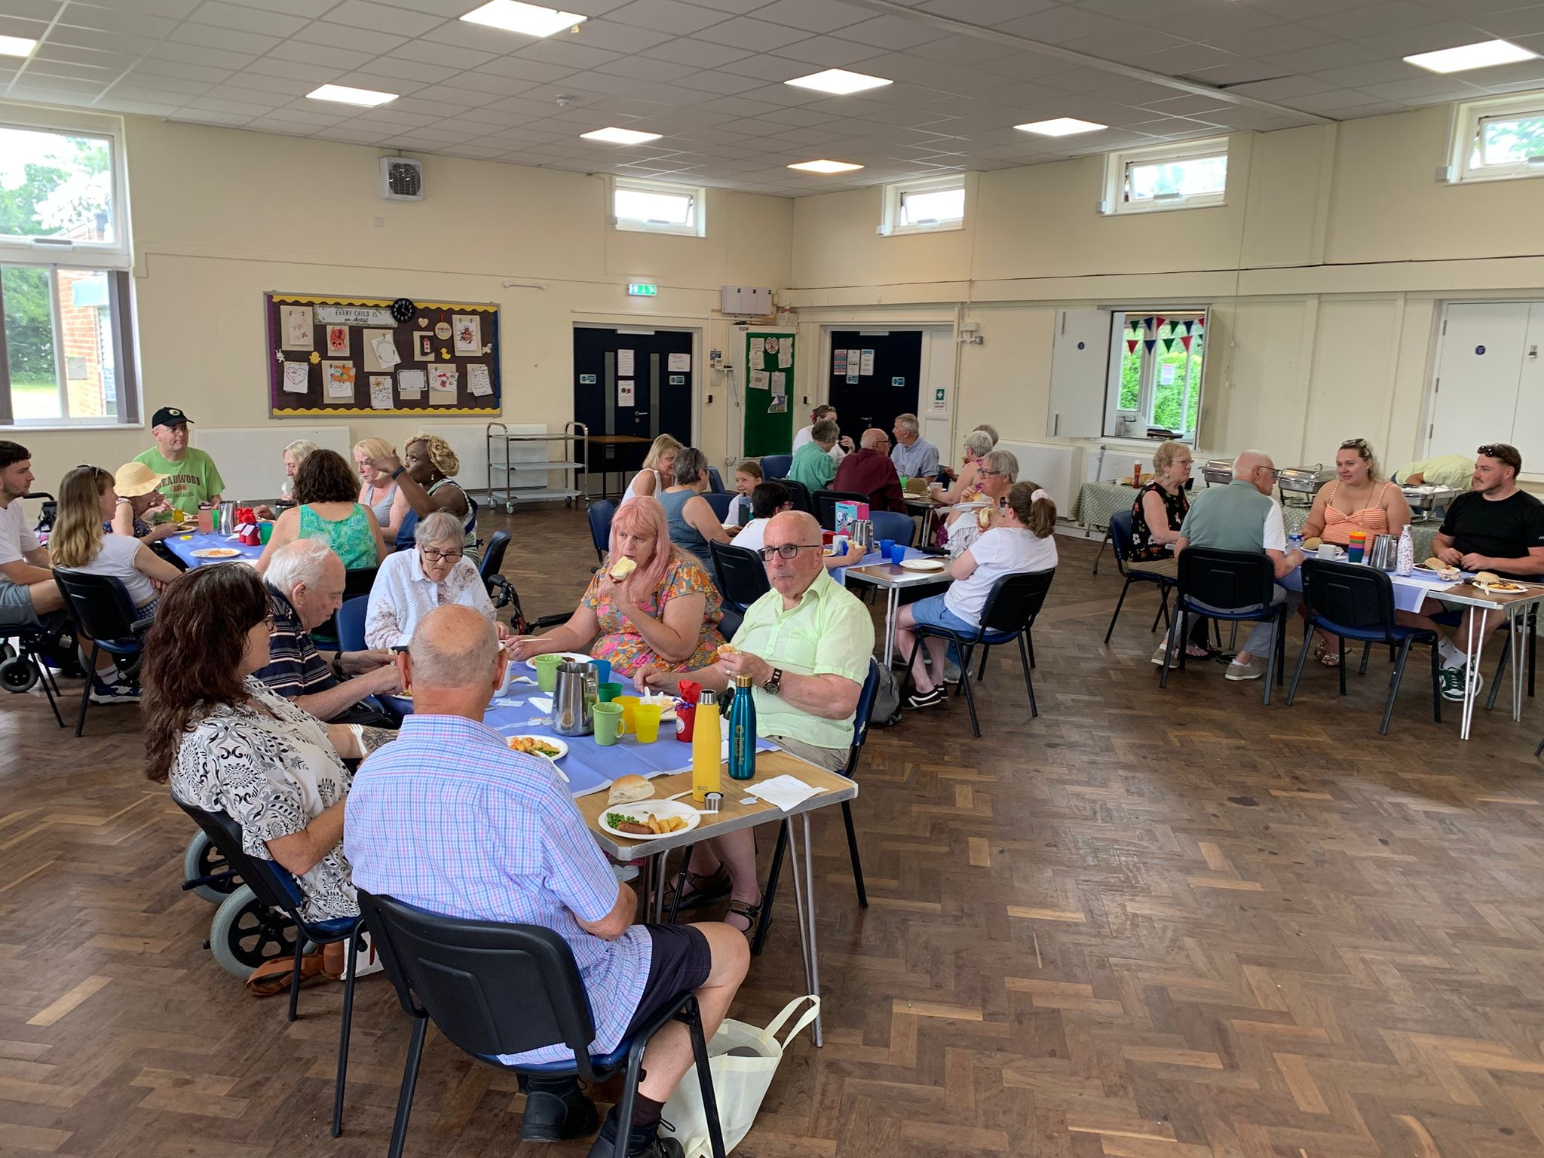
PHBC worships in a Community Centre which lies at the heart their residential suburb. The church is very community focused and has close links to a local charity called Manna Meals which provides community meals, and a baby bank charity set up and run by PHBC for baby equipment and clothes to help those who need it.
There are two house groups, a prayer meeting occurs twice monthly, and some individuals also run a service in the local care home.
Their current attendance comprises mainly of middle aged to elderly, although encouragingly a younger family has recently joined. Manpower for activities and general help can be an issue, but they have been encouraged all the way through their past ministerial vacancy as they have pulled together despite being smaller. They see this as a God-given strength due to their closeness as a church family.
Prayer Focus: Pilgrims Hatch Baptist Church, Brentwood, Essex

Slide 2
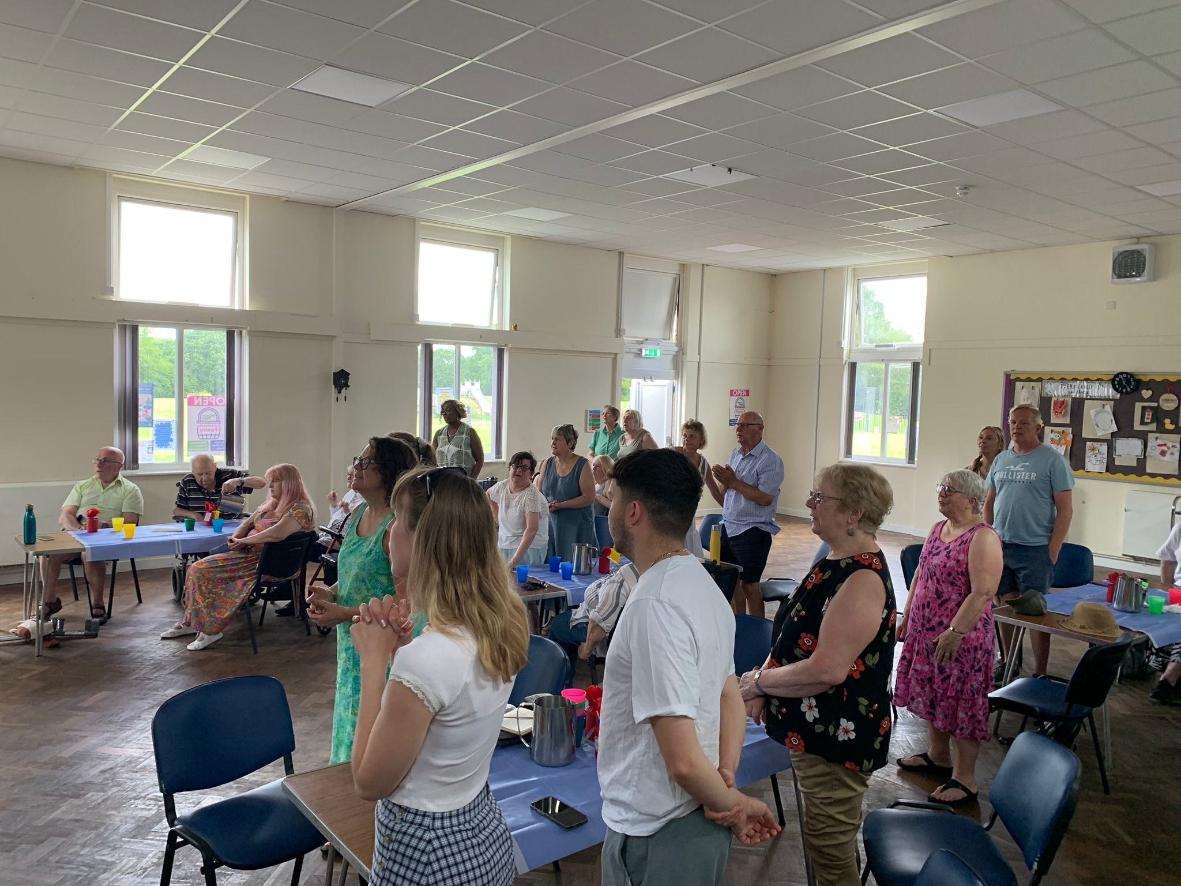
Exciting times lie ahead as they have recently called a new minister who will start with them in August and who also shares their vision as a community focused church. This will really help to remotivate and envision them further into the future.
Prayer is valued for:
• Their new minister, her husband and three sons as they relocate and settle in.
• The planning of and arrangements for the coming induction on 19th September.
• That new families will be led by God into the church.
• And that God will bless them as a church and lead them forward under their new leadership, that the community around will see the light of Christ radiating from them.
Prayer Focus: Pilgrims Hatch Baptist Church

