Slide 1
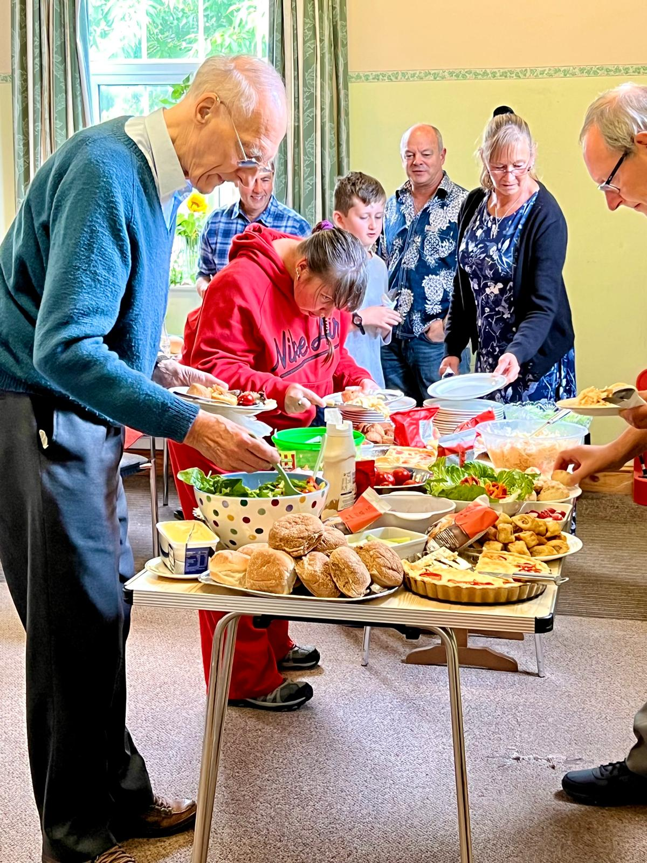
Prayer Focus: Worstead Baptist Church, Norfolk
Life in a small rural church varies from a town or city, with the struggle with admin and building repairs being real. Though few, its members love, support, refresh, restore and sustain one another and those whom God has sent. These include society’s most vulnerable.
The church is very alive spiritually, wanting to be part of Kingdom growth. Sunday services are café-style. It holds a Bible study, plus a prayer meeting with Canaan Christian Centre. Recently, it has filled its hall with special services, including a pet service and welcomed a group from Hungary

Slide 2
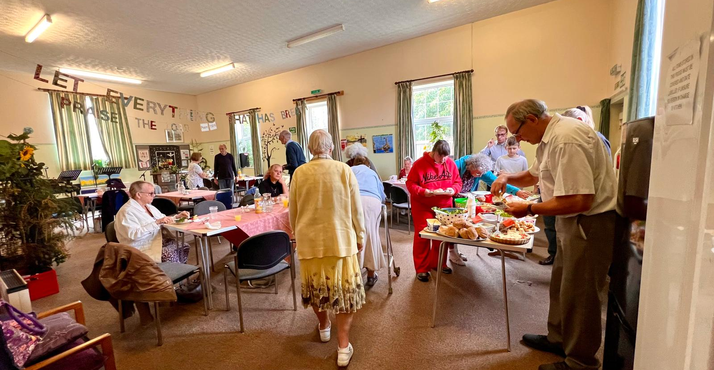
Prayer Focus: Worsted Baptist Church
Please pray for
• The church to be blessed with new people: including those who have gifts of admin and policy making
• The folk with long-term health needs who see the church as being there for them
• The difference the church is making in the lives of those in its small community and beyond.
• Its commitment and partnership with Canaan Christian Centre

