Slide 1
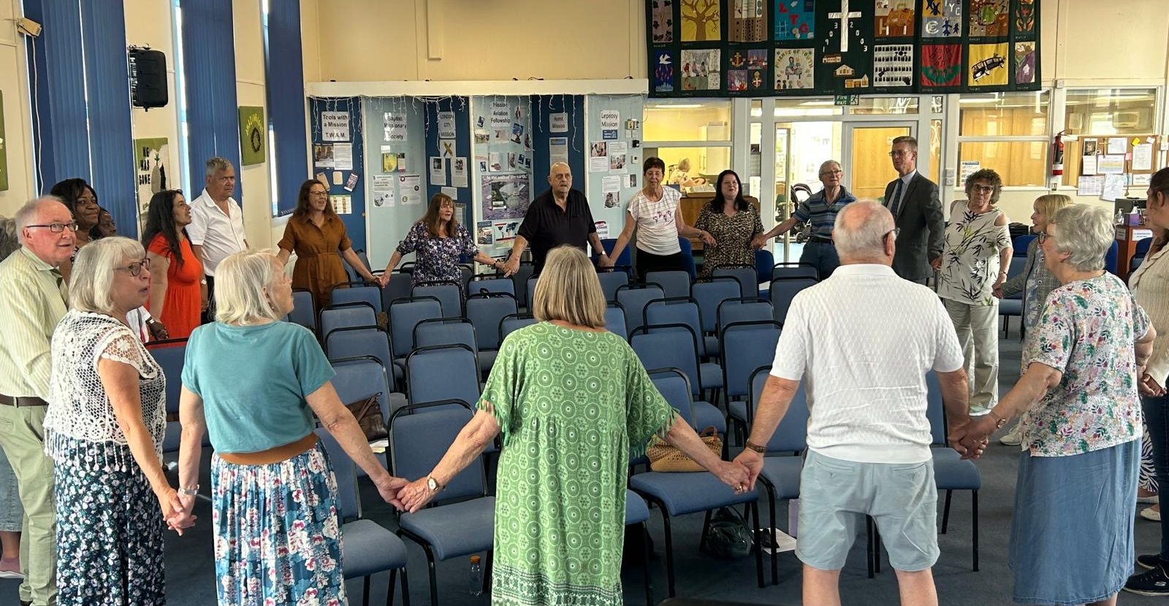
Prayer Focus: Canvey Island Baptist Church
CIBC is a congregation who believe in God, know His love and share that love with their community. With their new minister, Andrew James, they have agreed a focus on: the strength of their unity, filling their hearts with more love for God and finding new ways to help their community. Since Andrew’s induction, they have enjoyed close fellowship and have been encouraged by joint events with local churches. They are grateful that the love and support amongst these churches is so nurturing.
To aid growth CIBC have created a website, children’s activity table, prayer corner, and book-sharing area.

Slide 2
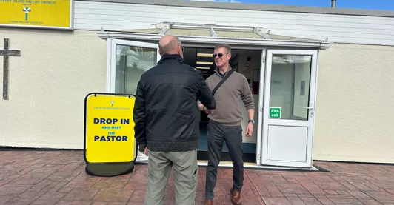
Prayer Focus: Canvey Island Baptist Church
Last November, three members were baptised, and they have just completed a six-week Discipleship course to nurture these new Christians. A number of older folk in the faith join the course, which has added real richness to the conversation. They have recently welcomed two new members, which is a testament to the love and care people feel when they first visit the church. Please join them in praying:
• That they will see the fruits of the discipleship course.
• That church friends will choose to become members.
• For growth in the children’s work

