Slide 1
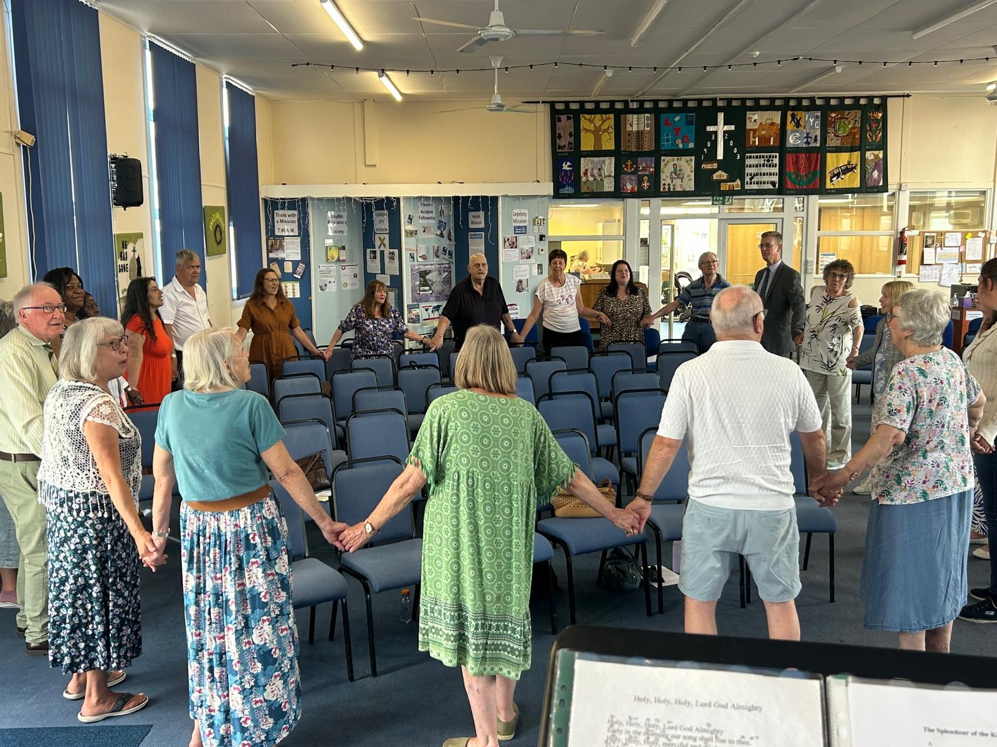
CIBC is a congregation who believe in God, know His love and share that love with their community. With their new minister, Andrew James, they have agreed that their focus is on three things: the strength of their unity, filling their hearts with more love for God and finding new ways to help their community. Since Andrew’s induction, they have enjoyed close fellowship and have been encouraged by the strong ties with other local churches. The inter-church work has included breakfast meetings, Maundy Thursday meal, walk of witness, and Pentecost Picnic. They are grateful that the love and support amongst these churches is so nurturing.
At CIBC, their first challenge was creating a website. In addition, they have set up a children’s activity table, a prayer corner, and a book-sharing area, each serving a much-needed purpose and helping their growth as a church family.
Prayer Focus: Canvey Island Baptist Church

Slide 2
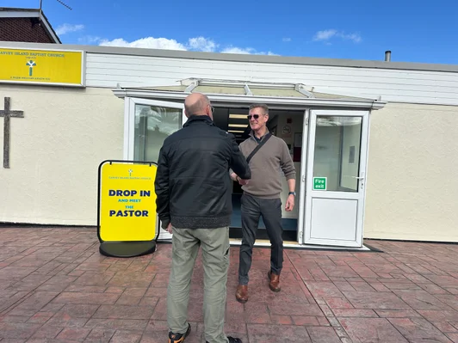
Last November, three members were baptised, and they have just completed a six-week Discipleship course to nurture these new Christians. It has been wonderful to see a number of older folk in the faith join the course, which has added real richness to the conversation. Andrew is delighted that very early on his pastorship, they welcomed two new members, which is a testament to the love and care people feel when they first visit the church. The church is currently praying and seeking guidance on how to express the value of membership to committed worshippers who are not yet members. Please join them in praying:
• That they will see the fruits of the discipleship course.
• That church friends will choose to become members.
• For growth in the children’s work
Prayer Focus: Canvey Island Baptist Church

