Slide 1
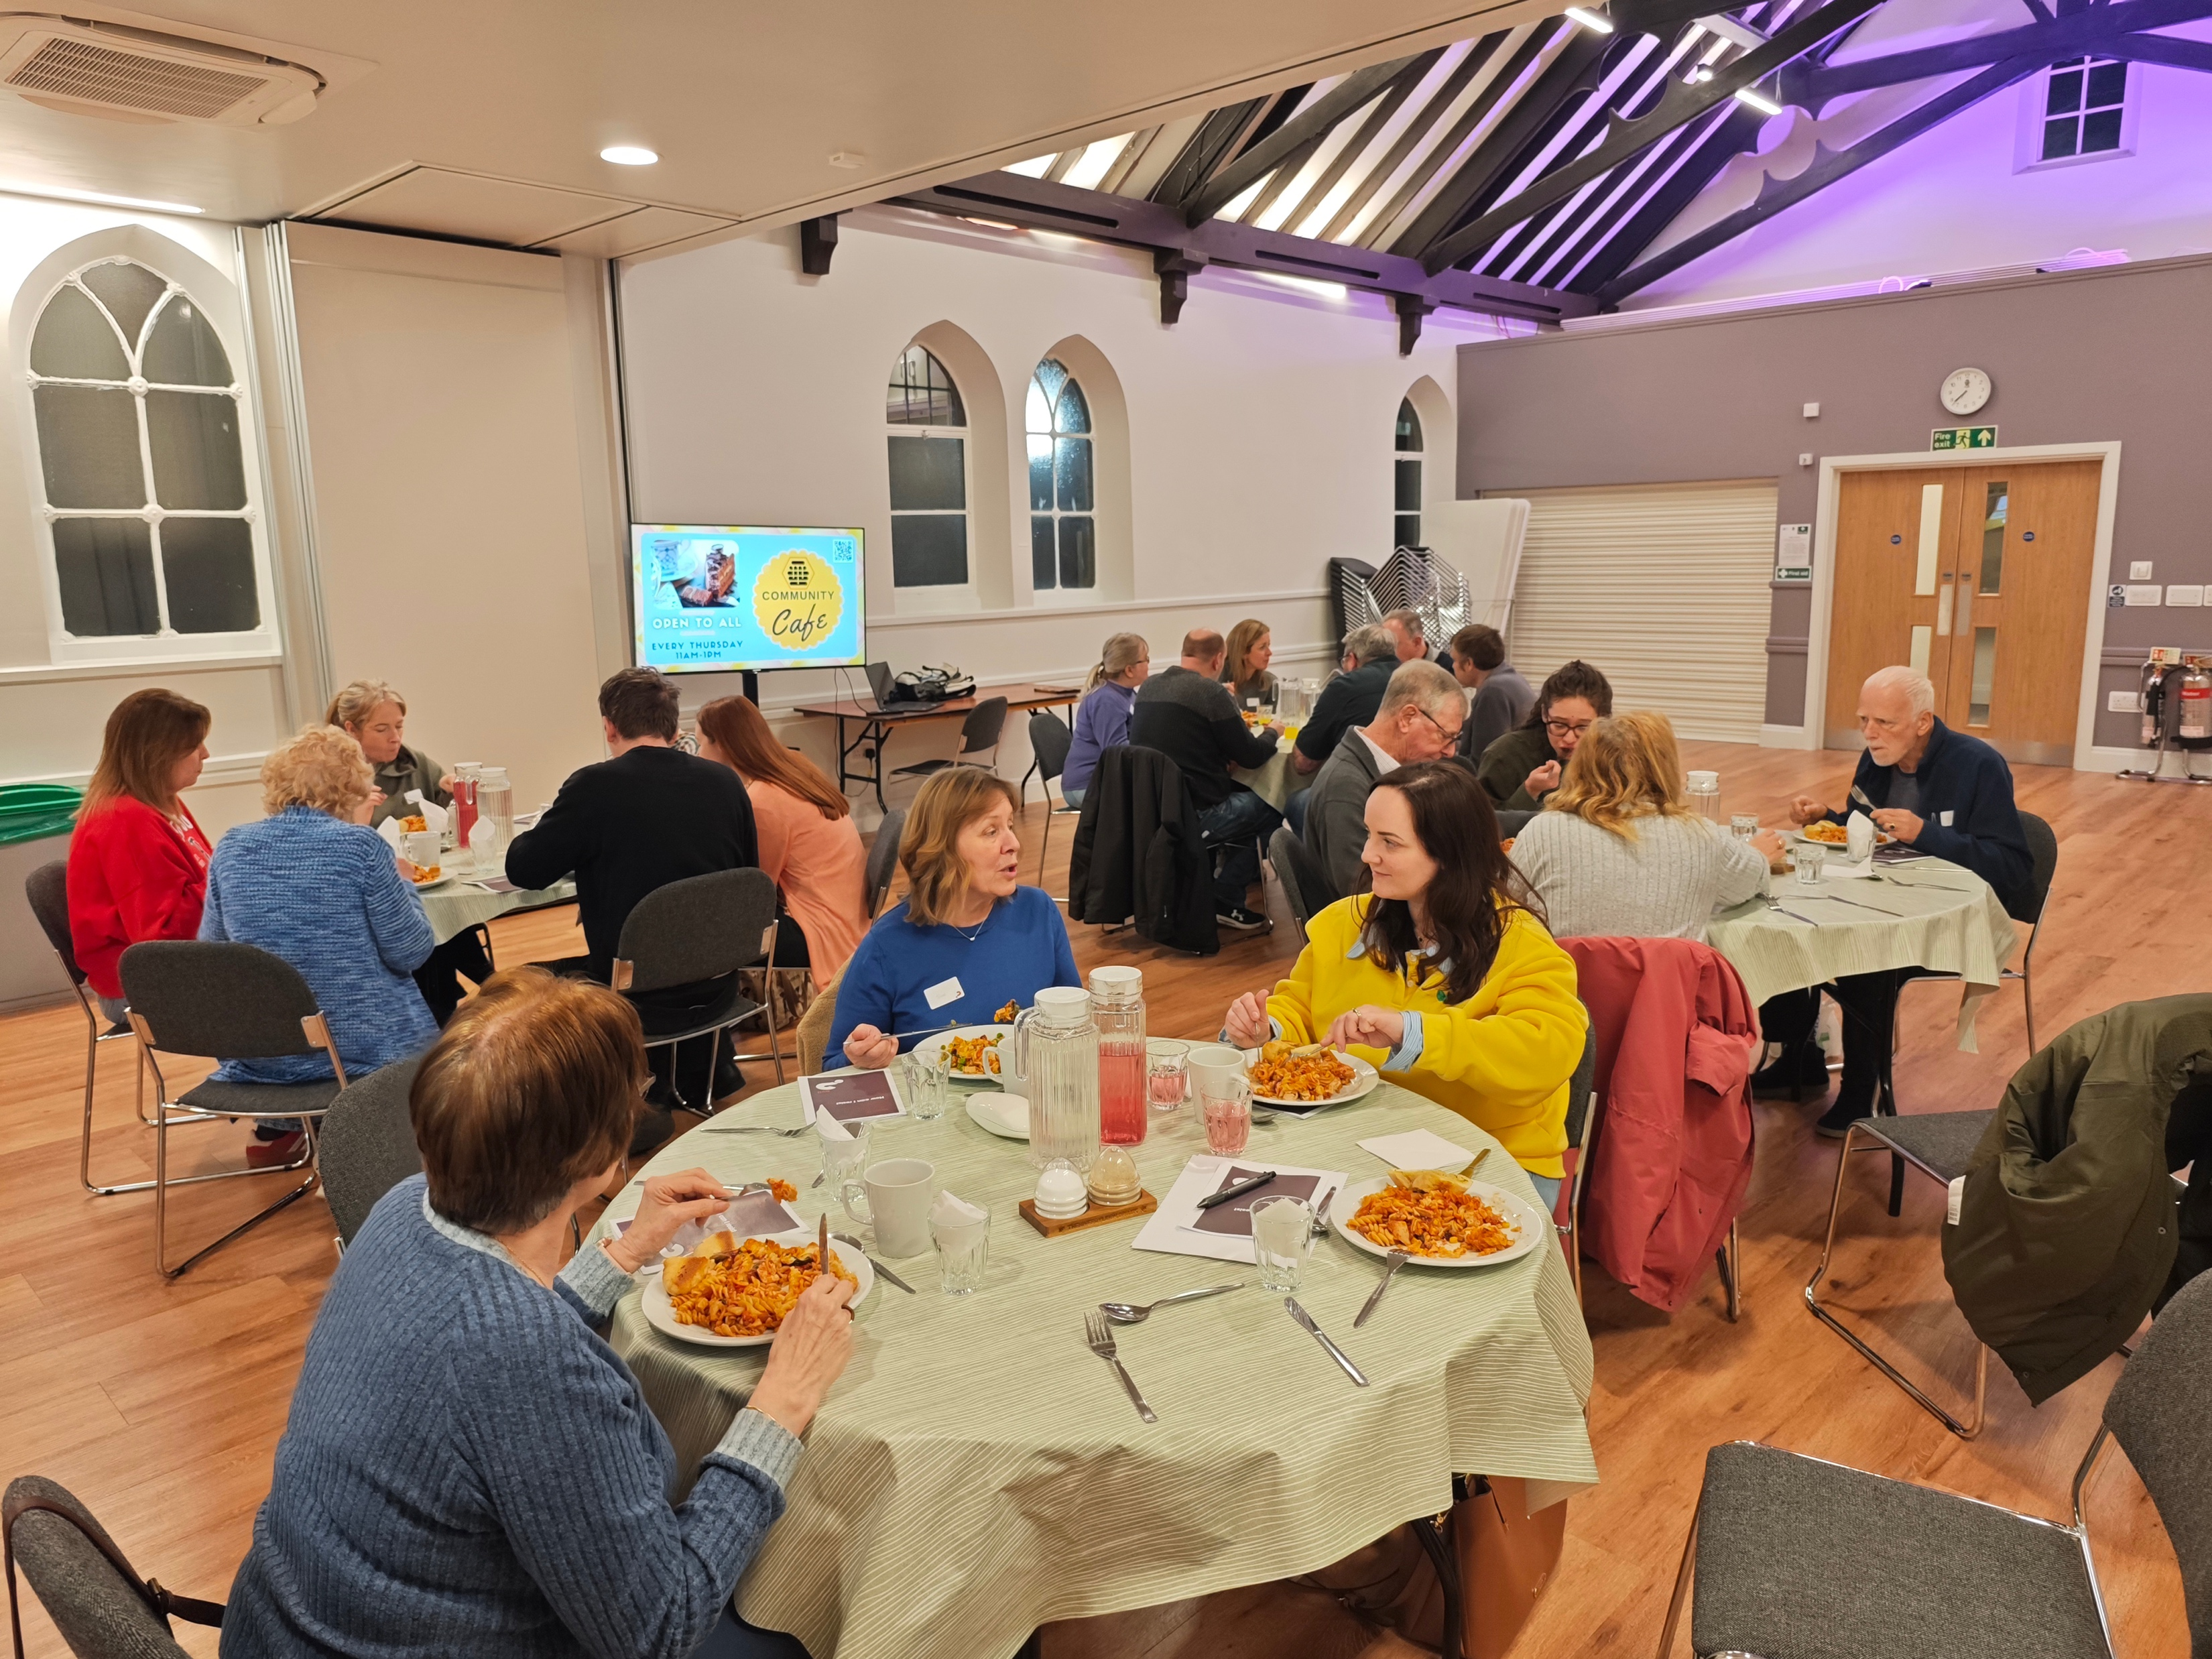
Rayleigh is a vibrant, growing professional town. Rayleigh Baptist Church is similarly a vibrant church with a strong focus on family and community work. Following a period of mourning for some in its fellowship who died, the church is in a season of joy as it sees God’s blessings emerging, through its community outreach. 15 months ago, the church welcomed a new Community Minister, Michelle, to serve alongside Ricky, the Lead Minister; its Alpha and Begin with Jesus courses have created new disciples; the church held a baby blessing service for new families coming to the church through its baby group; and its new community centre, The Hive, has increased missional opportunities and strengthened partnerships with local groups. Church activities include ‘Bump to baby’, parent and toddler and young children’s groups, a community café, seniors’ ministry, and partnerships with schools and community nursing team.
Prayer Focus: Rayleigh Baptist Church

Slide 2
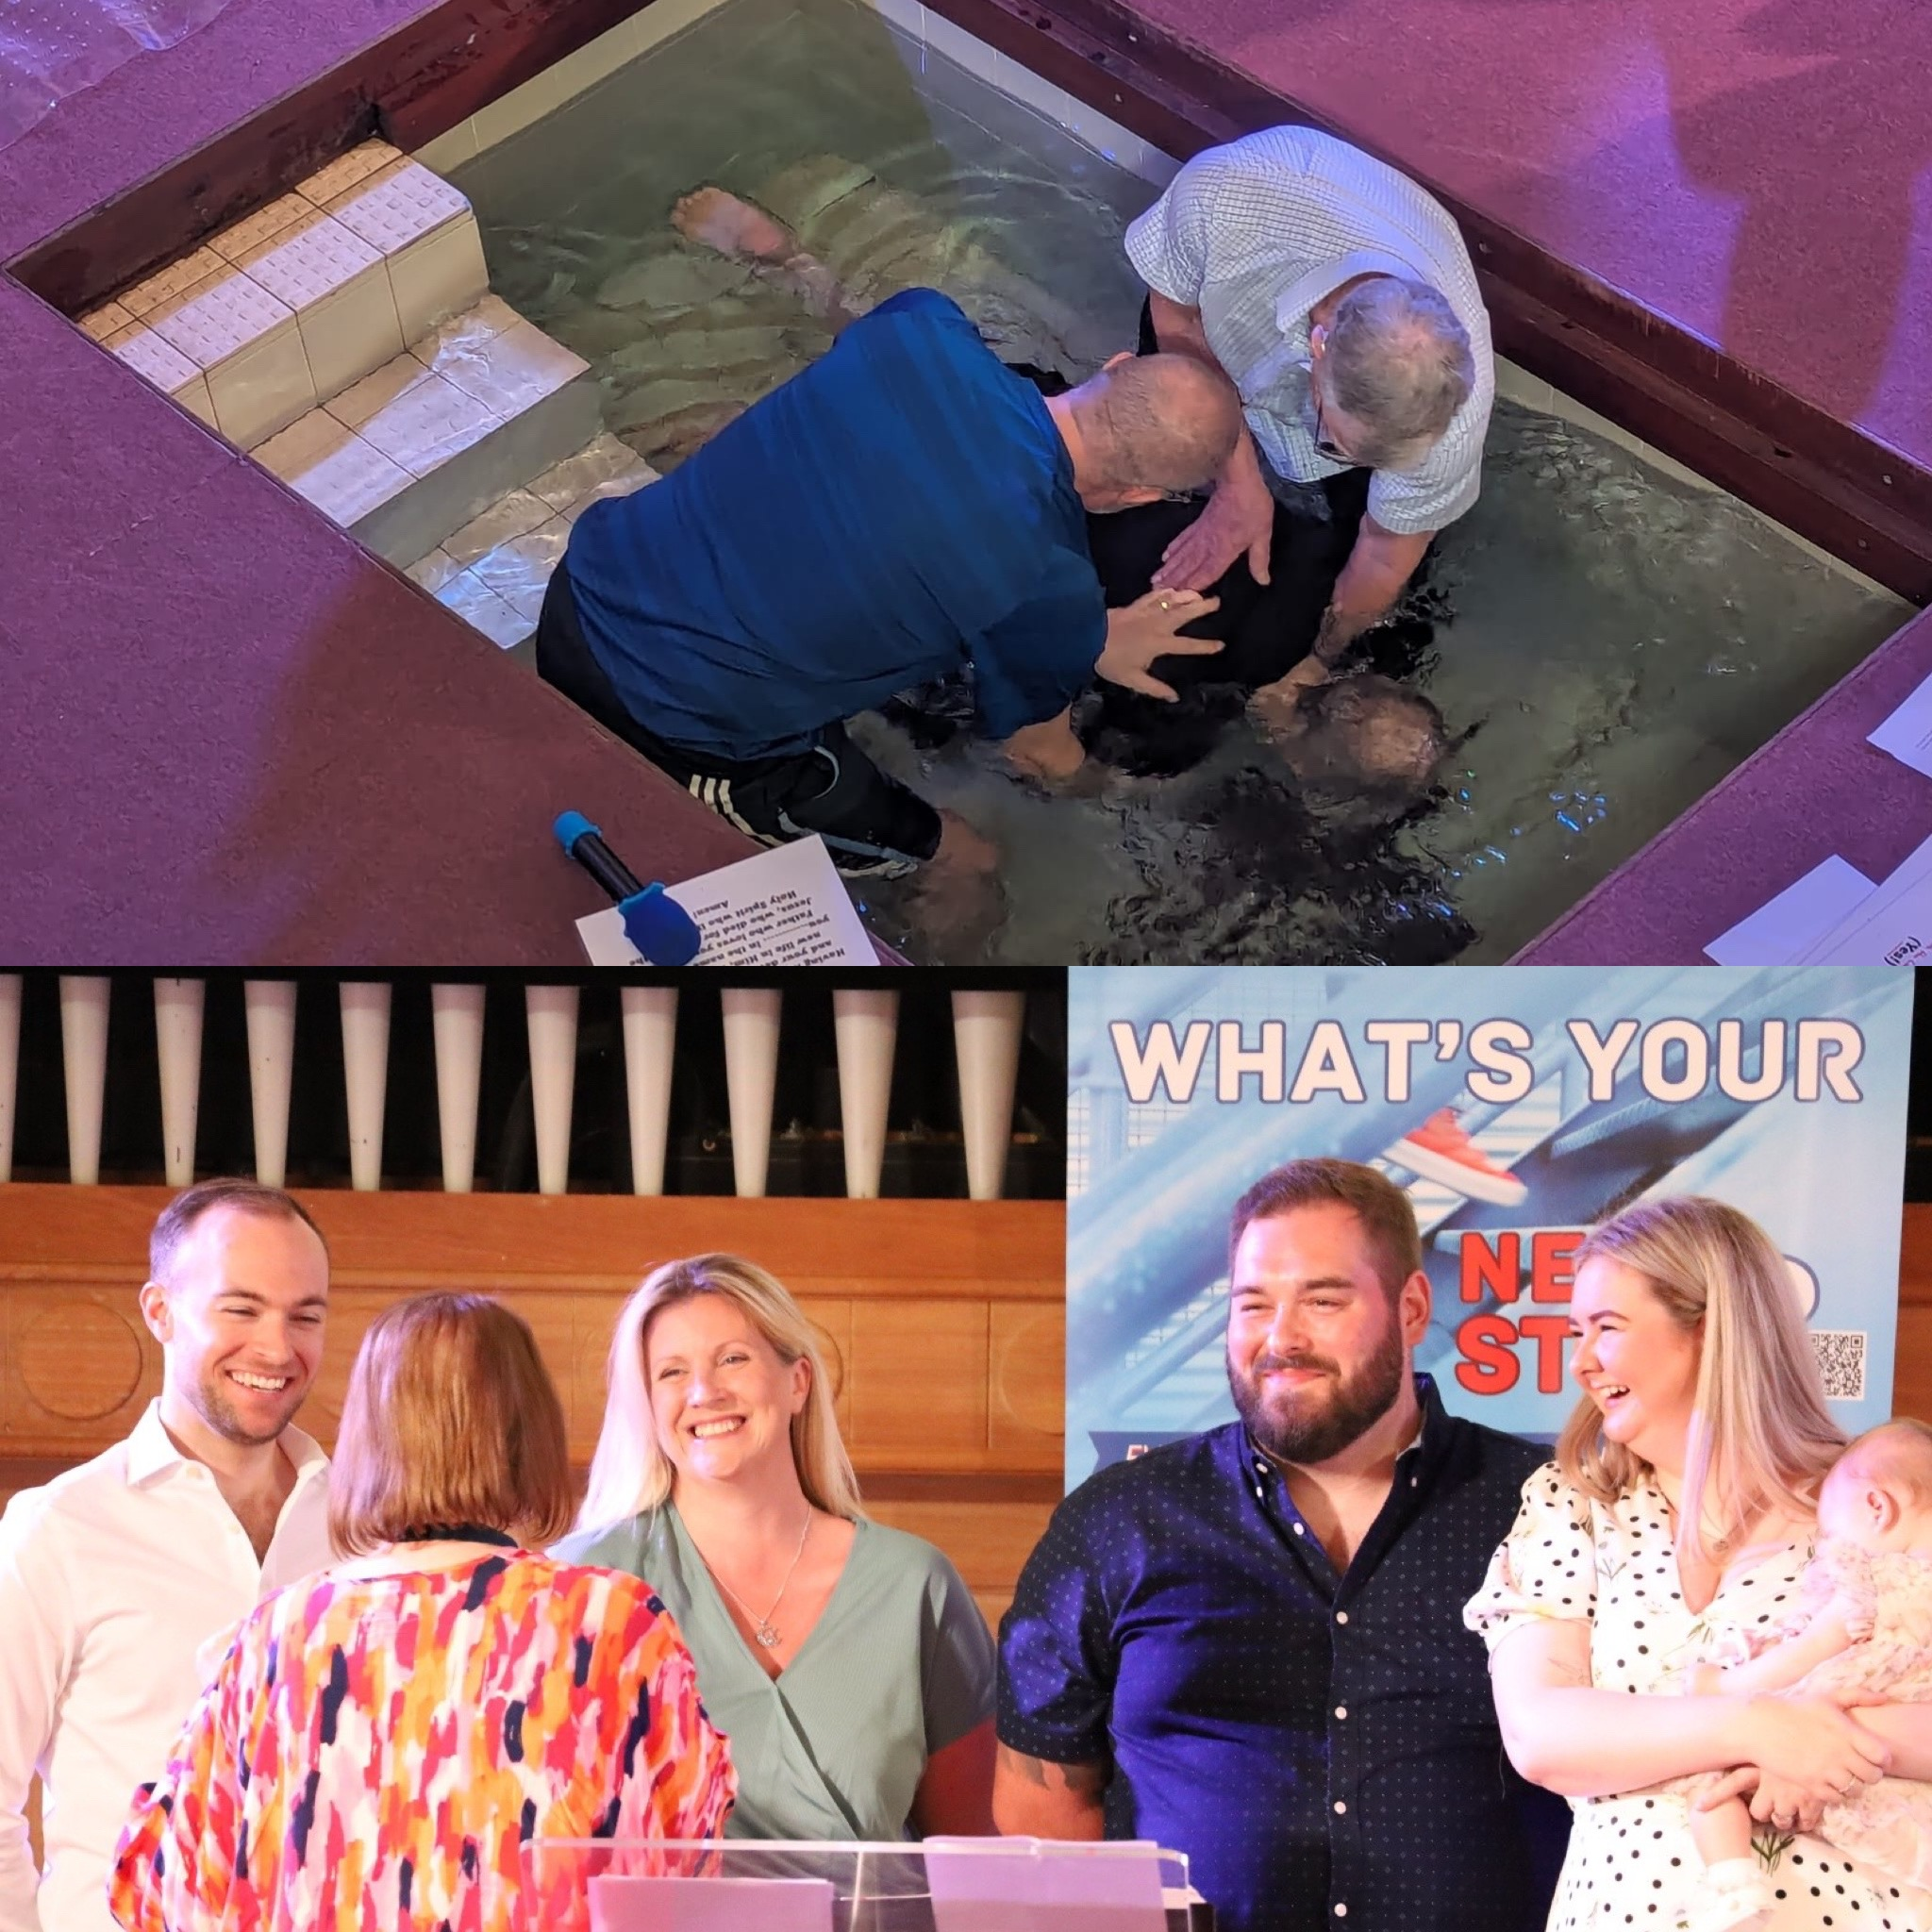
To bless the local community, the church is planning a community ‘Fun Day’, in July, with activities from the newly born to those aged 99+. With the growing number of new people joining regular worshippers on a Sunday, the church feels God is ‘enlarging its tent’ and is seeking His discernment on whether to hold a second morning service. Please pray for
• Godly wisdom and discernment on a second Gathering for morning worship
• A continuing and progressing intergenerational focus
• God’s revelation and guidance on new missional opportunities in the town to help make and grow disciples.
• The Community Fun Day
• The new youth space, commencing September 2026
Prayer Focus: Rayleigh Baptist Church

