Slide 1
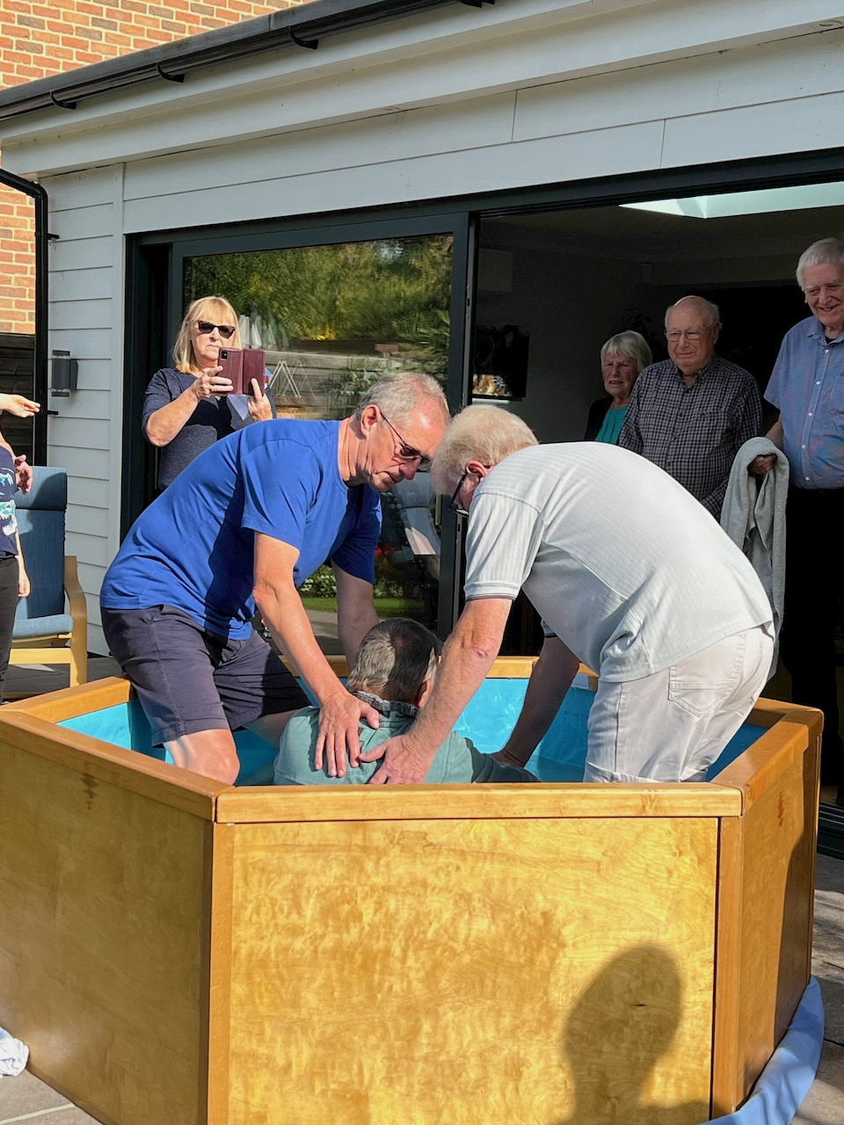
Prayer Focus: Parsons Heath Baptist Church, Colchester
Parsons Heath is a small church community with a passion for prayer, and a longing for encounter with Jesus. In 2016, they received a specific call to stop their busyness, and seek God’s guidance for their future and mission. This became a whole-life discipleship focus and a call to be missional in their everyday lives.
Prayer times are weekly highlights as they surrender before the Lord. They have meaningful worship in Zoom, with opportunities for participation, which have blessed those who find access to buildings difficult. This enabled the older congregation to participate, renewing a sense of value, purpose & growth.

Slide 2
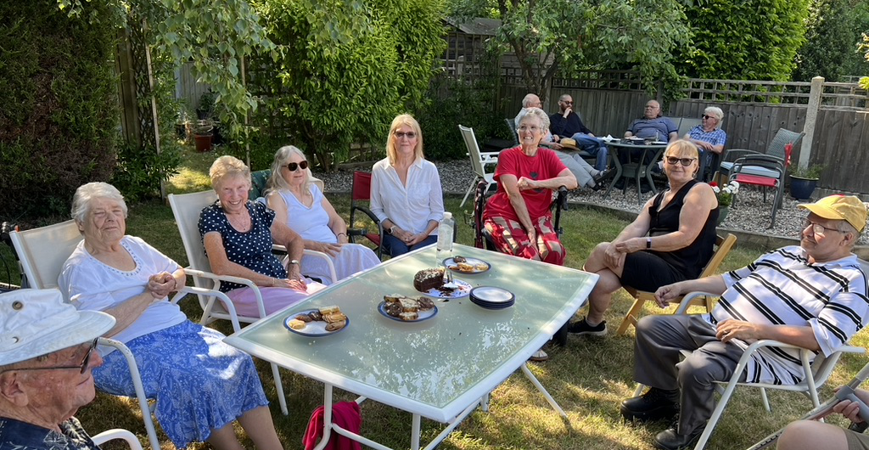
Prayer Focus: Parsons Heath Baptist Church
Recently, the Church was prompted to sell its building, and to step into their new calling, and continue their specific journey with the Lord. Prayer Points:
· Give thanks that they were able to clear and sell their building quickly and with relative ease – an example of God’s continued extraordinary timing and provision.
· Ask God to lead and grow their fellowship, as they seek to be a blessing for others who struggle to access conventional church.
· That they will know the Lord’s direction from this current moment of transition.
· For wisdom in sharing “the story of their specific calling” on their website

