Slide 1
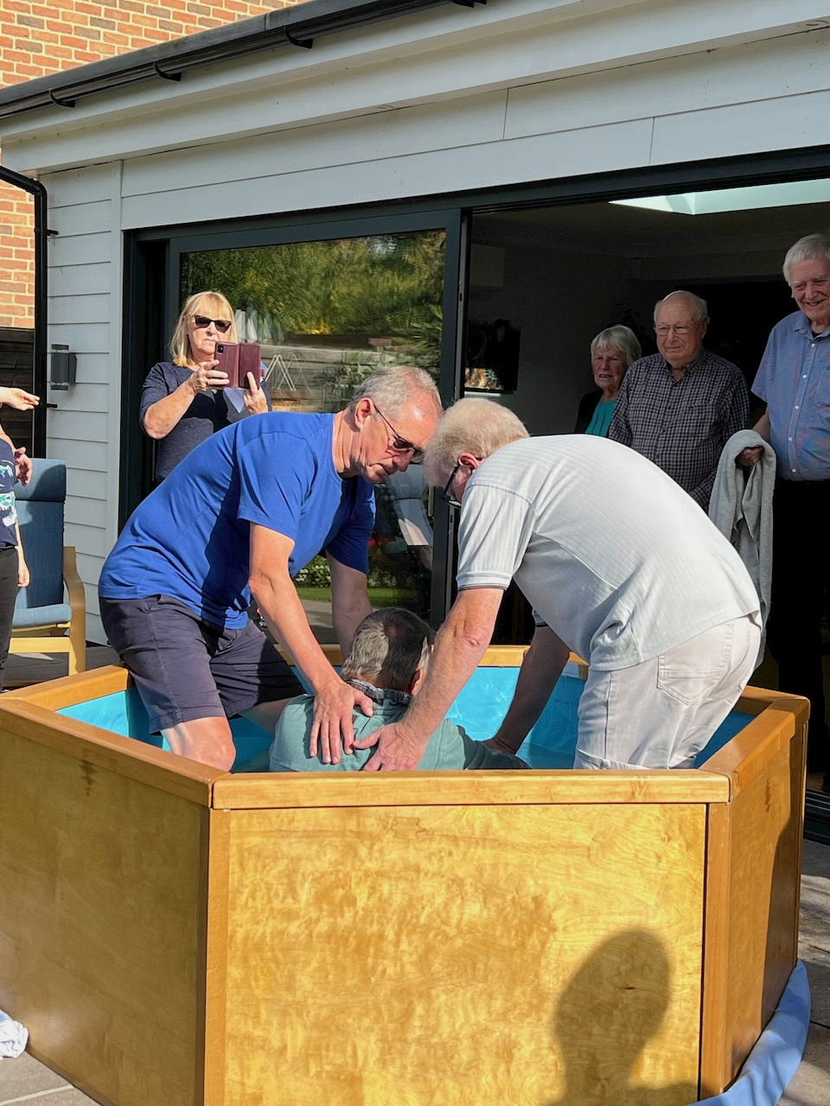
Parsons Heath is a small church community with a passion for prayer, and a longing for encounter with Jesus. In 2016, they received a specific call to stop their busyness, to be still before the Lord, and seek God’s guidance for their future and mission. This led to a challenging call to put down their external activities, as they sought the heart of God for the brokenness around them. This became a whole-life discipleship focus and a call to be missional in their everyday lives.
Prayer times are highlights of the week as they surrender before the Lord. They have learned to have meaningful worship in Zoom services, with opportunities for participation. Online services have been a blessing for those who find access to conventional building-based communities difficult. This enabled the predominantly older congregation to fully participate, renewing a sense of value, purpose & growth.
Prayer Focus: Parsons Heath Baptist Church, Colchester

Slide 2
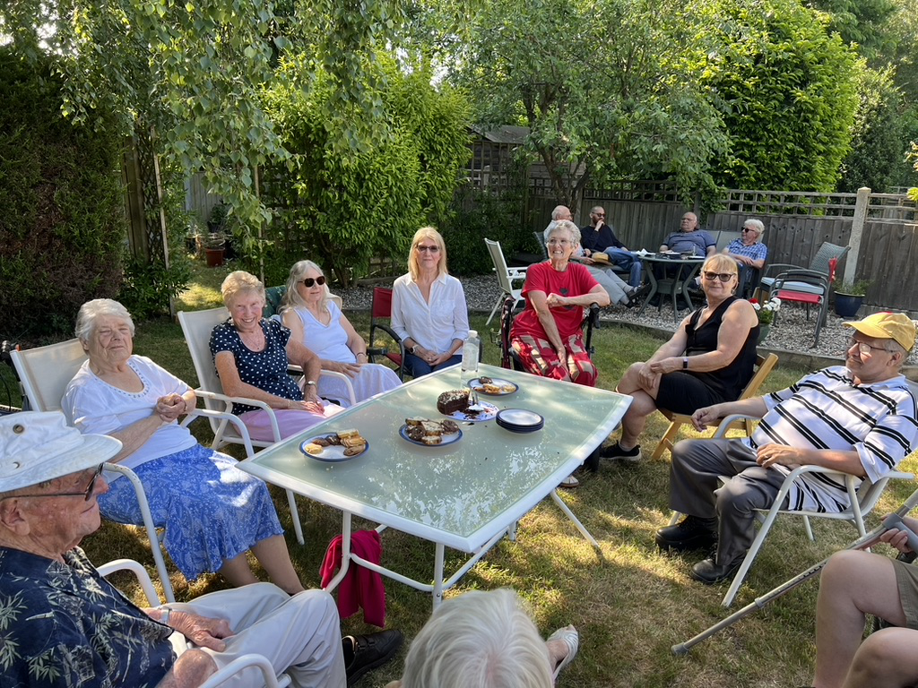
Recently, the Church was prompted to sell its building; further releasing them from a financial and practical burden, and to step into their new calling, and continue their specific journey with the Lord. Prayer Points
· Give thanks that they were able to clear and sell their building quickly and with relative ease – an example of God’s continued extraordinary timing and provision.
· Ask God to lead and grow the spiritual growth and active participation of their fellowship, as they seek to be a blessing for others who struggle to access conventional church.
· That they will know the Lord’s direction from this current moment of transition.
· For wisdom in sharing “the story of their specific calling” through a completely revised website.
Prayer Focus: Parsons Heath Baptist Church

