Slide 1
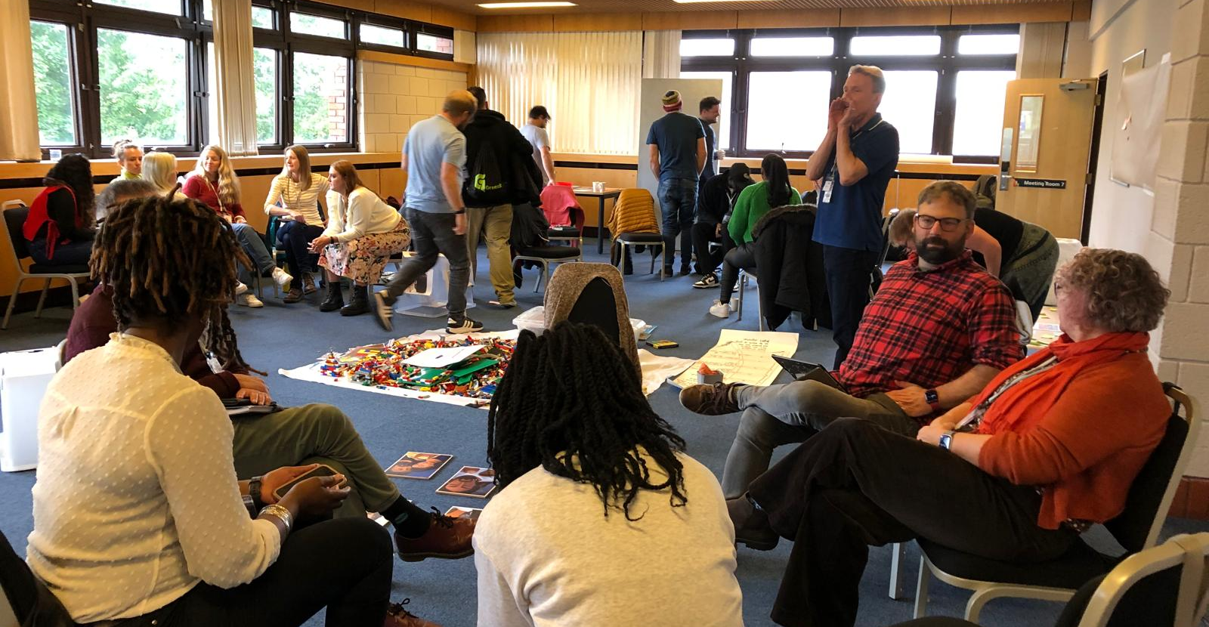
Prayer Focus: Children, Youth and Families
Vicky Baker writes: I have the great privilege of supporting CYF ministry across the EBA and if you are involved in this ministry, you don’t need me to tell you this is a busy term planning for the summer! I would like mention two events in June.
Toddler Groups - The National Month of Prayer. This is organised by 1277 an ecumenical group. The theme this year is The Good Shepherd and is based around the bible verses John 10: 14-16. Toddler groups are such a blessing to the community. I’ll be visiting a number of groups across the region this month to celebrate this fantastic ministry and pray with organisers.

Slide 2
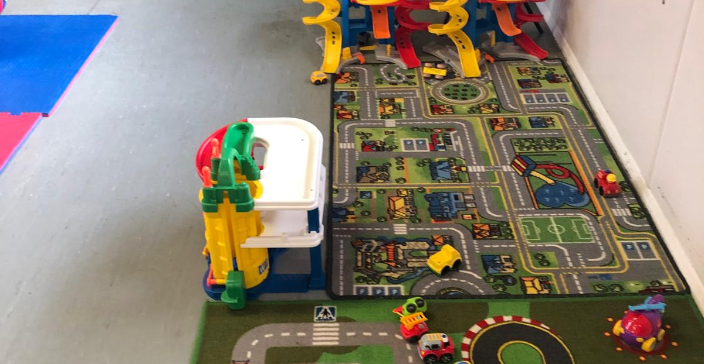
Prayer Focus: Children, Youth and Families
CYF Retreat CYF workers nationally will be on retreat in Northamptonshire, where we aim to learn from one another, and encounter God through Jesus’ life & ministry.
Prayer Points
• Give thanks for Toddler groups across the EBA, pray for the families that attend, the leaders and volunteers.
• For safe travel to the CYF retreat and a time of rest.
• For those planning summer camps and holiday clubs, the logistics, and the teams. Also, for the children and young people going to these events.

