Slide 1
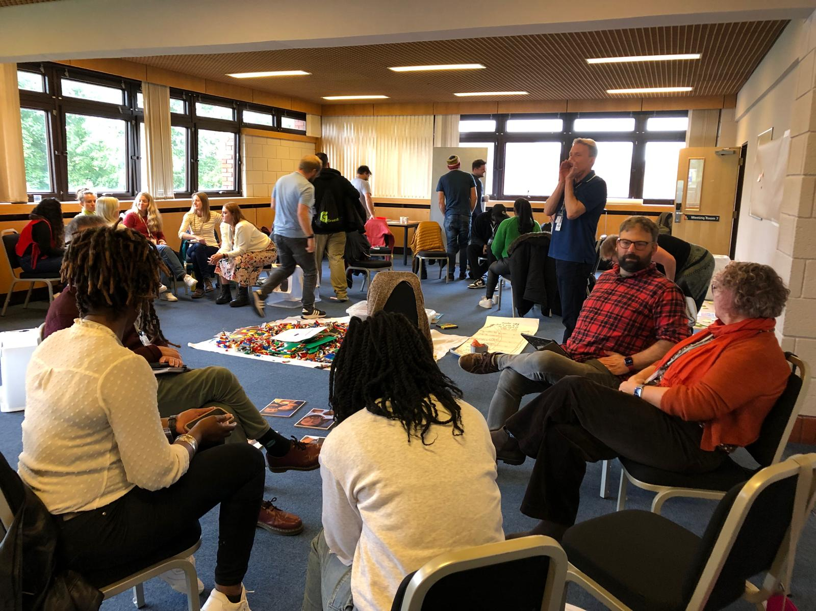
Vicky Baker, CYF Networker writes: I have the great privilege of supporting CYF ministry across the EBA and if you are involved in this ministry, you don’t need me to tell you this is a busy term! Whether you are a volunteer or are the paid ministry lead, you are probably up to your eyes in planning a summer camp, or annual holiday and that’s alongside all the regular activities that happen for children and young people across the region. I would like to draw particular attention to two events in June.
Toddler Groups - The National Month of Prayer. This is organised by 1277 an ecumenical group. The theme this year is The Good Shepherd and is based around the bible verses John 10: 14-16. Toddler groups are such a blessing to the community. I’ll be visiting a number of groups across the region this month to celebrate this fantastic ministry and pray with organisers.
Prayer Focus: Children, Youth and Families

Slide 2
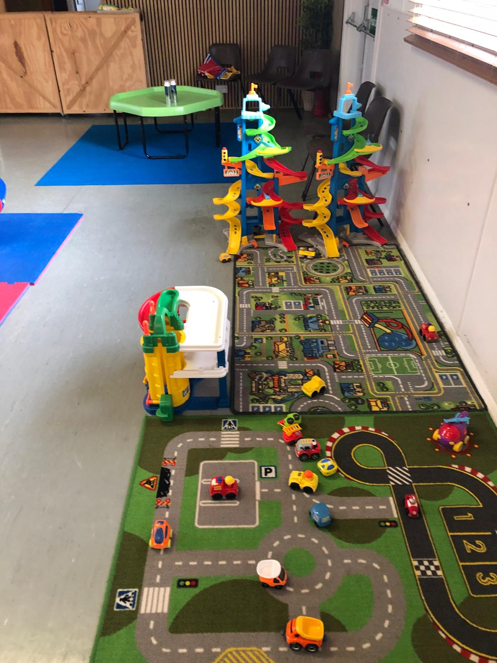
CYF Retreat
June will also see a national gathering of CYF workers. We will be on retreat in Northamptonshire, where we aim to learn from one another, and find space to encounter God through the story of Jesus’ life and ministry.
Prayer Points
• Give thanks for Toddler groups across the EBA, pray for the families that attend, the leaders and volunteers.
• For safe travel to the CYF retreat and a time of rest.
• For those planning summer camps and holiday clubs, the logistics, and the teams. Also, for the children and young people going to these events.
Prayer Focus: Children, Youth and Families

