Slide 1
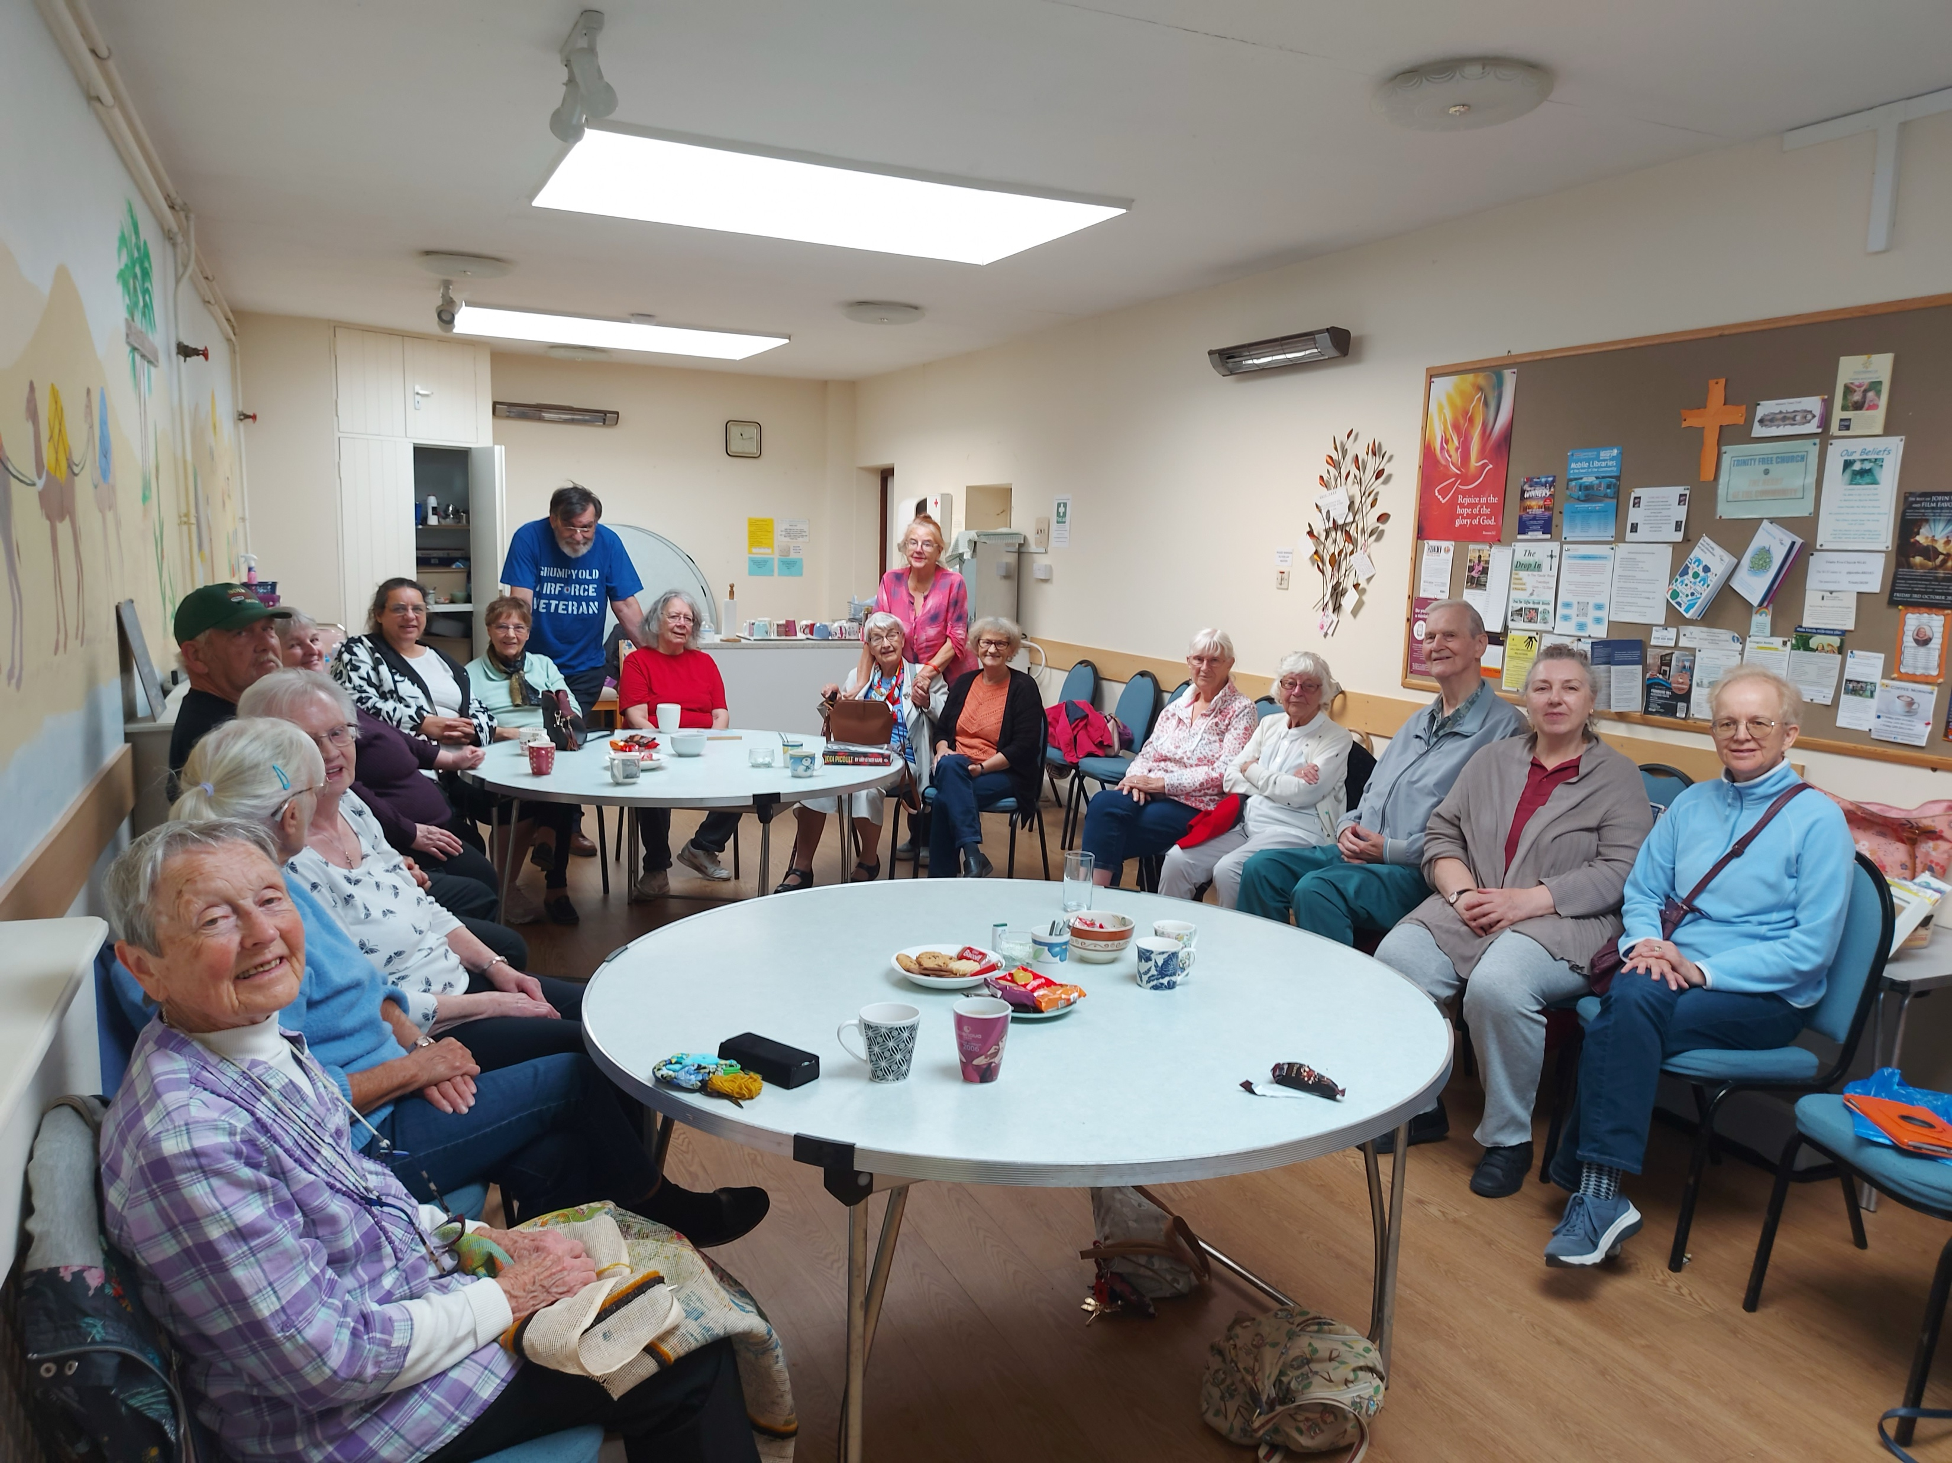
Trinity Free Church is in Huntingdon. With the 1960’s development of a new housing estate, the church responded to a vision to be part of this new community.
It is a joyful, prayerful, worshipping church and members and visitors are assured of a warm welcome. In recent months, 3 younger people with no previous experience of church and who described themselves as ‘feeling lost’ have joined the fellowship. They have since come to describe the church as ‘theirs’ and two have been baptised. Currently without a moderator or minister, the fellowship ensure continuity; and are very grateful for visiting speakers. Weekly activities include Bible Study, Prayer, a ‘Drop-In’ and a sewing club. Through the hire of their three halls, the church has strong community links : from uniformed organisations, through ‘Darby and Joan’ and an after school teenage café, to karate and a Lithuanian yoga group.
Prayer Focus: Trinity Free Church

Slide 2
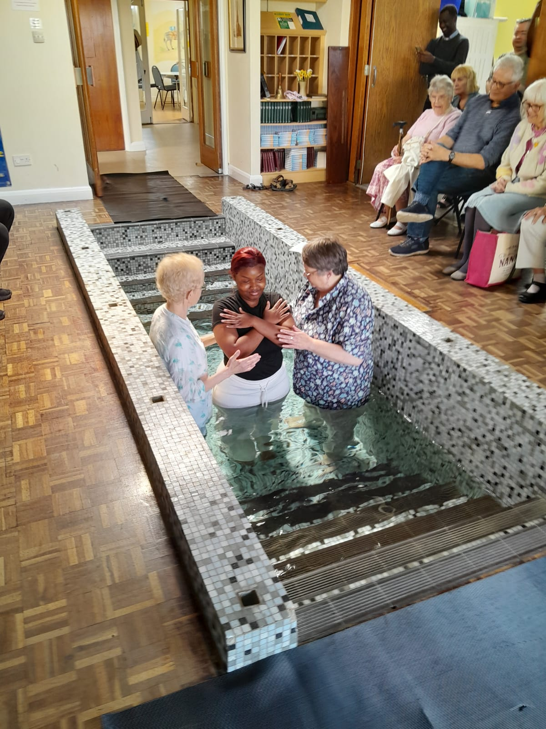
Since January, the church has been holding monthly prayer meetings specifically focused on the future, looking upward and forward. Prayer Points
● Thanks for new people and baptism
● Visiting preachers – variety and supportive
● 5 deacons to continue to maintain church
● Reviews Church constitution and profile
● Moderator and new minister
● New members mature in faith
Prayer Focus: Trinity Free Church

