Slide 1
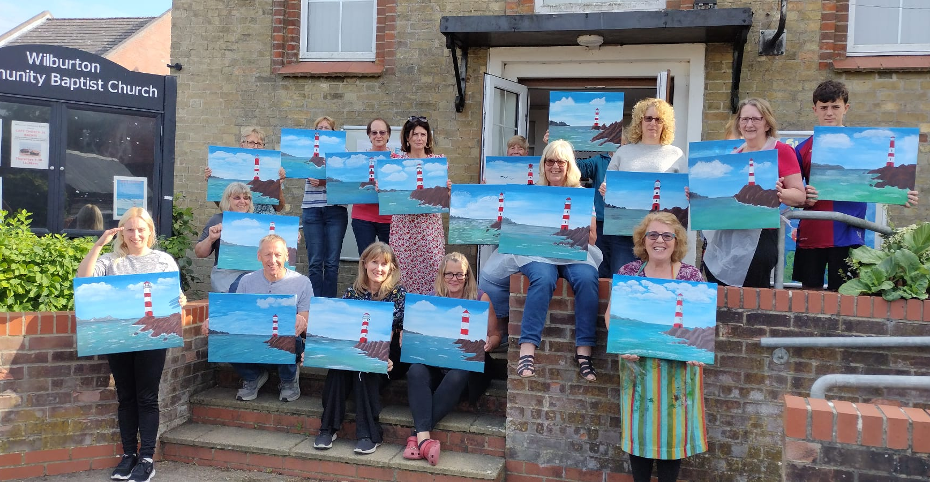
Prayer Focus: Wilburton Baptist Church, Nr Cambridge
WBC is in the heart of a small village near the commuter belt. The church is a small, elderly fellowship without a minister. Anthea Dodson, is ‘leader by default,’ despite Anthea’s husband having vascular dementia. But this small church has the biggest heart for its community: Showing God’s Love Through Connections. Everything they do is about reaching out and showing love to the community: Including giving flowers, Coffee morning, fundraising for local organisations and painting sessions. Recently, three people have been baptised.

Slide 2
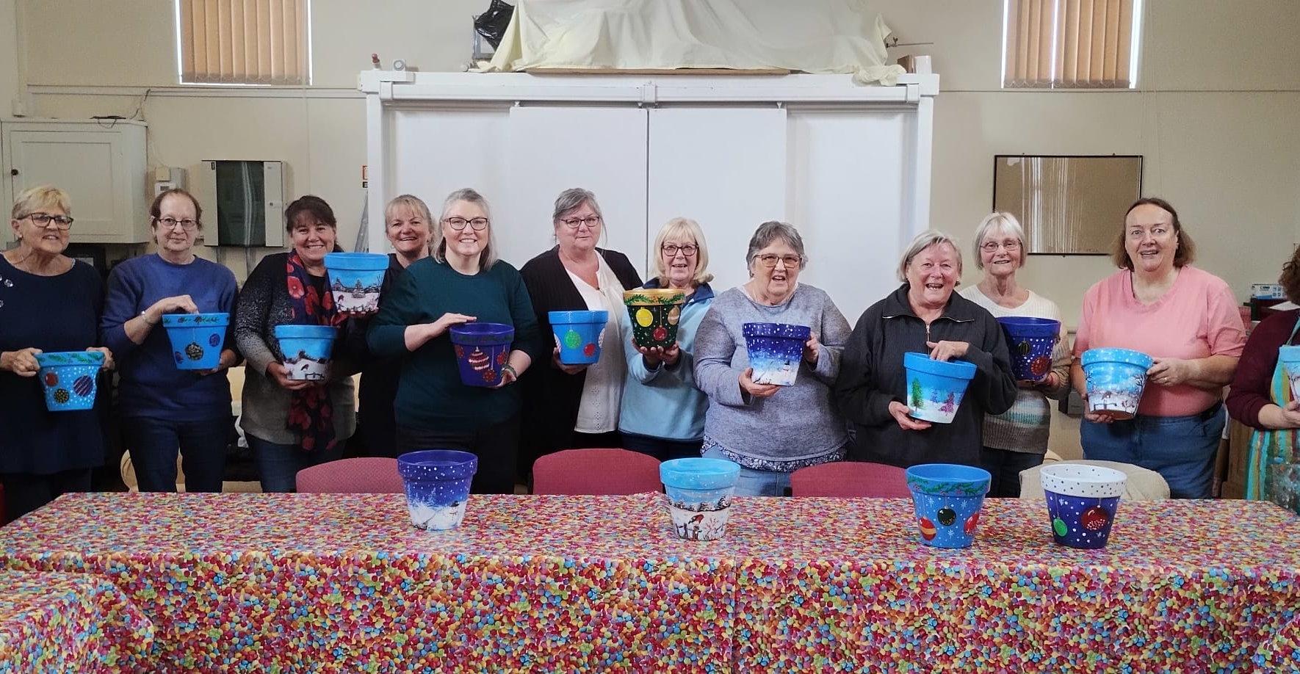
Prayer Focus: Wilburton Baptist Church
Anthea has strong connections with the local C of E school. The school’s Reception Class visits for Remembrance Sunday and at Christmas time, as well as other classes visiting the Café Church and singing carols there. Please pray: • For the three recently baptised people: for their commitment and involvement to grow and new leaders to emerge • Prayer for the church as a whole and for God to use all of them as He wills • For God to richly bless this outward-looking church as they continue to grow and serve Him.

