Slide 1
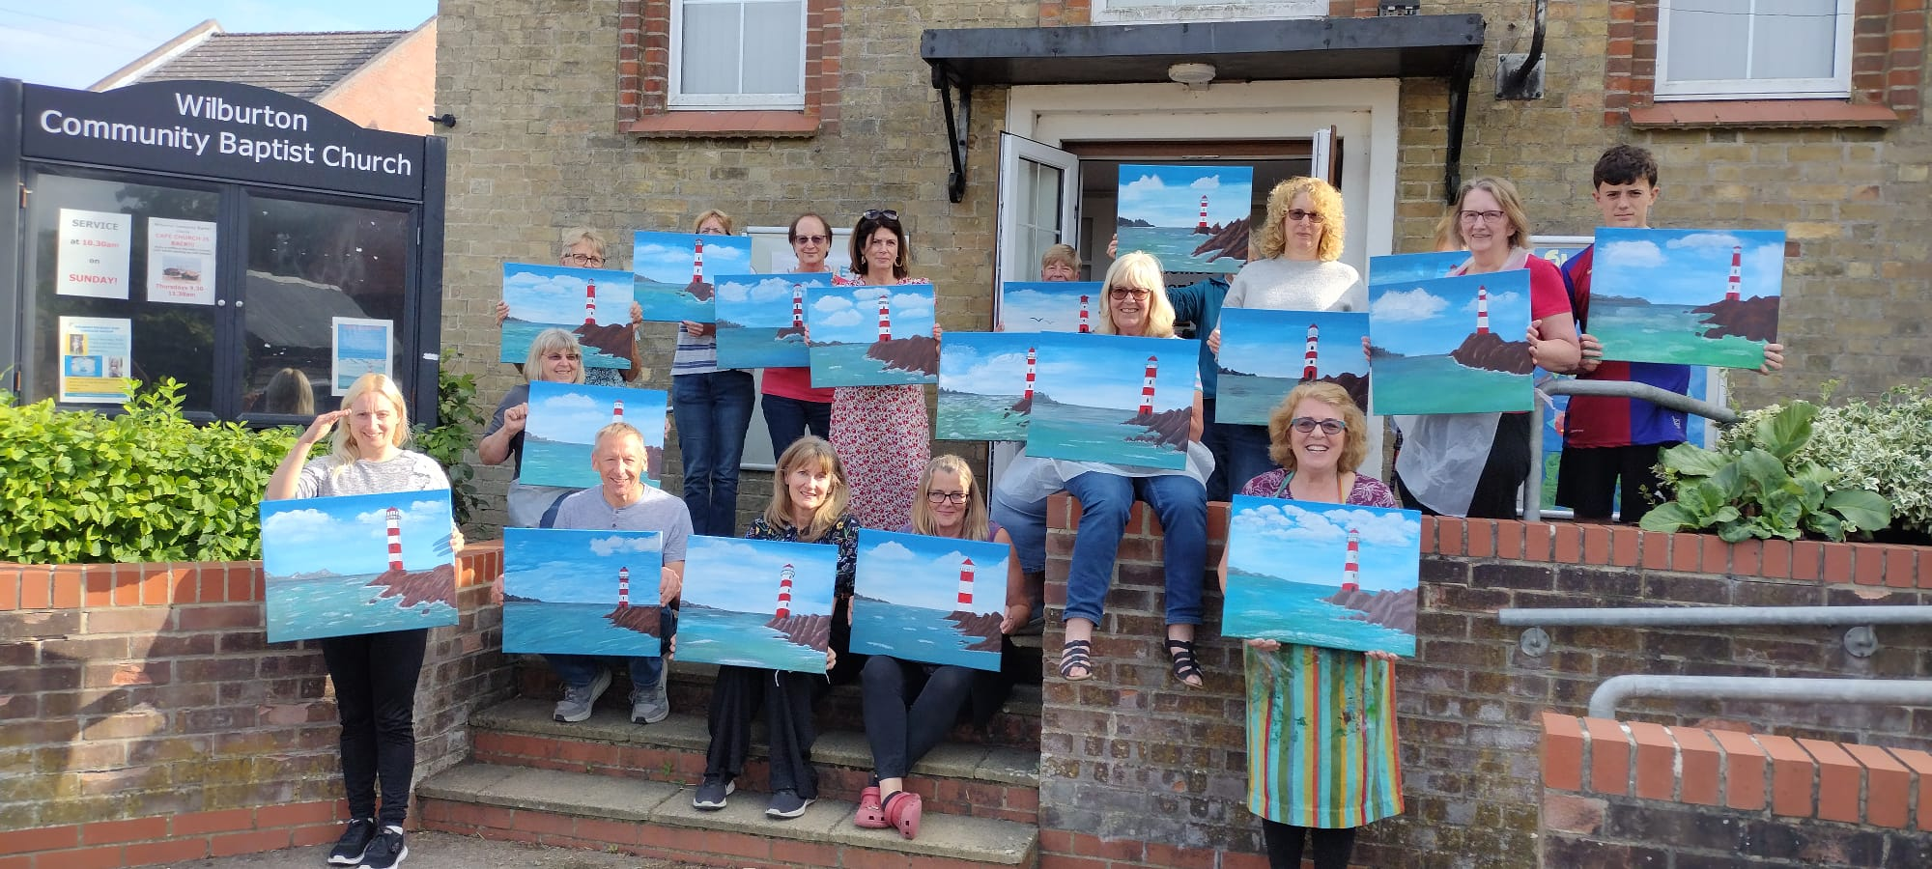
Wilburton Baptist Church is in the heart of a small village which is gradually being overtaken by the Cambridge commuter belt. The church is a small, elderly fellowship without a minister. Anthea Dodson, is ‘leader by default,’ despite Anthea’s husband having vascular dementia. But this small church has the biggest heart for its community, and its strapline is : Showing God’s Love Through Connections.
Everything they do is about reaching out and showing love to the community. Giving flowers is touching hearts and lives and making links from the church to the community and back into the church. Recently, three people have been baptised.
They have a Café Church coffee morning on a Thursday, where up to eight men often attend, along with others, and who now regularly undertake carol service readings at Christmas time despite not being church goers. Painting sessions are held for the community, led by a local artist. They also hold Fundraiser Cafés to raise funds for local organisations. Both are vital in opening doors to the community.
Prayer Focus: Wilburton Baptist Church

Slide 2
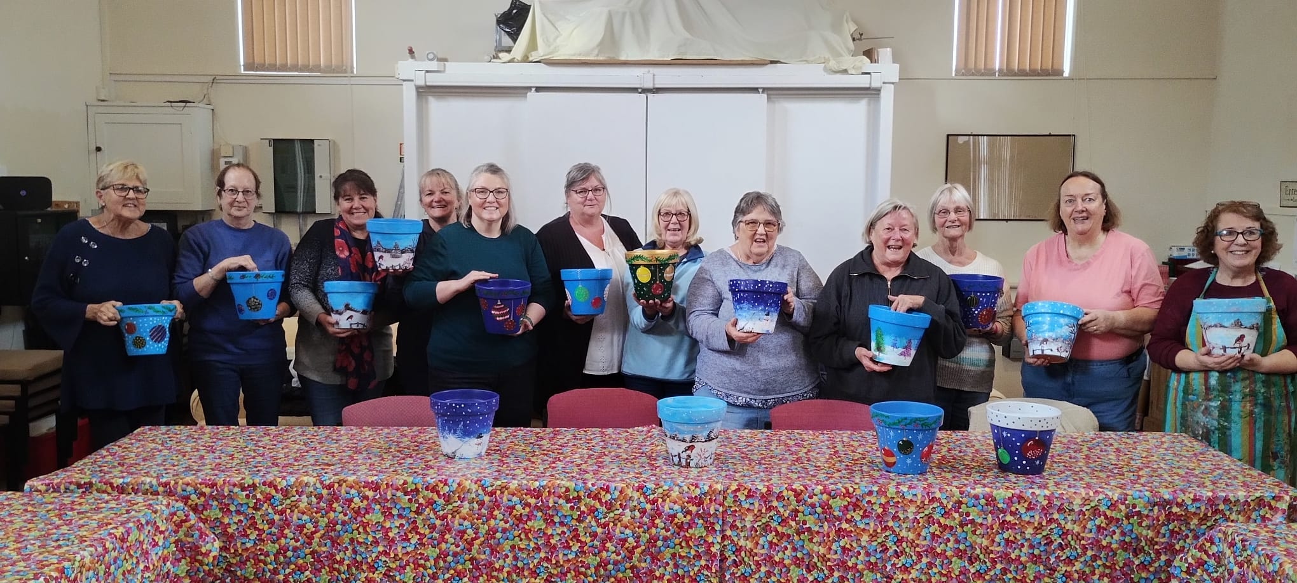
Anthea has strong connections with the local C of E school and is now a Foundation Governor as well as being Chair of Governors. The school’s Reception Class visits for Remembrance Sunday and at Christmas time, as well as other classes visiting the Café Church and singing carols there. This is an important connection between church and school.
Please pray:
• For the three recently baptised people: for their commitment and involvement to grow and new leaders to emerge as Anthea gradually releases the reins due to her husband’s health.
• Prayer for the church as a whole and for God to use all of them as He wills and enables.
• For God to richly bless this outward-looking church as they continue to grow and serve Him.
Prayer Focus: Wilburton Baptist Church

