Slide 1
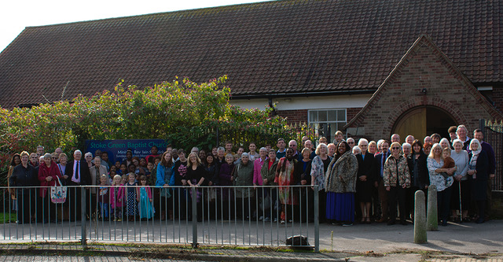
Prayer Focus: Stoke Green Baptist Church, Ipswich
Stoke Green is a community church that moved to serve a new housing estate 1950s with the intention of serving a new housing estate. Over time, the estate has evolved into a diverse community, which is now reflected in the fellowship of the church. The church has 56 members, and between 50 and 70 gather to worship on a Sunday. The church has been without its own minister for over three years, with Rev Aubrey Cardy providing pastoral support as moderator. The church is moving forward, with young families attending, and two young people have been baptised recently.

Slide 2
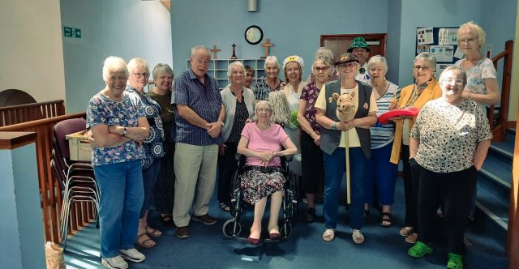
Prayer Focus: Stoke Green Baptist Church
A Community Café runs weekly, with over 30 young people dropping in, leading to Stoke Green drawing on the help of a Youth Worker from another local church. A team pays regular visits to local schools, with “Open the Book”, and local schools visit the church for Easter and Christmas-themed events. Please pray for : • The appointment of a new minister. • With an older leadership team, for mature Christians to join them. • Wisdom, as their Messy Church is well attended, but is not growing disciples

