Slide 1
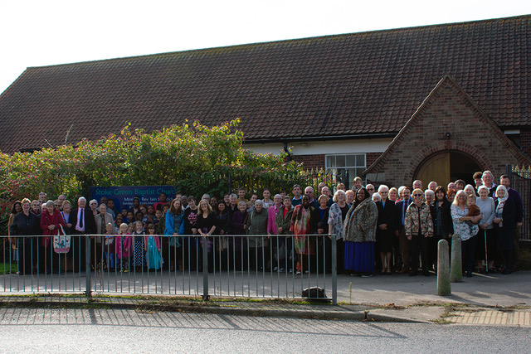
Stoke Green is a community church, located in south-west Ipswich. - The church moved to its current location in the 1950s with the intention of serving a new housing estate that was in the process of being built. Over time, the estate has evolved into a diverse community, which is now reflected in the fellowship of the church. The church has 56 members, and between 50 and 70 gather to worship on a Sunday. The church has been without its own minister for three and a half years, with Rev Aubrey Cardy acting as moderator and providing pastoral support to the fellowship. However, the church is moving forward, with young families attending, and two young people have been baptised recently.
Prayer Focus: Stoke Green Baptist Church

Slide 2
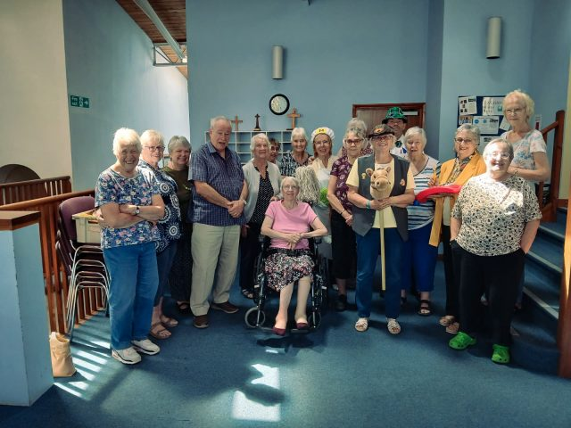
A Community Café runs on Thursday afternoons, with between 30 and 40 young people from local schools dropping in, which has led to Stoke Green drawing on the services of a Youth Worker from another local church to help. A team from the church pays regular visits to local schools, with “Open the Book”, and local schools visit the church for Easter and Christmas-themed events. The church would like prayer for: • The appointment of a new minister. • With an older leadership team, they pray that mature Christians will join them to provide good succession. • Wisdom in strategy with regard to their Messy Church outreach, which although well attended, is not leading into discipleship.
Prayer Focus: Stoke Green Baptist Church

