Slide 1
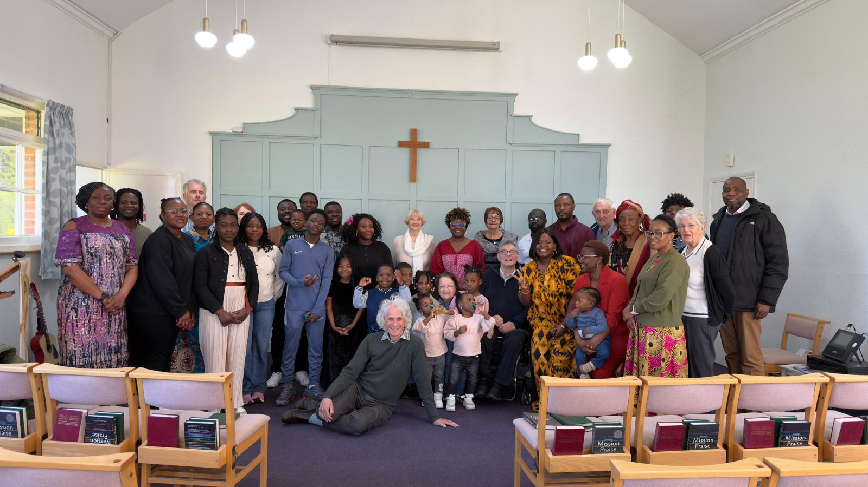
Prayer Focus: Hutton Free Church, Essex
Hutton Free Church was planted in 1850. It is a small, united fellowship led by Rev Eric Fenwick. The Church meets for Sunday worship fortnightly and has a regular afternoon “Parlour” Gathering. Here, over a cup of tea, they socialise, have quizzes and share stories. It is a good opportunity to build unity and support one another. They share their Church building with two other Churches. One uses their hall for a toddler group, and the other meets in its hall whilst they are meeting in the Church. They greatly value the hospitality they can offer and have built strong relationships with both Churches, meeting people from different backgrounds.

Slide 2
Prayer Focus: Hutton Free Church
They would value prayer : · For the ongoing life of their Church. That by God’s grace they will continue to worship together in the truth of Jesus. May God bless their passion to continue to be a witness for Him in their community. · For God to bless their relationship with Emmanuel Church and Grace Church – may all these Churches see fruit from their working together. · Of thanks for the 15 years of ministry of pastor Eric. Please pray for his love for one another to bless the Church and be an effective witness of God’s love for others.

