Slide 1
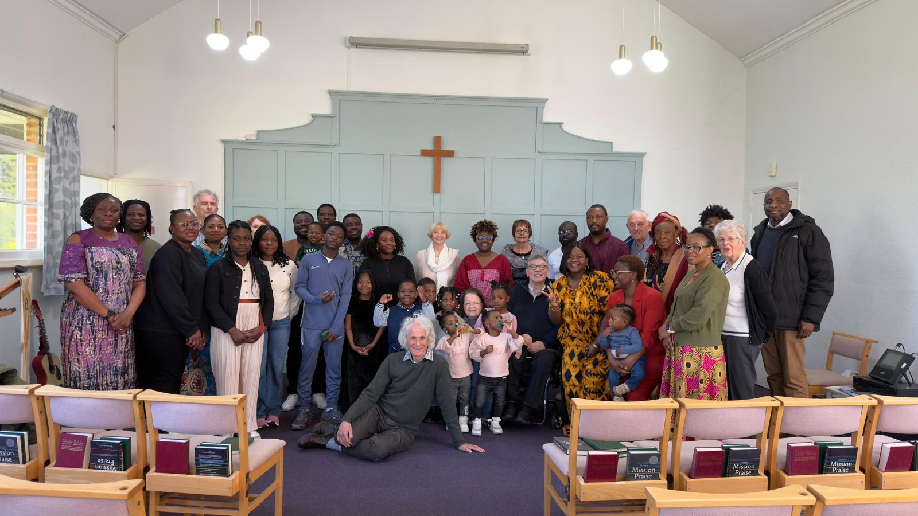
Hutton Free Church was planted in 1850 and is proud to continue as a worshipping and witnessing Church of God today. It is a small, united fellowship led by its part-time Minister Rev Eric Fenwick. The Church meets for worship fortnightly on Sunday mornings and has a regular Thursday afternoon “Parlour” Gathering. Here, over a cup of tea, they socialise, have quizzes and share stories and histories. It is a good opportunity to build unity and support one another.
They share their Church building with two other Churches. Emmanuel Church uses their hall for a weekly toddler group, and on Sundays, the “Grace Redeemed Church of God” meets in its hall whilst they are meeting in the Church. They greatly value the hospitality they are able to offer and have built strong relationships with both Churches, enjoying meeting people from different backgrounds to their own. They have seen a few people from “Grace Church” join them.
Prayer Focus: Hutton Free Church, Essex

Slide 2
They would value prayer :
· For the ongoing life of their Church. That by God’s grace they will continue to worship together in the truth of Jesus. May God bless their passion to continue to be a witness for Him in their community.
· For God to bless their relationship with Emmanuel Church and Grace Church – may all these Churches see fruit from their working together.
· Of thanksgiving for the 15 years of ministry of their pastor Eric at Hutton and 25 years at Woodham Ferrers. Many years ago Eric arrive for a 3 year period but God had other plans, filling Eric with such love for the Church that he has continued. Please pray for this love for one another to bless the Church and be an effective witness of God’s love for others.
Prayer Focus: Hutton Free Church

