Slide 1
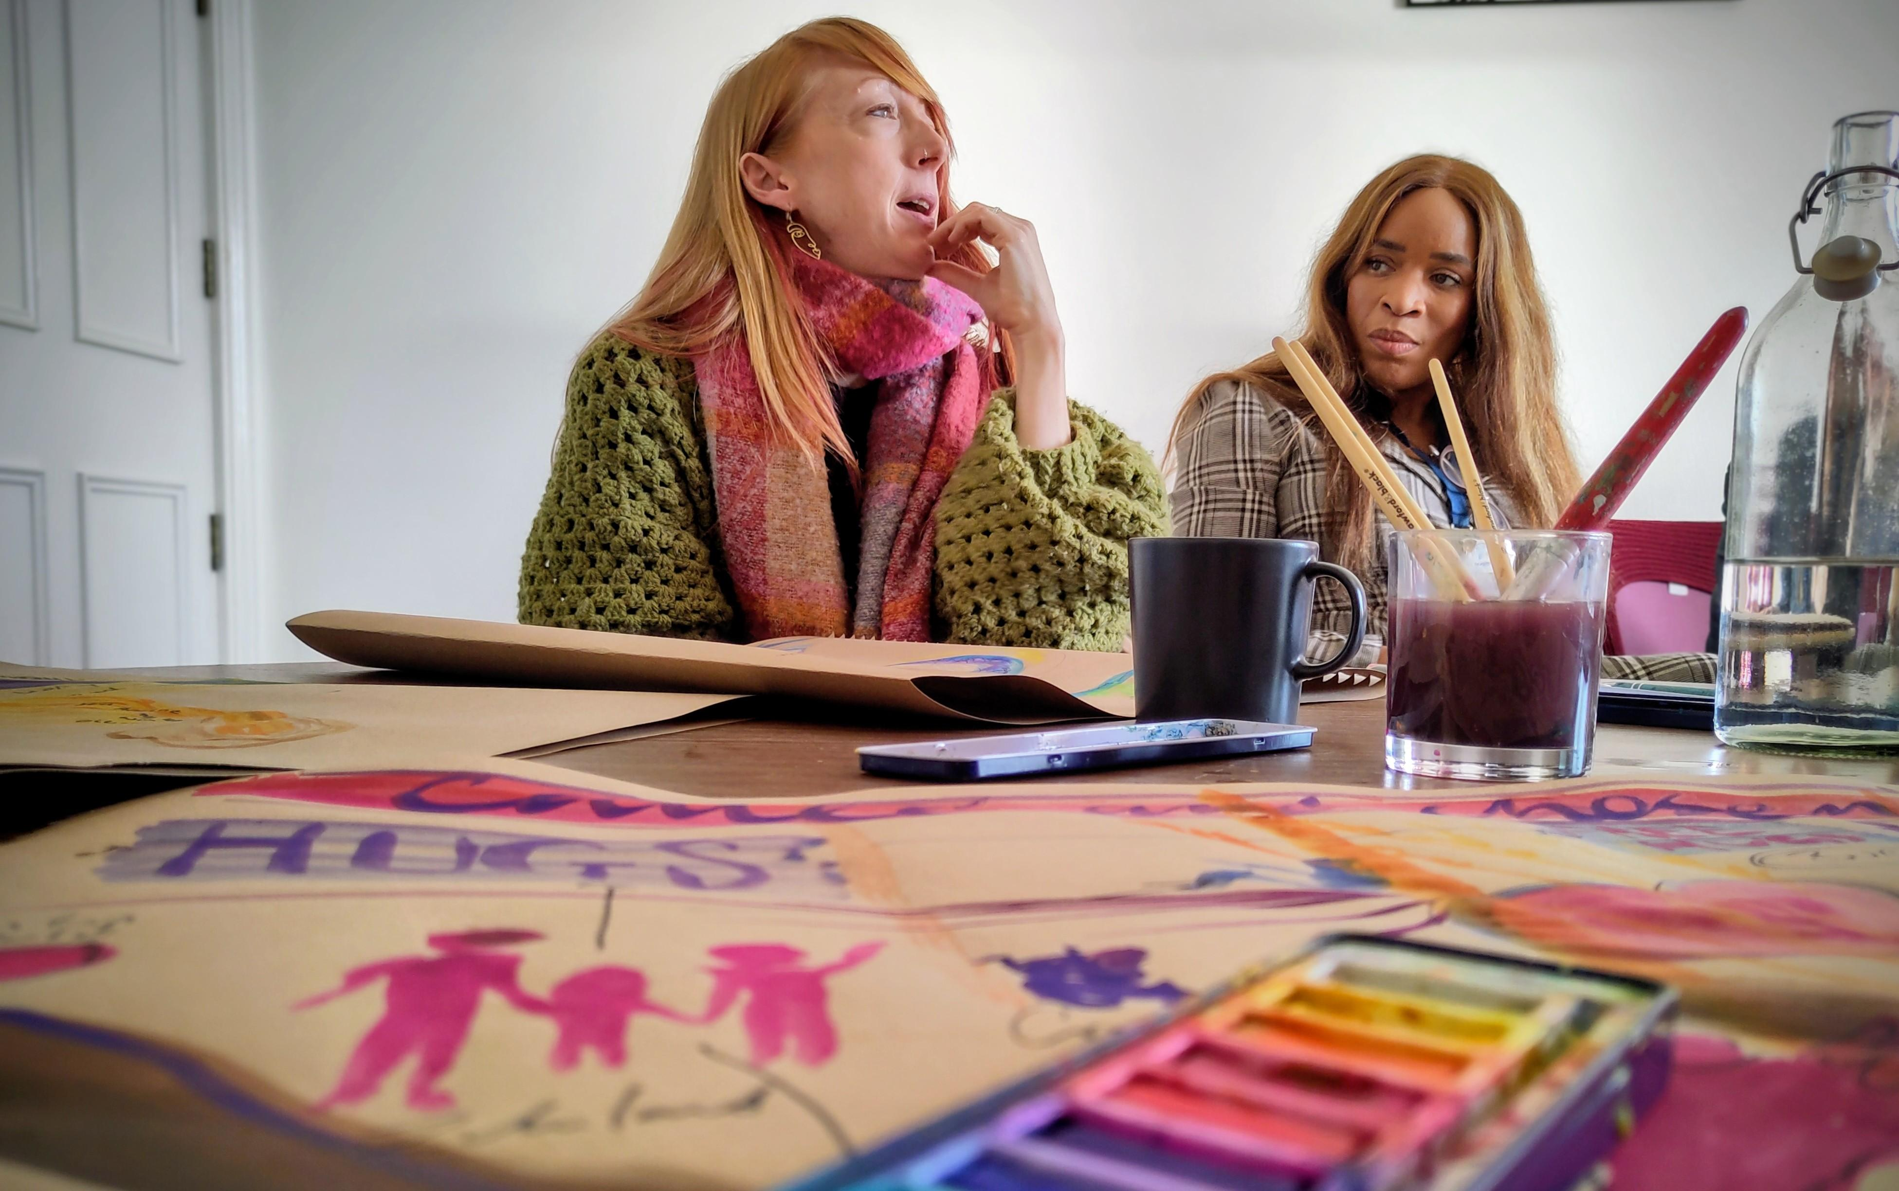
Prayer Focus: Pioneer
This week we pray for our EBA pioneers. We have a wealth of creativity amongst our small group of pioneers across the association as they seek to demonstrate good news to people who have yet to make sense of the Christian faith. From wild church and forest church to fresh expressions. From church planting in new housing developments to simple church in small groups our pioneers are reaching people and making a difference! It was a blessing to be able to gather our pioneers together for a day earlier this year before the minister’s conference to share, learn and pray together

Slide 2
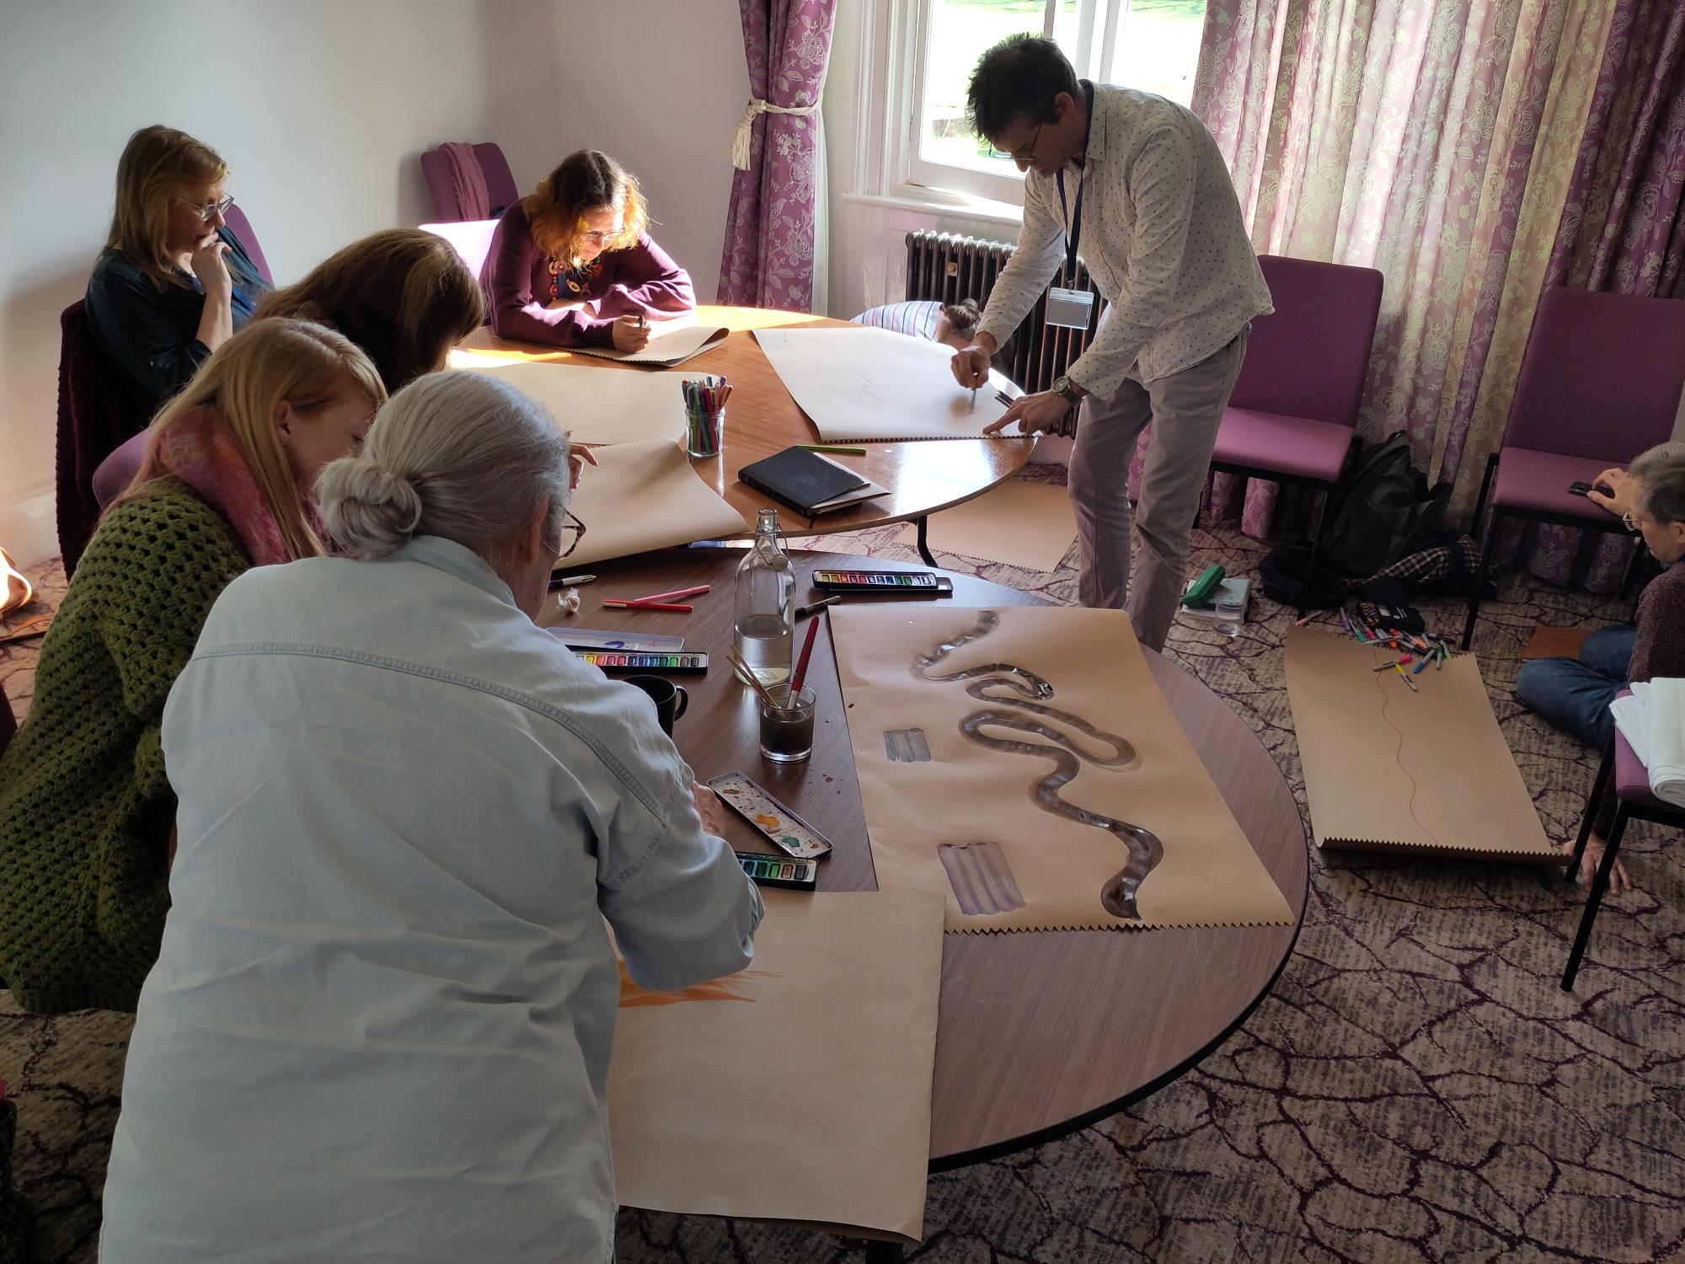
Prayer Focus: Pioneer
Therefore, please pray for: • Protection over our pioneers. Pioneering is a spiritual discipline; we need spiritual protection from harm, discouragement and attack from the enemy. • Encouragement. Lift our pioneers and ask God to encourage them to keep going!
• Multiplication. We have a vision to see more of our Baptist churches plant and pioneer new churches! What if over the next 5 years 50 of our 170 churches did that?
• For 'Everyone Everywhere' our national Baptist vision for every Baptist to reach everyone everywhere to impact our EBA and for more pioneers to join our cohort.

