Slide 1
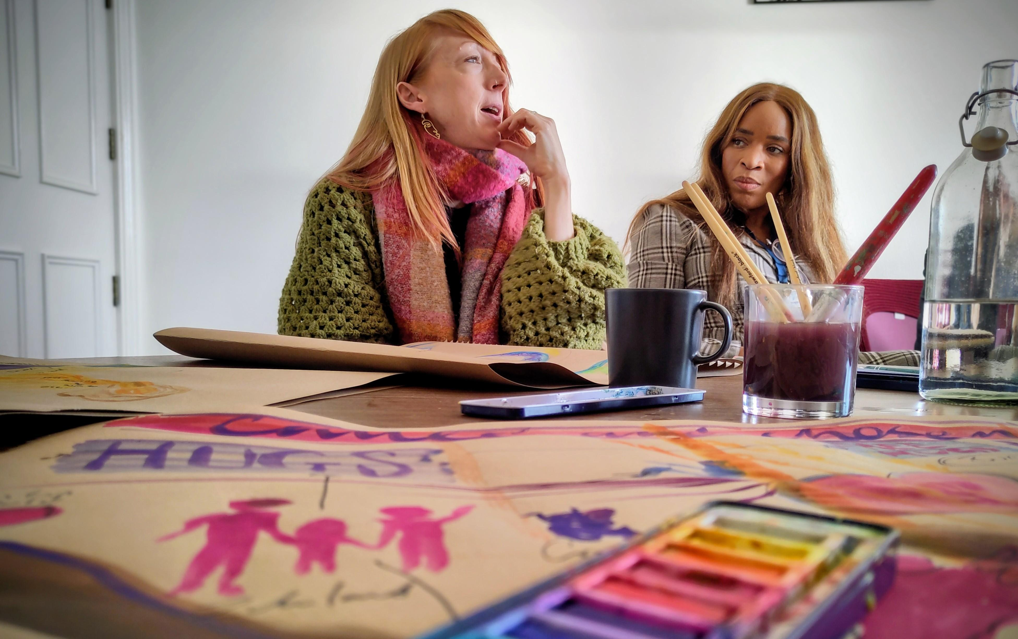
This week we pray for our EBA pioneers. We have a wealth of creativity amongst our small group of pioneers across the association as they seek to demonstrate good news to people who have yet to make sense of the Christian faith. From wild church and forest church to fresh expressions. From church planting in new housing developments to simple church in small groups our pioneers are reaching people and making a difference! It was a blessing to be able to gather our pioneers together for a day earlier this year before the minister’s conference to share, learn and pray together
Prayer Focus: Pioneer

Slide 2
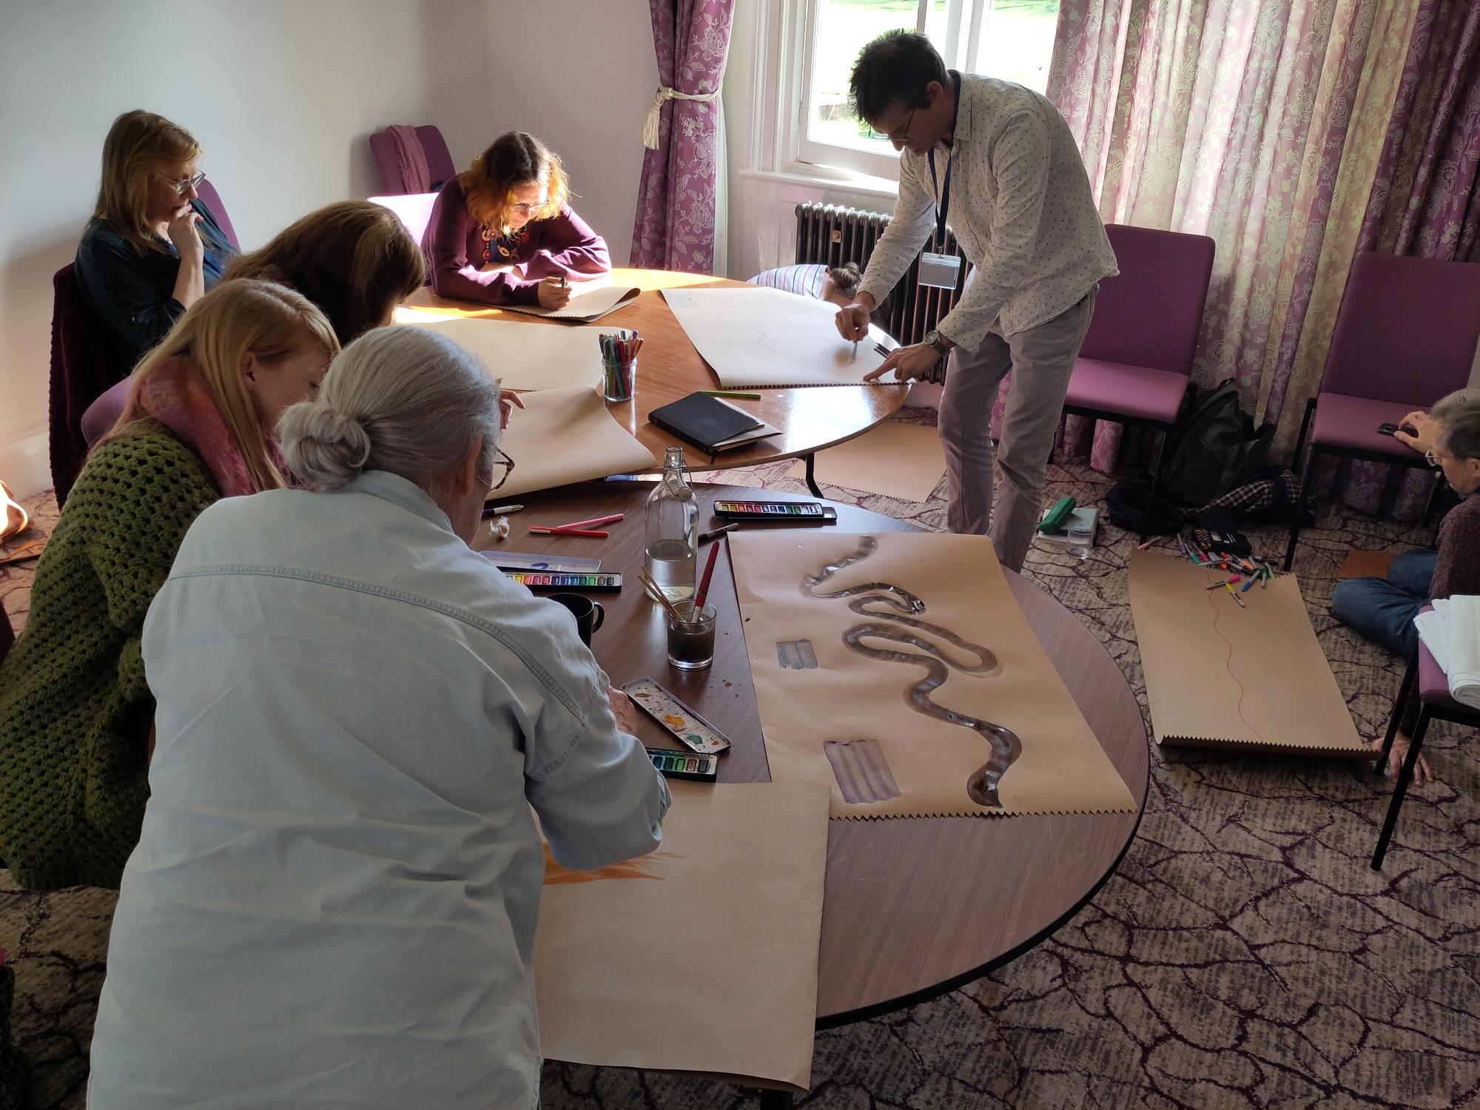
Therefore, please pray for: • Protection over our pioneers. Pioneering is a spiritual discipline; we need spiritual protection from harm, discouragement and attack from the enemy. • Encouragement. Lift up our pioneers and ask the Lord to encourage them this week to keep going! Gal 6.9 is a good verse to use: 'Let us not become weary in doing good, for at the proper time we will reap a harvest if we do not give up.’ • Multiplication. Chris (EBA Pioneer Networker) and fellow Baptist minister Mark Massey, have a vision to see more of our Baptist churches plant and pioneer new churches! What if over the next 5 years 50 of our 170 churches did just that? Please pray for 'Everyone Everywhere' our national Baptist vision for every Baptist to reach everyone everywhere to impact our EBA and for more pioneers to join our cohort.
Prayer Focus: Pioneer

