Slide 1
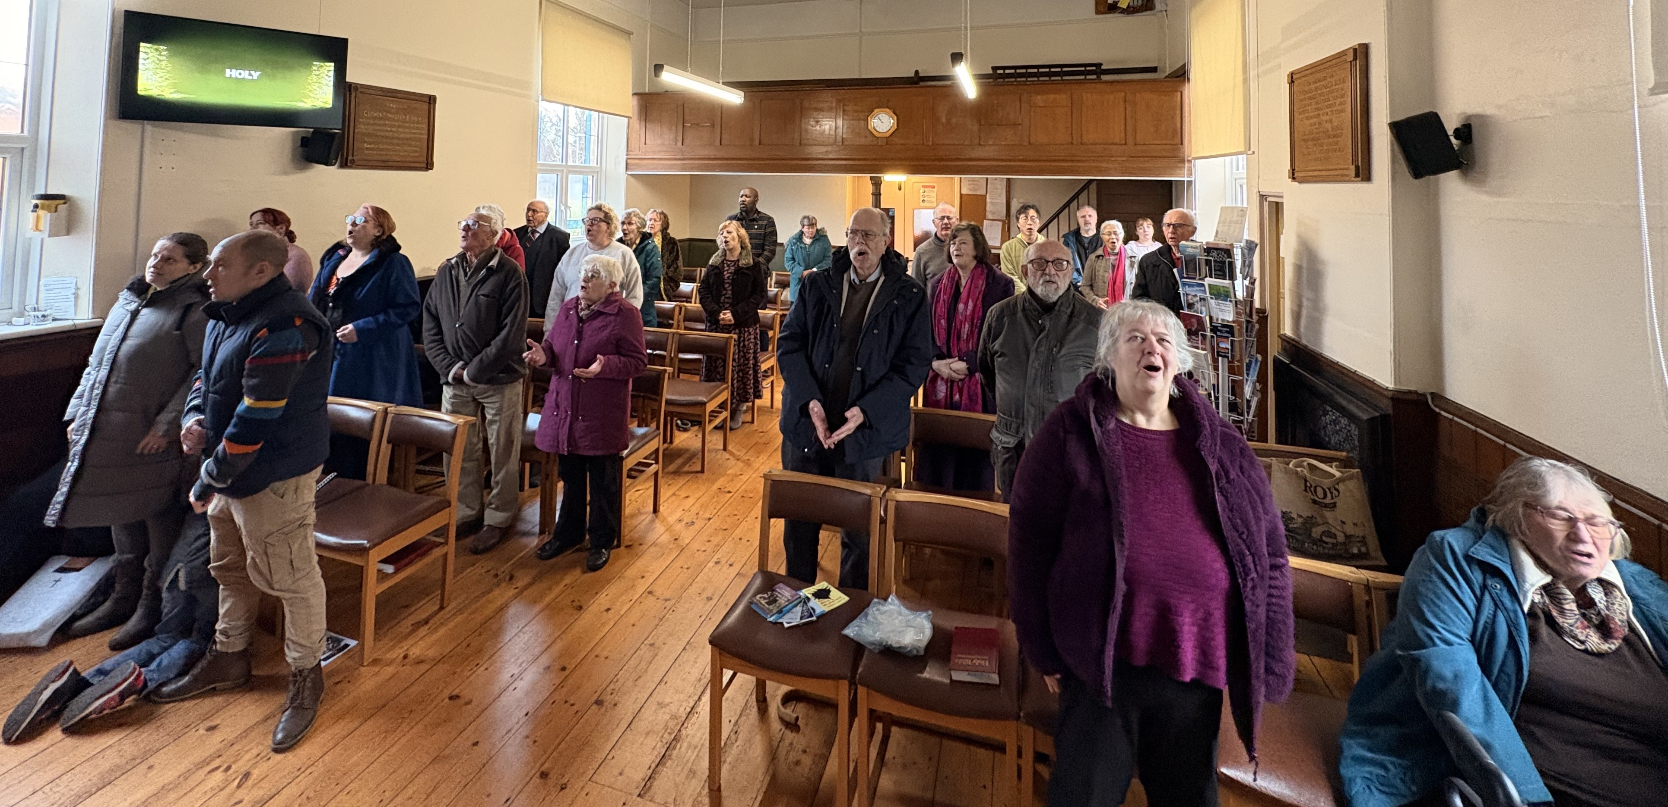
Prayer Focus: Cotessey Baptist Church, Cotessey, Norwich
Costessey Baptist Church is a growing church. Its congregation spans generations, welcoming 17 new people, including 2 new families, increasing the Sunday numbers to around 40. Sunday worship includes children’s teaching, and the church holds monthly teen discussion and all age cafe church. They are delighted to have held a recent baptism. The fellowship also loves meeting socially. The church encourages discipleship has seen their spiritual lives deepen. The running of an Alpha group is being considered. The church runs a coffee morning and a parent-toddler group.

Slide 2
Prayer Focus: Cotessey Baptist Church
The church has been in pastoral vacancy since 2022. Services are led by their moderator Derrick, church members and other local speakers. Derrick feels the church is in a strong position - spiritually thriving and growing. In its search for a minister, the church seeks someone with a focus on local outreach. Please pray for:
• God’s blessing as the church enters the next phase of pastoral vacancy
• God’s guidance and blessing on the ministry of the church moving forward
• For the discernment of His plan, that the right person will come in His time
• For the people of Costessey to know that CBC is a place of support and love

