Slide 1
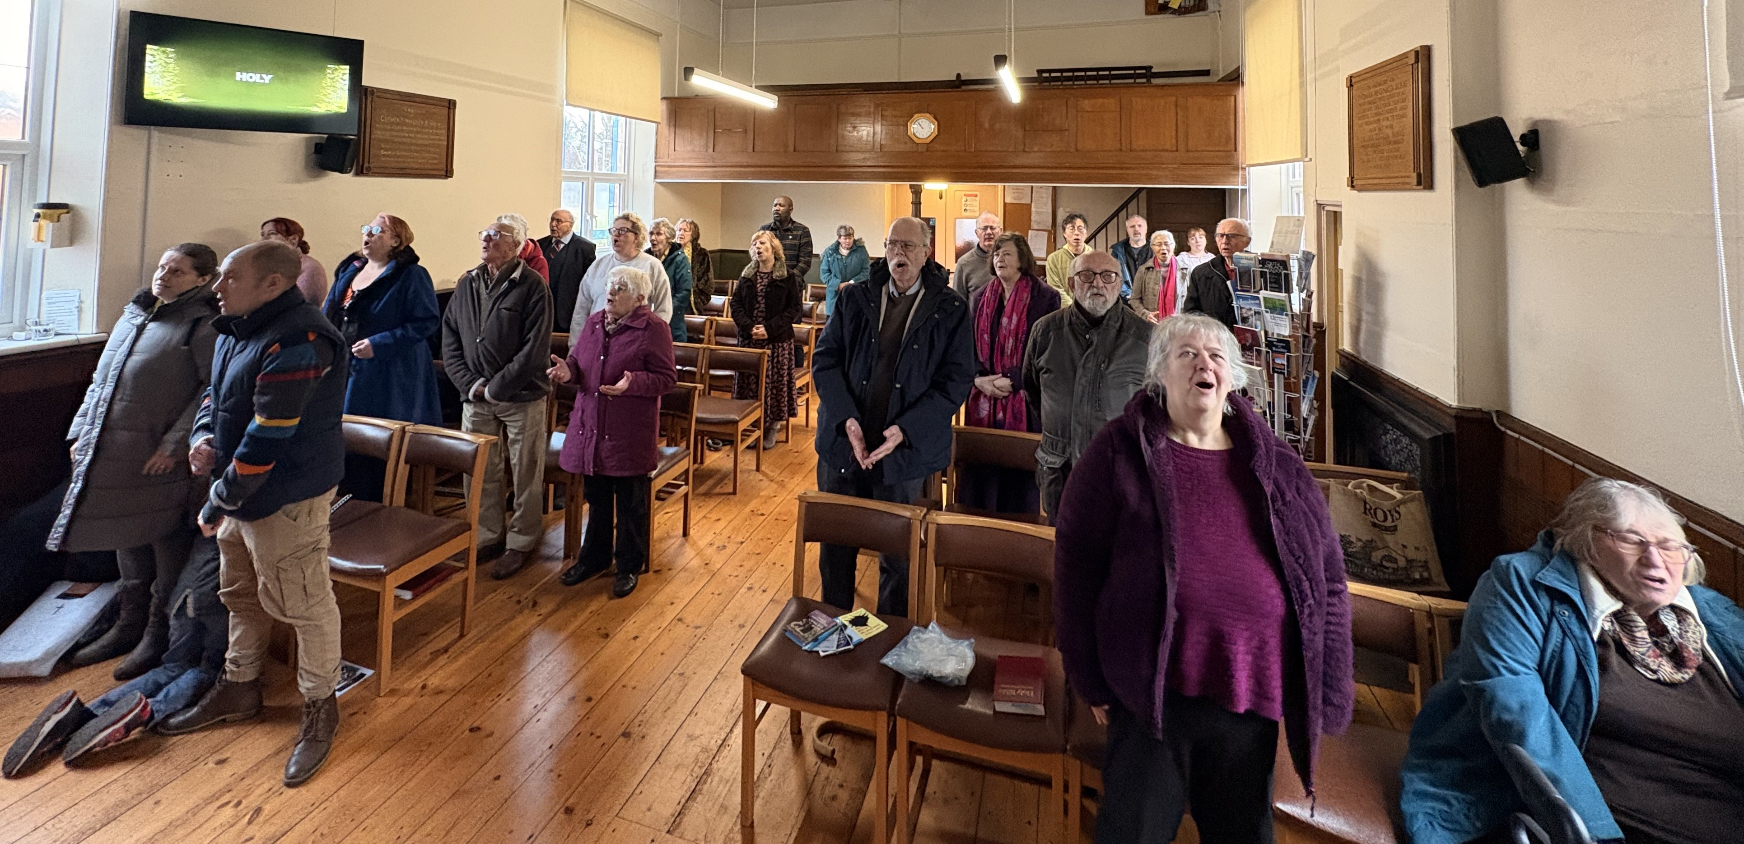
Costessey Baptist Church is a growing church, in Costessey, Norwich. Its congregation spans the generations and, over the last couple of years, has welcomed 17 new people, including 2 new families, increasing the number on a Sunday morning to around 40. Sunday worship includes children’s teaching, and the church holds monthly teen discussion and all age cafe church. They are delighted to have held a recent baptismal service. The fellowship also loves meeting together socially, including a boat trip on the Broads and its Christmas party.
The church encourages discipleship and, through its house groups and Bible studies, has seen the spiritual lives of its congregation deepen. The running of an Alpha group is being considered. In reaching out to the local community, the church runs a monthly coffee morning and a weekly parent-toddler group.
Prayer Focus: Cotessey Baptist Church

Slide 2
The church has been in pastoral vacancy since 2022 and has been blessed by the ministry and guidance of their moderator, Revd Derrick Hill. Services have also been led by church members and other local speakers. Derrick has now been called to another ministry locally, but feels the church is in a strong position - spiritually thriving and growing. In its search for a minister, the church seeks someone with a particular focus on local outreach. Please pray for:
• God’s blessing as the church enters the next phase of pastoral vacancy
• God’s guidance and blessing on the ministry of the church moving forward
• For the discernment of His plan, that the right person will come in His time
• For the people of Costessey to know that Costessey Baptist Church is a place of support and love where they can experience the saving love of God.
Prayer Focus: Cotessey Baptist Church

