Slide 1
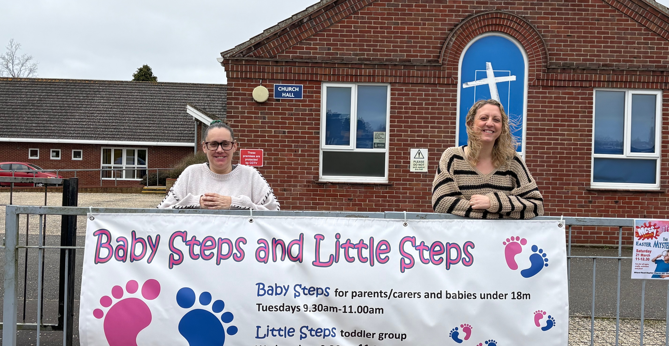
Prayer Focus: Witard Road Baptist Church, Norwich
WRBC is a growing, multigenerational church. There is a sense of unity as they welcome people from a variety of backgrounds and gently grow numerically and spiritually. Recently, prayers were answered, with a Children’s and Family Worker and a Cafe Manager appointed. Each day there is an activity: from a food bank, Messy Church, Baby Steps and Toddler group to the café, which after 3 years is seeing people from the community joining. There is always a mission and community element, as they aim to be “welcoming to all, with a heart to serve God, inspired by the Holy Spirit to make Jesus known, so that lives can be transformed.”

Slide 2
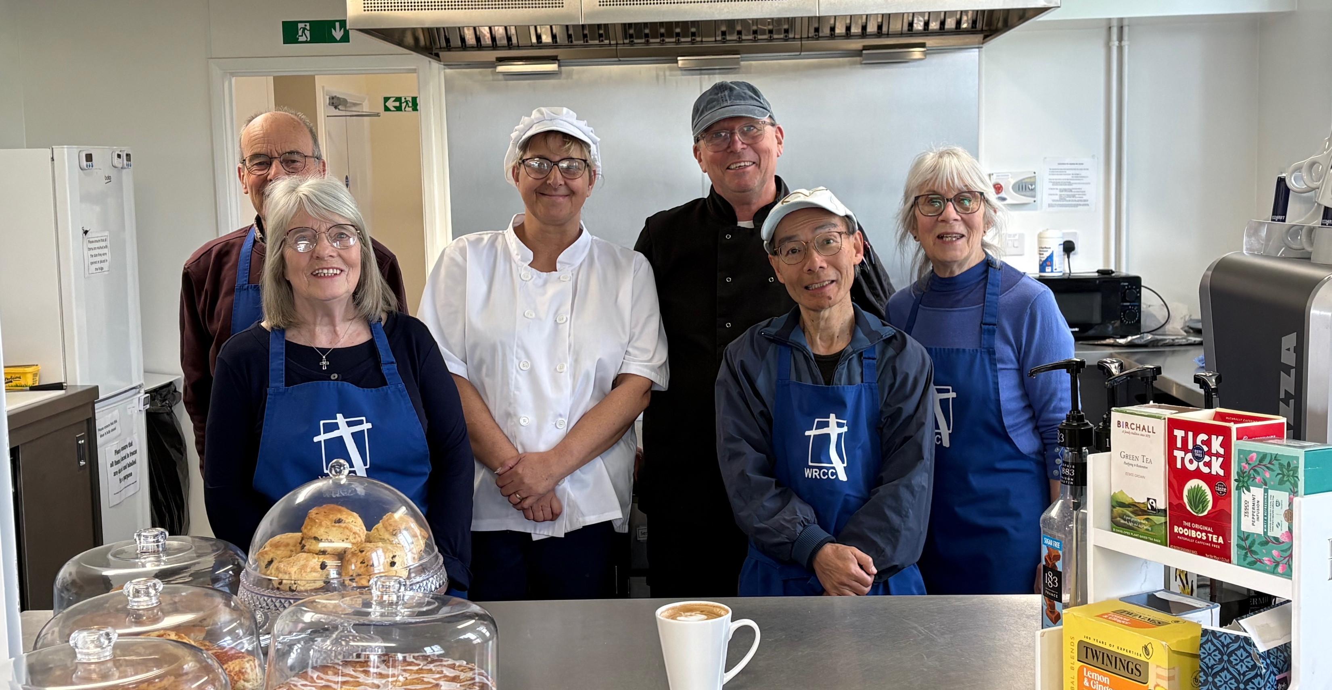
Prayer Focus: Witard Road Baptist Church
They are grateful for the recent Baptism on Easter Sunday and the joint service with the local Anglicans on Good Friday, walking from one church to another as they reestablish links. Please join with them in prayer: • During this season as their Pastor Steve, retires and they search for a new minister • That they may build and strengthen community links through their children’s work, café and Foodbank ministries • That they may have increasing opportunities to share Jesus.

