Slide 1
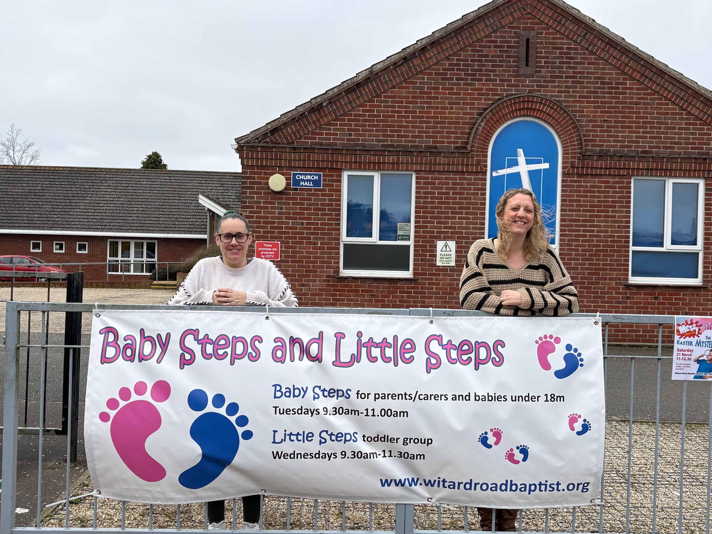
WRBC is a growing, multigenerational church just outside city centre Norwich. There is a sense of unity in this church as they welcome people from a variety of backgrounds into the family and gently grow numerically and spiritually.
Recently, they have seen their prayers answered, with a Children’s and Family Worker and a Cafe Manager appointed. Each day there is an activity in the church: from a food bank, Messy Church, Baby Steps and Toddler group to the café, manned by volunteers. After three years of faithfully running the café, the church is now seeing more people from the community joining. There is a mission and community element in everything that they do, as they move towards their vision of being “welcoming to all, with a heart to serve God, inspired by the Holy Spirit to make Jesus known, so that lives can be transformed.”
Prayer Focus: Witard Road Baptist Church

Slide 2
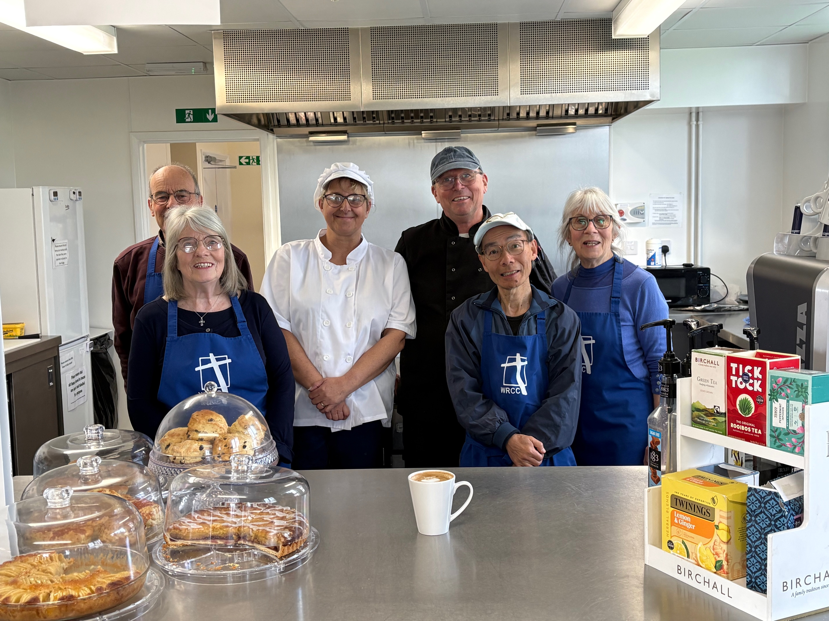
They are grateful for the recent Baptism on Easter Sunday and the joint service with the local Anglicans on Good Friday, walking from one church to another as they reestablish links.
Please join with them in prayer:
• During this season of transition as their Pastor Steve, retires and they search for a new minister
• That they may build and strengthen community links through their children’s work, café and Foodbank ministries
• That they may have increasing opportunities to share Jesus.
Prayer Focus: Witard Road Baptist Church

