Slide 1
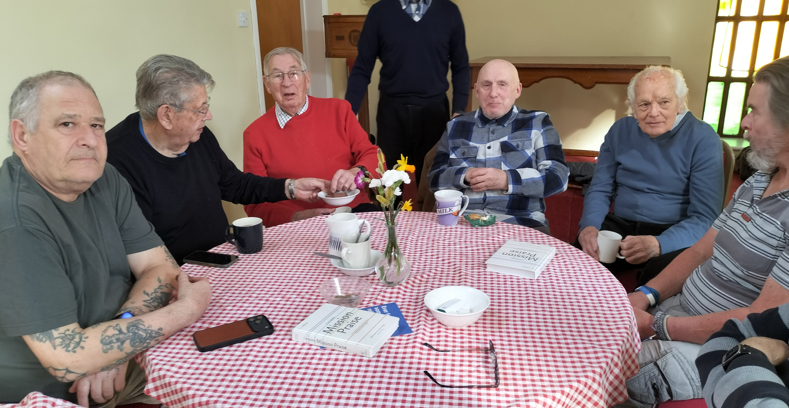
Prayer Focus: Willingham Baptist Church, Nr Cambridge
Willingham Baptist Church is an outgoing and evangelistically minded rural Church. While it is a smaller congregation, it is a strong part of the local community. The Church has seen a split before their current Minister Kwaku Efah, was called to the Church. In his ministry, Kwaku has a strong evangelistic focus, and this is resulting in new growth and provides encouragement and a new drive for the fellowship. They have new families attending and re-established a thriving Sunday School. Church life is busy through the week. Before Easter there was a local ecumenical mission drive to raise awareness of the Gospel, followed by joint services

Slide 2
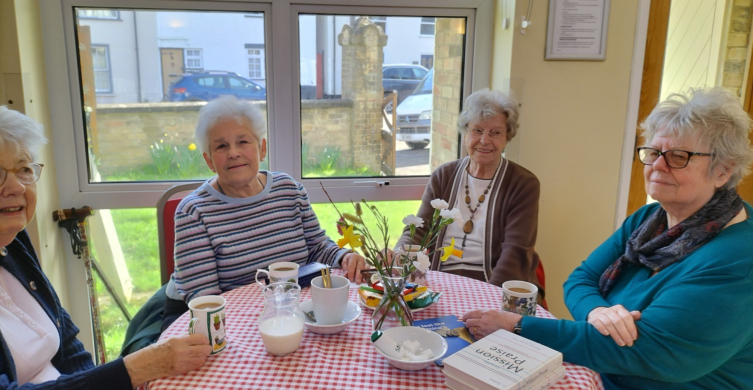
Prayer Focus: Willingham Baptist Church
Hopefully, the new members will eventually be encouraged to enter leadership roles, as an elderly congregation has worked hard to sustain the Church. Demographics are changing in the area, and this is now reflected in the fellowship. Please pray for: • Those in the Church to be active witnesses to the community. • To grow in confidence and share effectively as part of the current evangelical drive. • For commitment levels to rise and new people to pick up some responsibilities. • And that God will help them to be more prayerful as a Church, conscientious and committed to the global working of Christ to see his Kingdom grow.

