Slide 1

Willingham Baptist Church is an outgoing and evangelistically minded Church set in a rural village. The Church was founded in 1875, and while it is now a smaller congregation, it remains a strong part of the local community. The Church has seen a split, which occurred four years ago, before their current Minister Kwaku Efah, was called to the Church. In his ministry, Kwaku has a strong evangelistic focus, and he has led the way in growing the Church. This is resulting in new growth and provides encouragement and a new drive for the fellowship. They have seen new families attending, and the re-establishment of a thriving Sunday School. Different activities happen throughout the week, and Church life is busy. Before Easter there was a local ecumenical mission drive to raise awareness of the Gospel. Each Church celebrated their separate events, as well as attending each other’s.
Prayer Focus: Willingham Baptist Church, Nr Cambridge

Slide 2
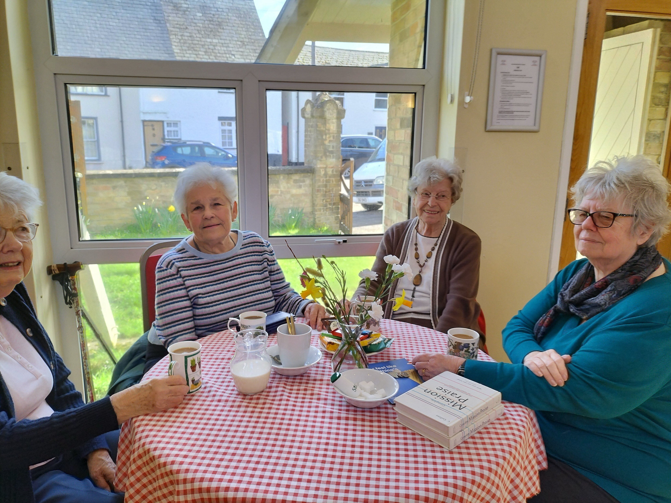
Hopefully, the new members will eventually be encouraged to enter leadership roles, as an elderly congregation has worked hard over the years to sustain and guide the life and direction of the Church. Demographics are changing in the area, and this is now reflected in the fellowship, with more Black and Indian people attending. Prayer would be valued for: • Those in the Church to be active witnesses to the community. • To grow in confidence and share effectively as part of the current evangelical drive. • For commitment levels to rise and new ones who have joined to pick up some of the responsibilities. • And that God will help them to be more prayerful as a Church, conscientious and committed to the global working of Christ to see his Kingdom grow.
Prayer Focus: Willingham Baptist Church

