Slide 1
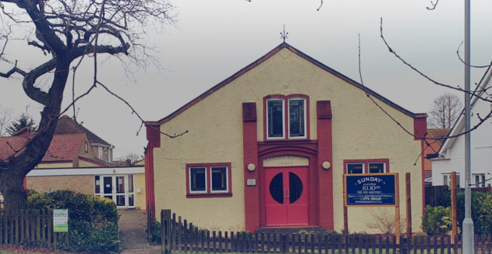
Prayer Focus: Laindon Baptist Church
Laindon Baptist Church was established as a village church, but now finds itself on the outskirts of Basildon. The church, which is currently in vacancy, is led by a team of volunteers. There are around 20 in attendance weekly, including 3 or 4 children. Services are led by church members, with occasional visiting preachers. On the first Sunday of the month, the fellowship enjoys a Bring-and-share lunch. A committed Pastoral Team keeps the fellowship connected, and the church makes good use of a Prayer Chain to encourage members to support one another prayerfully.

Slide 2
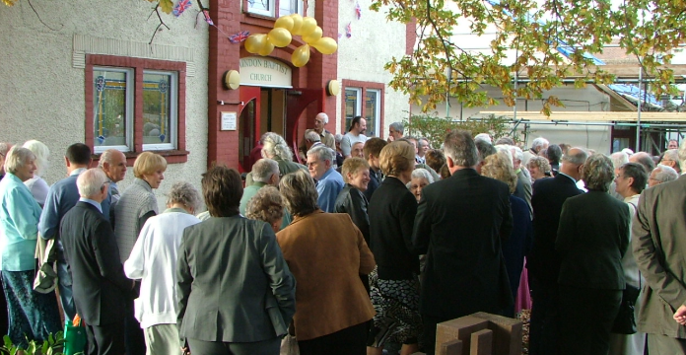
Prayer Focus: Laindon Baptist Church
The church is home to a thriving Girl’s Brigade, as well as a weekly youth meeting and runs two Bible study groups: one online and one face-to-face. Points for Prayer: • The appointment of a minister to encourage and disciple people so that they may realise their full potential in the church and in outreach. • An increase in younger families attending the church to continue and encourage the work that is already taking place. • Younger people to take up leadership/diaconate roles as the current elderly deacons become unable to continue.

