Slide 1
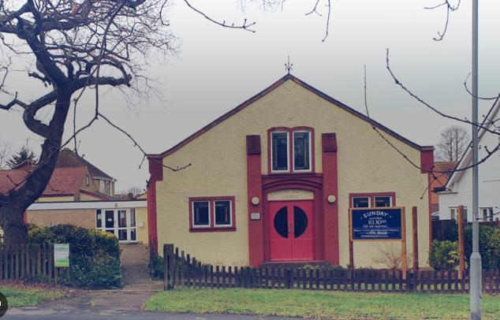
Laindon Baptist Church was established around 120 years ago as a village church, but now finds itself situated on the outskirts of the “new town” of Basildon in a large residential area in the south of Essex. The church, which is currently in vacancy, is being led by a committed team of volunteers, including Rene Baker, their Church Secretary. There are 23 members, with around 20 in attendance weekly, including three or four children. Services are led by a willing team of church members, with occasional visiting preachers. On the first Sunday of the month, the fellowship enjoys a Bring-and-share lunch. A committed Pastoral Team keeps the fellowship connected, and the church makes good use of a Prayer Chain to encourage members to support one another prayerfully.
Prayer Focus: Laindon Baptist Church

Slide 2
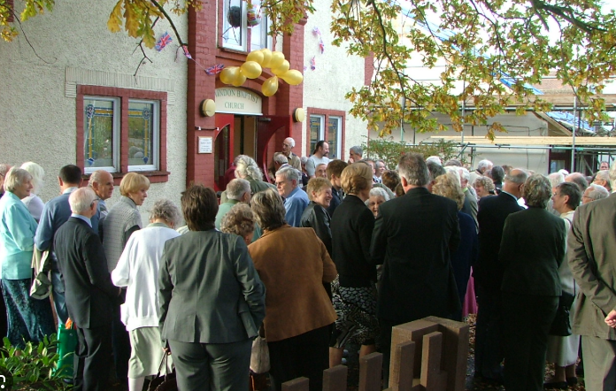
The church is home to a thriving Girl’s Brigade, which meets on a Monday evening, as well as CATCH – a weekly youth meeting for 8 - 15-year-olds and runs two Bible study groups: one online and one face-to-face. Points for Prayer • The appointment of a minister to encourage and disciple people so that they may realise their full potential in the church and in outreach. • An increase in younger families attending the church to continue and encourage the work that is already taking place. • Younger people to take up leadership/diaconate roles as the current elderly deacons become unable to continue.
Prayer Focus: Laindon Baptist Church

