Slide 1
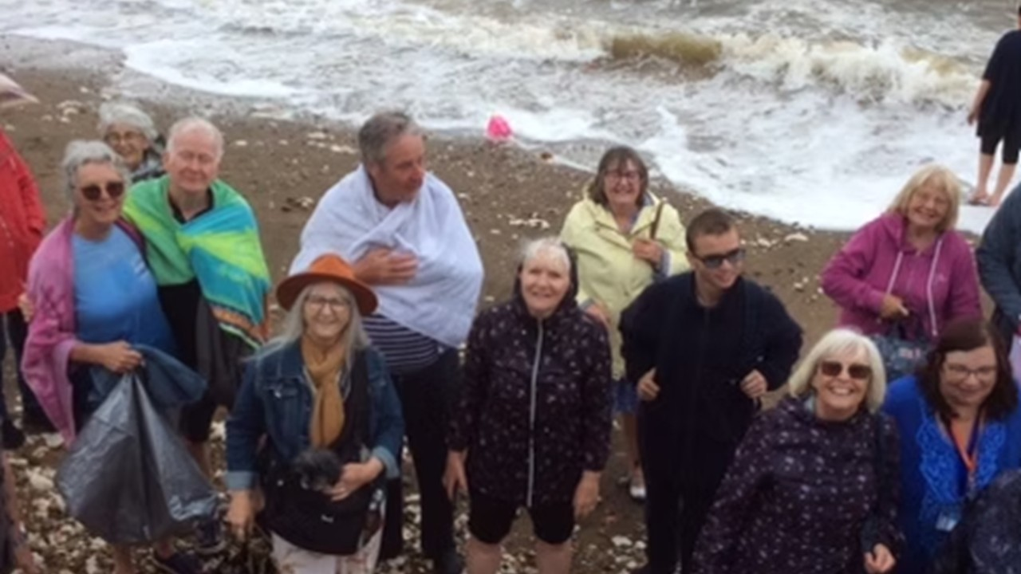
P
Prayer Focus: Union Church, Hunstanton, Norfolk
The Church is a union of Baptist and U.R.C and is being by led Revd. Chris Collict with some capable Deacons. Union has 24 active, mature members, with 40 people and some dogs in regular attendance. The Summer months bring in many Tourists. The church runs two Bible Study groups; one traditional, and one creative. The ladies meet for Afternoon Tea, while the men meet for breakfast. Part of the church’s ministry is joining up with the other local churches for celebrations and to bring “church” outdoors through Songs of Praise-style worship.

Slide 2
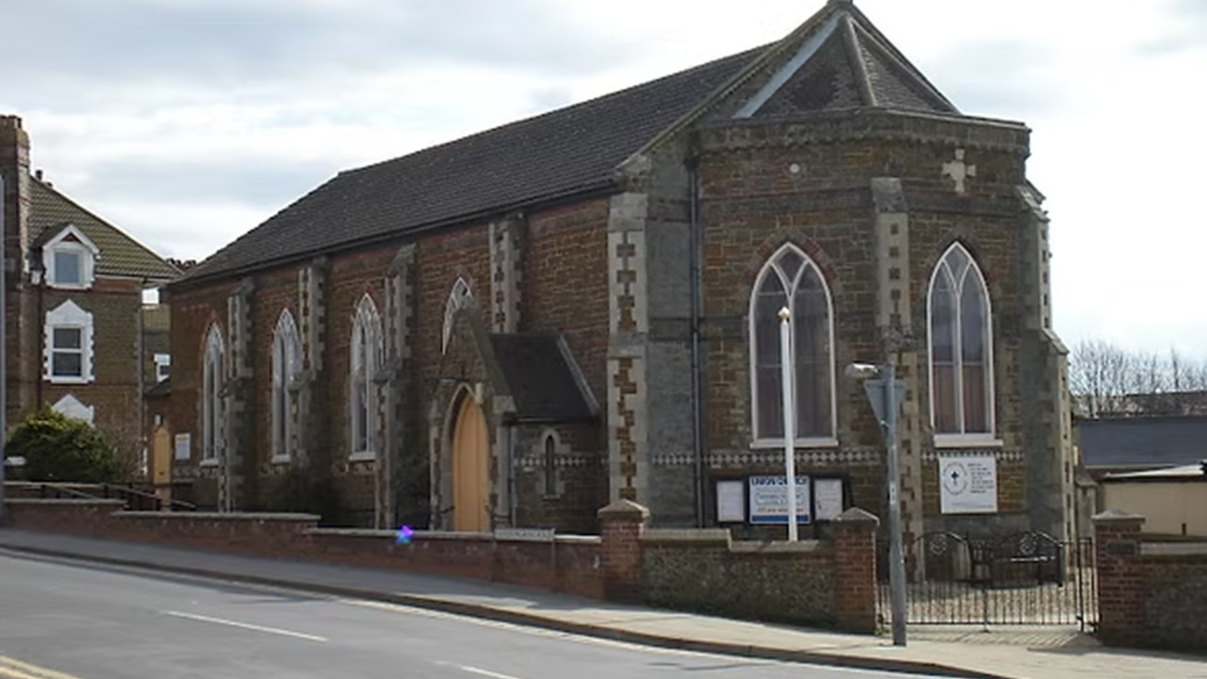
Baptisms have been held in the summer months on the beach as a public witness of how God transforms lives. The church hosts Guides, Brownies, and Rainbows, with Parade Services being held twice a year. Following a long period of pastoral vacancy, the church is keen to welcome new people (and their dogs) Please pray for: • Growth within the fellowship • That God will prompt members to consider leadership roles within the church. • For continuing links with the local United Reformed Church. • For Gods love to spread within the fellowship and spill out into the community.
P
Prayer Focus: Union Church

